Slide 1
Disaster to Recovery:
Reconstituting the Mackintosh Library Collections and its Catalogue
Duncan Chappell
Glasgow School of Art
@duncanchappell

Slide 2
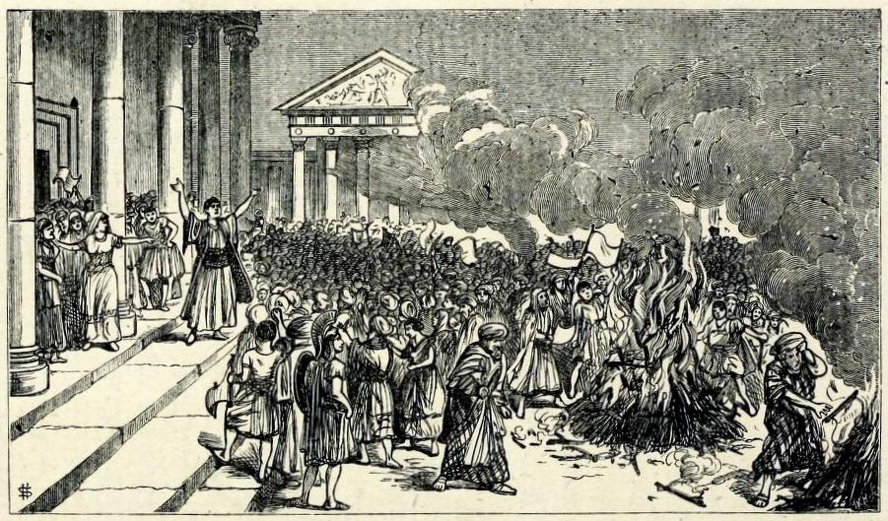
Notes:
In his 1880 treatise The Enemies of Books, the collector William Blades documents his outrage at the mistreatment suffered by books at the hands of biblioclasts, both human and non-human
His text enumerates and discusses threats to the survival of books, with dedicated chapters on water, gas and heat, dust and neglect, ignorance and bigotry, bookworms, other vermin, bookbinders, collectors, servants, and even children
His chapter on fire begins:
“There are many of the forces of Nature which tend to injure Books; but among them all not one has been half so destructive as Fire.”
He goes on: “It would be tedious to write out a bare list only of the numerous libraries and bibliographical treasures which, in one way or another, have been seized by the Fire-king as his own.”
This engraved illustration, taken from Blades’ text, depicts the destruction of books of magic at Ephesus

Slide 3
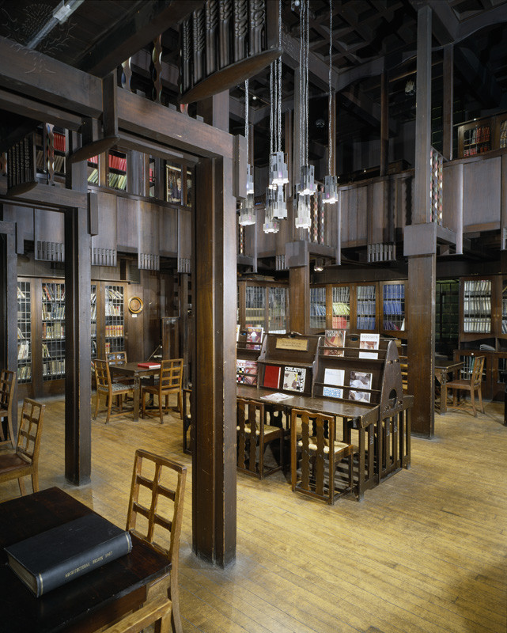
Notes:
On the 23rd of May 2014, the Fire-King struck the Glasgow School of Art, totally destroying its world-famous Mackintosh Library and the important historical collections in contained
The devastating fire was widely reported and discussed at the time, and continues to feature prominently as the School moves from a period of rescue and salvage to a period of rebirth and reconstruction
Indeed, many of you here will have seen the press coverage at the time
For those of you who never had the opportunity to visit the library in person, or who know of it only fleetingly, I will try to describe its significance

Slide 4
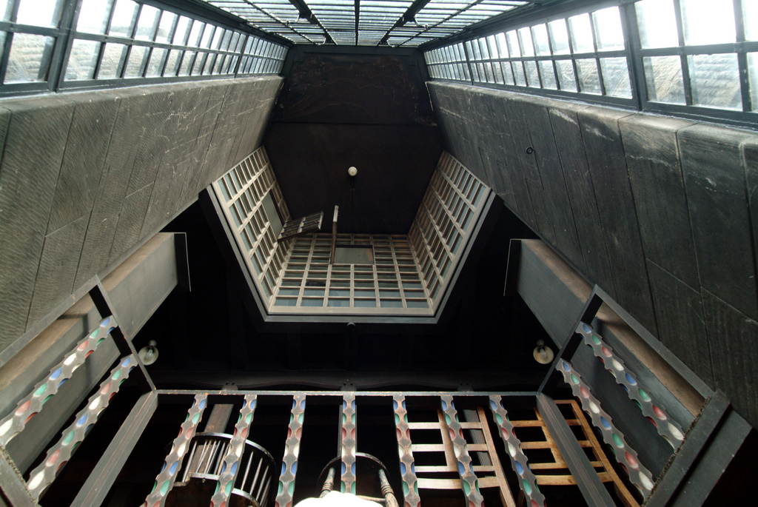
Notes:
The library was generally accepted as one of the finest Art Nouveau interiors internationally, and any visitor to the space could not help but be moved by its architectural and aesthetic beauty...
...from its hand-painted balusters...

Slide 5
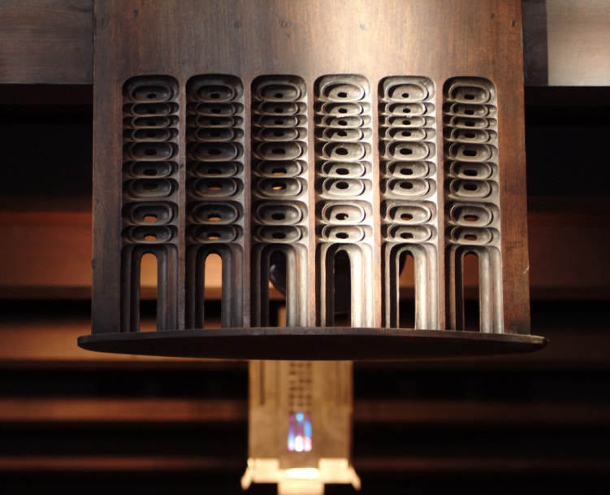
Notes:
...to its pierced wooden pendants...

Slide 6
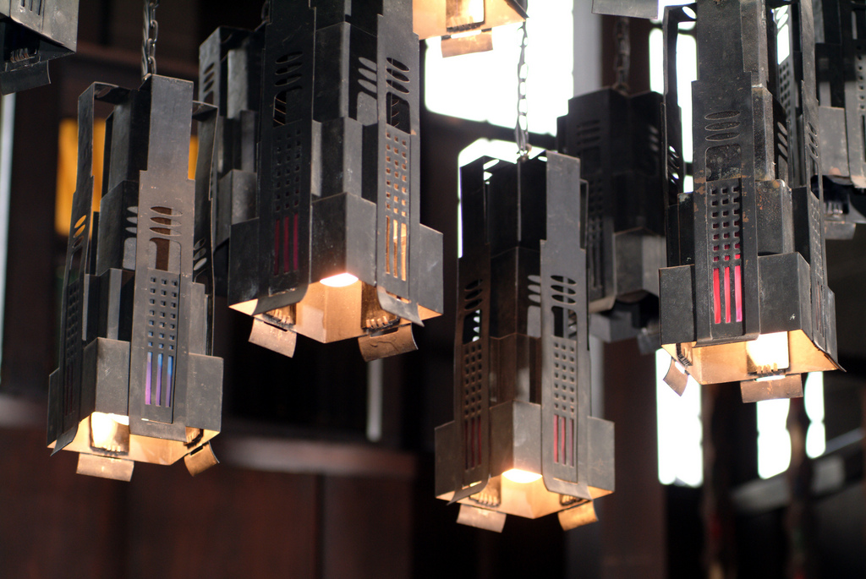
Notes:
...and from its coloured-glass hanging lamps...

Slide 7
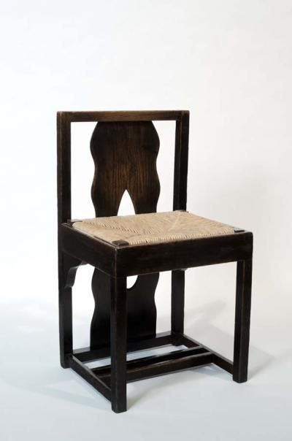
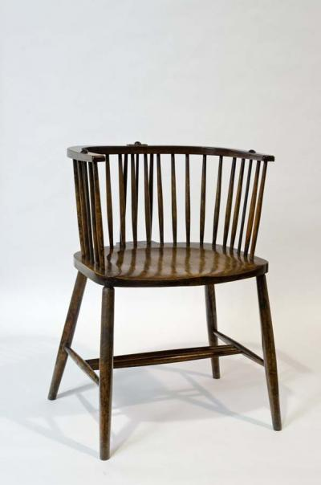
Notes:
...to its original tables and Windsor chairs...

Slide 8
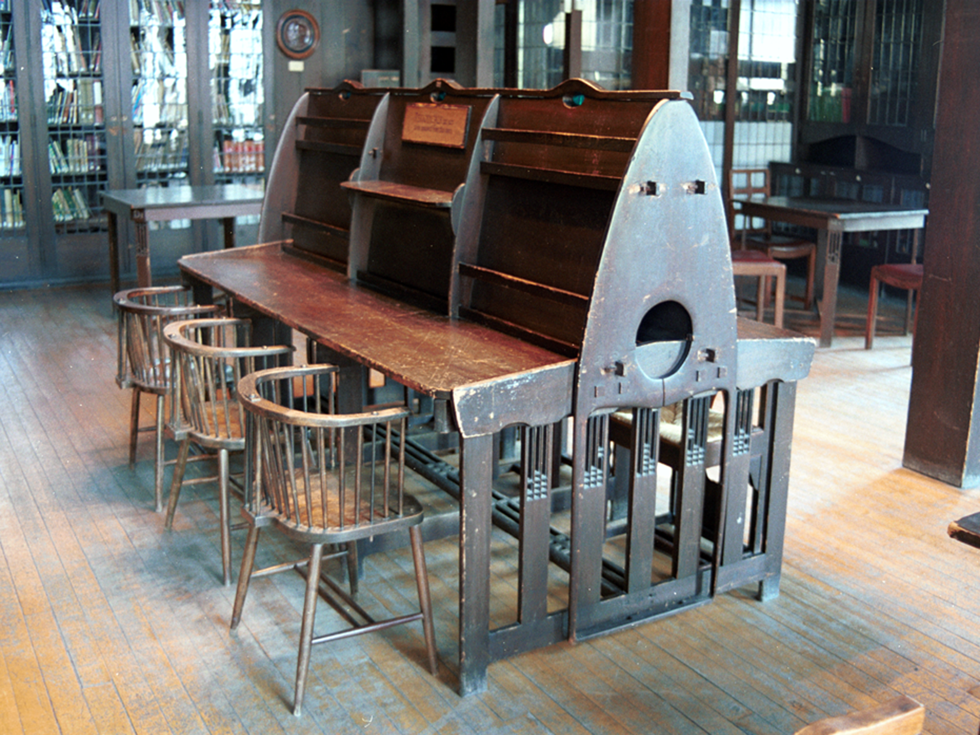
Notes:
...and periodicals desk, which formed such an arresting motif in the centre on the library

Slide 9
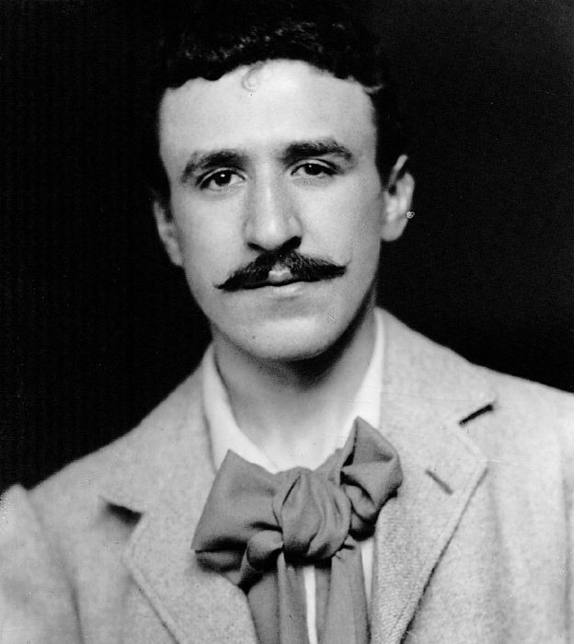
Notes:
The library was designed by architect and former student of the School Charles Rennie Mackintosh between 1907 and 1909, as part of the second phase of the building he had first designed for the School in 1896
And some of you may have seen the large Mackintosh exhibition currently on show at Kelvingrove Art Gallery in Glasgow in which Mackintosh’s scheme is explored in full

Slide 10
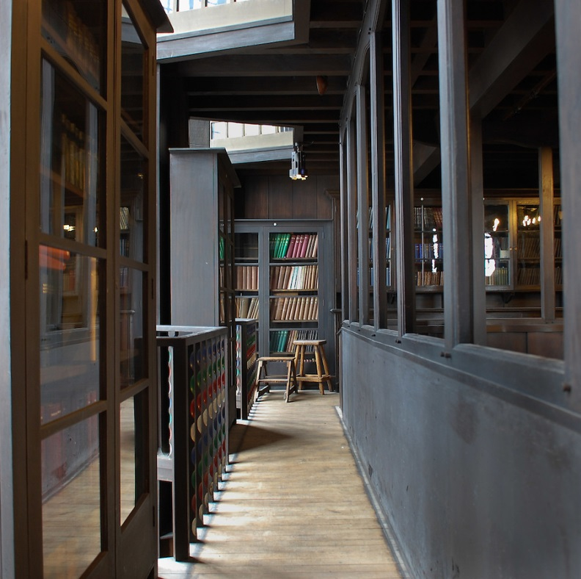
Notes:
Writing on the symbolic allusions of Mackintosh’s design, James Macaulay, in his authoritative 1993 Phaidon account of the building , states “…the library of the Glasgow School of Art is not only an aesthetic experience but the translation of philosophical thought into three dimensions.”
The building as a whole has been described by Sir Christopher Frayling, Rector of the Royal College of Art in London, as “the only art school in the world where the building is worthy of the subject...this is a work of art in which to make works of art”.

Slide 11
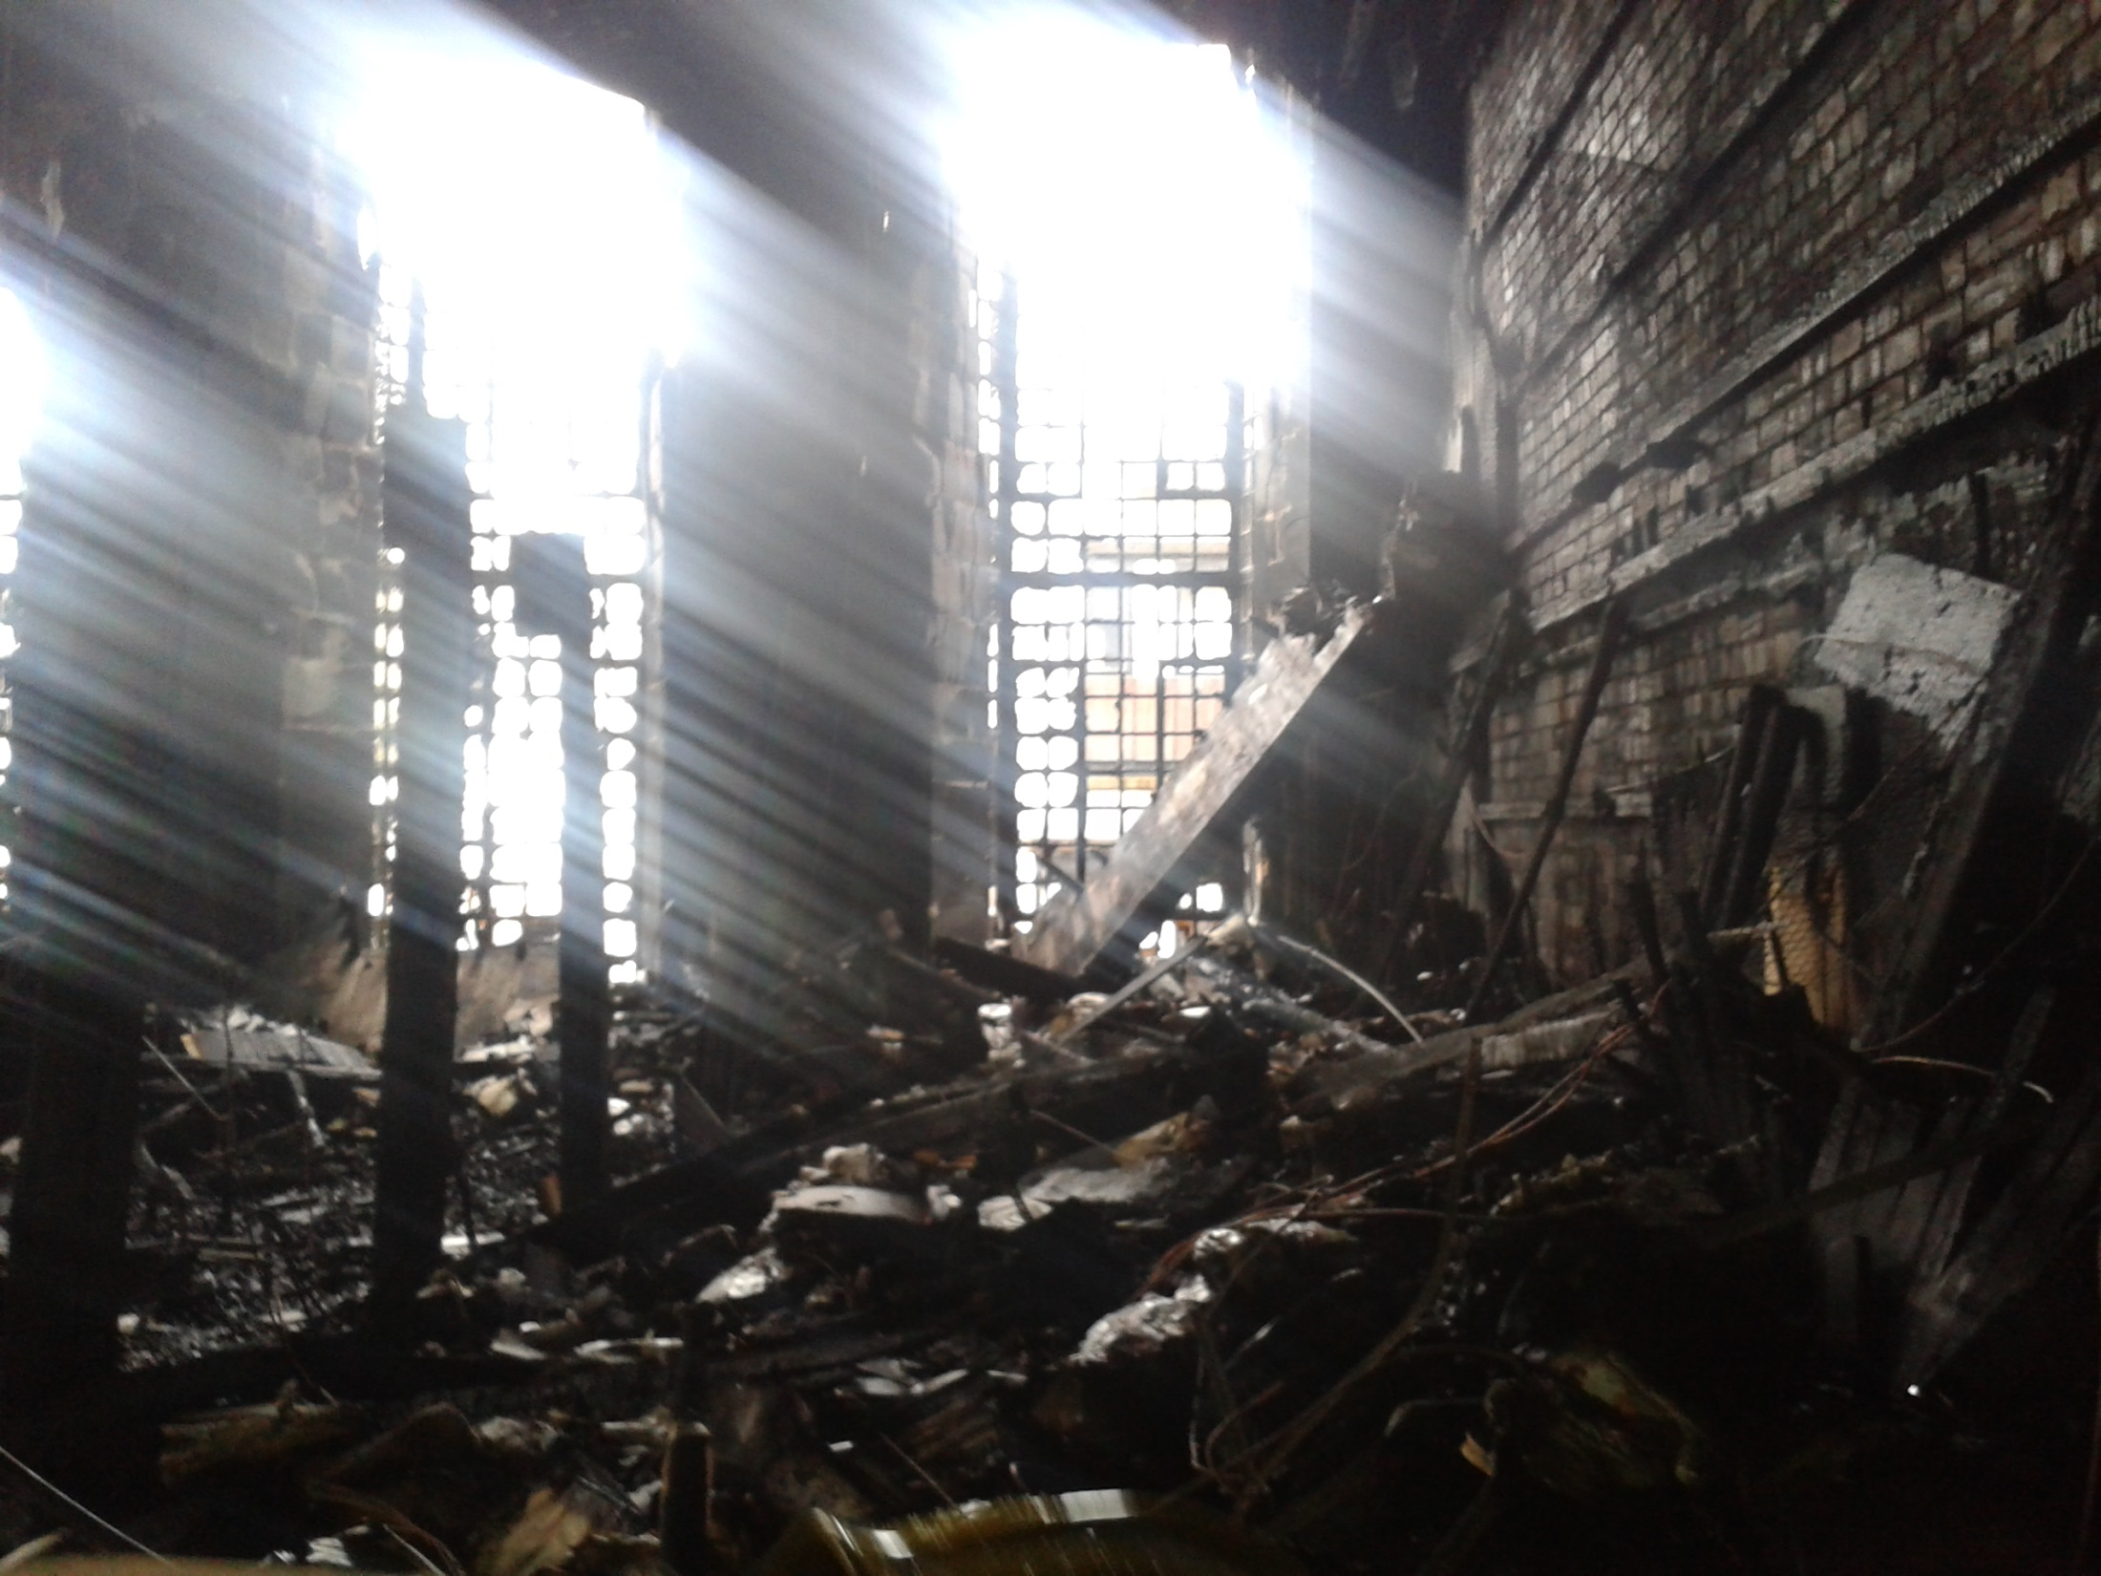
Notes:
Unhappily, On 23 May 2014 all these unique and beautiful spaces were totally destroyed by fire.
This photograph of the destroyed library was taken two days after that fire.
The resolution is low, but I hope it gives you a good indication of the extent of the devastation.
The remains of the columns leading to the mezzanine level of the library can be seen still standing on the left
To the right, the ferocity of the fire is evidenced by how the wood facing has been completely stripped back to bare brick

Slide 12
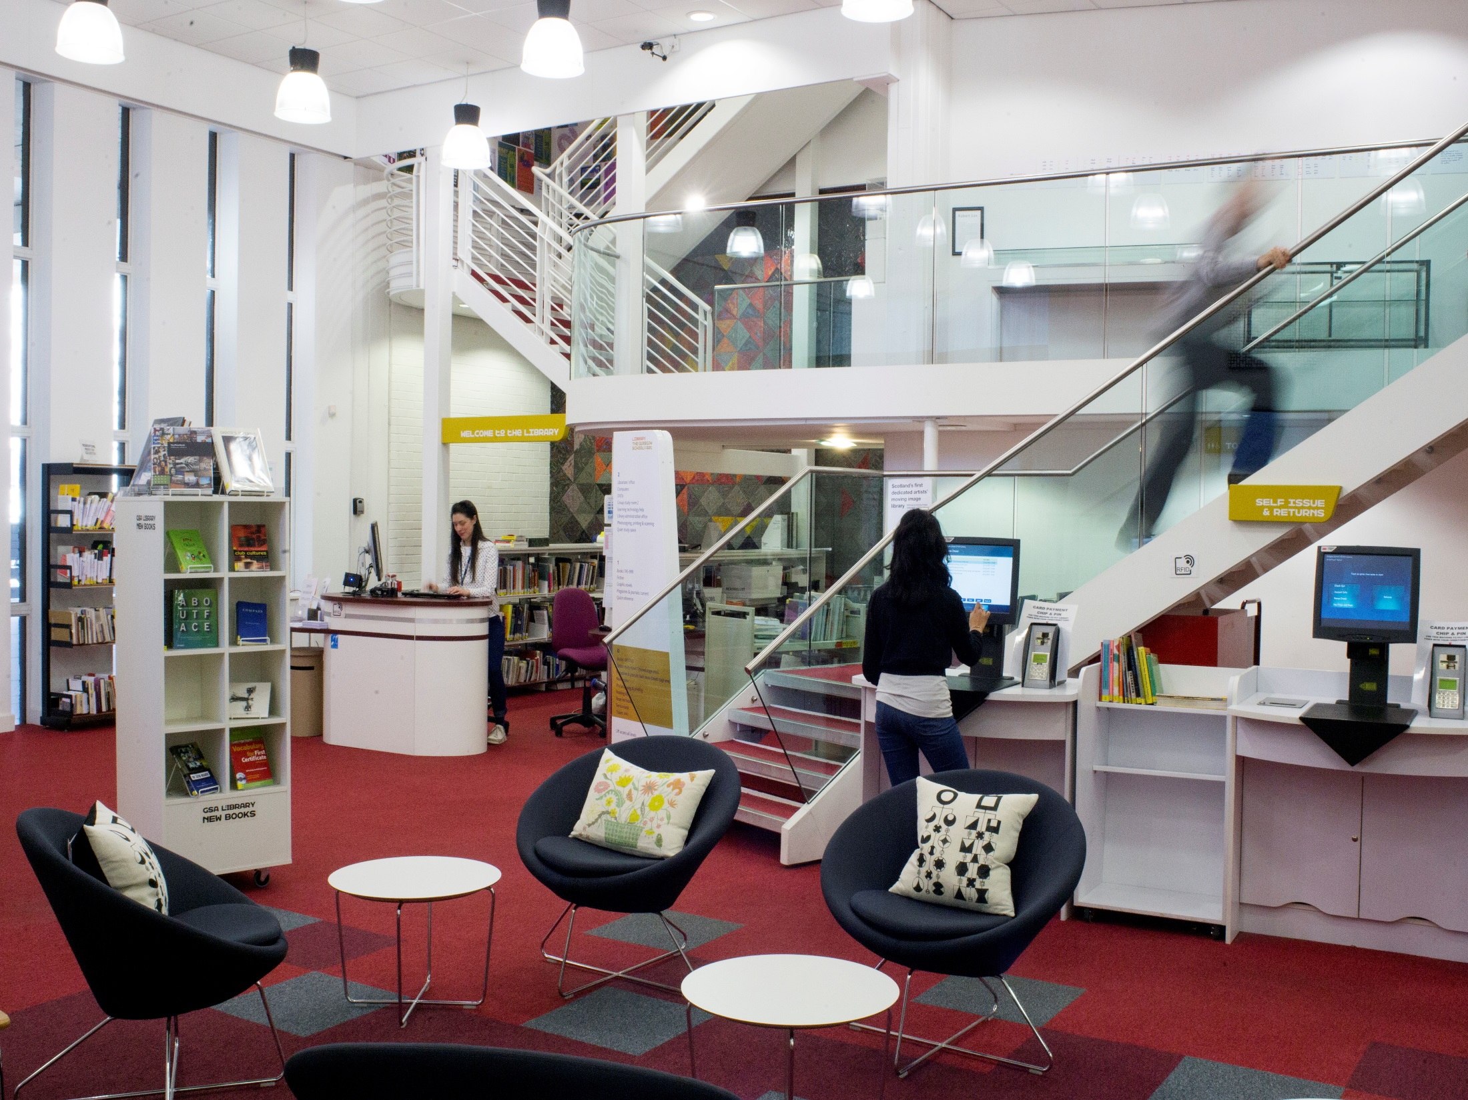
Notes:
I should probably clarify here that this loss was not complete
Our main library operates from a separate modern building across the street and was unaffected by the fire
This space houses the principal lending collections that our students use regularly as part of their programmes of study, with the older reference collections formerly held in the Mackintosh Library
The School as a whole was closed to students for a week in the immediate aftermath of the fire, but once this week had elapsed we were able to provide an essentially unchanged service to our students, with access to all the texts, facilities and services they require
It did inevitably mean that our more senior staff had to balance the sometimes conflicting demands of continuing to operate a library service whilst also leading on disaster recovery, with the considerable increase in workload that resulted

Slide 13
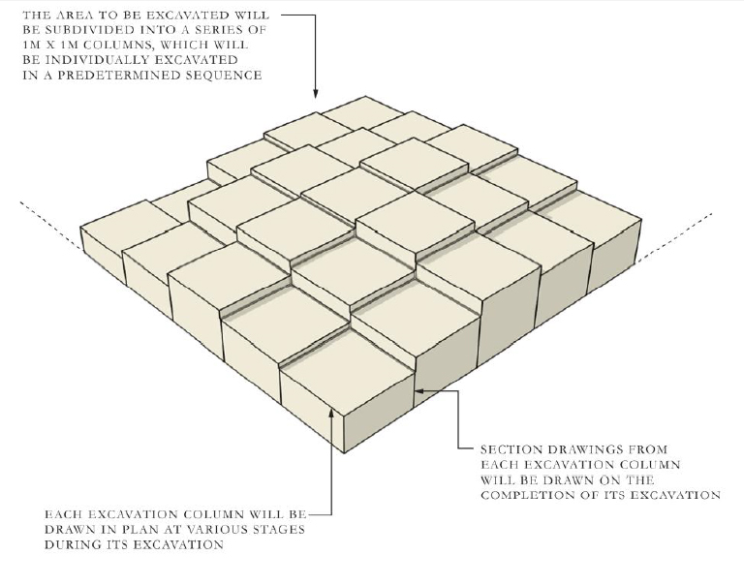
Notes:
Part of this increased workload included the operation to salvage what we could from the destroyed interior
Due to the art historical importance of the library, Historic Environment Scotland required a full archaeological investigation, and the School employed the services of Kirkdale Archaeology
They undertook a painstaking and systematic excavation based on 1m2 grids, excavating down in columns at 25cm increments
Each stratum was photographed and documented
Any salvaged artefacts were recorded following established methodologies, before removal for treatment or conservation

Slide 14
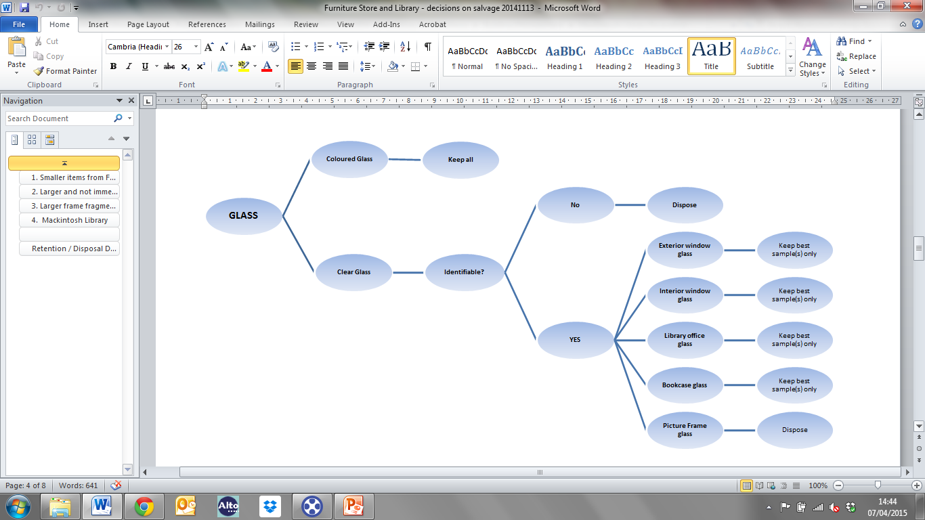
Notes:
Within the library, we formulated decision trees to help us decide which salvaged materials we should keep, and which we could dispose of.
Separate trees were developed for each media: paper and books, metalwork, glass, etc
These trees were reviewed and approved by colleagues in Museums and Galleries Scotland
Having these guidelines meant that our decisions were consistent across individuals, but also, importantly, transparent and accountable

Slide 15
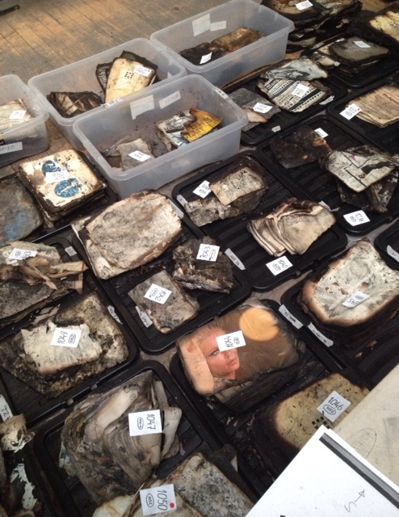
Notes:
Pre-fire, the library held around 10,000 volumes, and here you can see just a small percentage of those books awaiting disposal/retention assessment

Slide 16
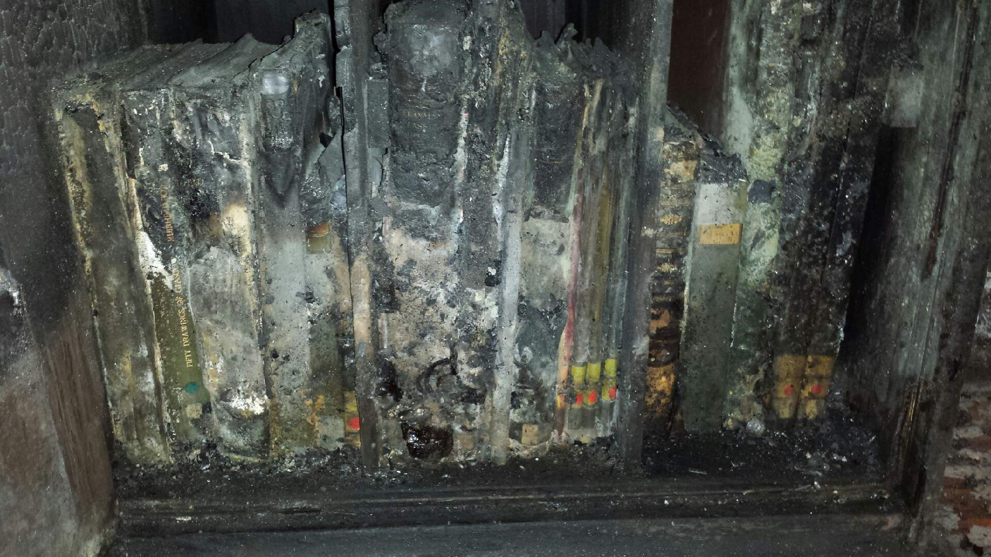
Notes:
Perhaps surprisingly some books survived better than others, depending on where they were situated, the amount of oxygen available to the fire, whether they were tightly or loosely packed on the shelves, and whether debris fell on top of them from above
In total, just 81 of the rarest books were salvaged and subsequently sent for deep freeze
Although the books themselves were sometimes difficult to identify immediately, our barcodes (which we use as distinguishing marks) were nearly always complete, which enabled us very quickly to put a title to each volume
In subsequent months we undertook a cost/benefit analysis for each volume, taking into account replacement costs on the open market, to decide which books to conserve and which to source anew

Slide 17
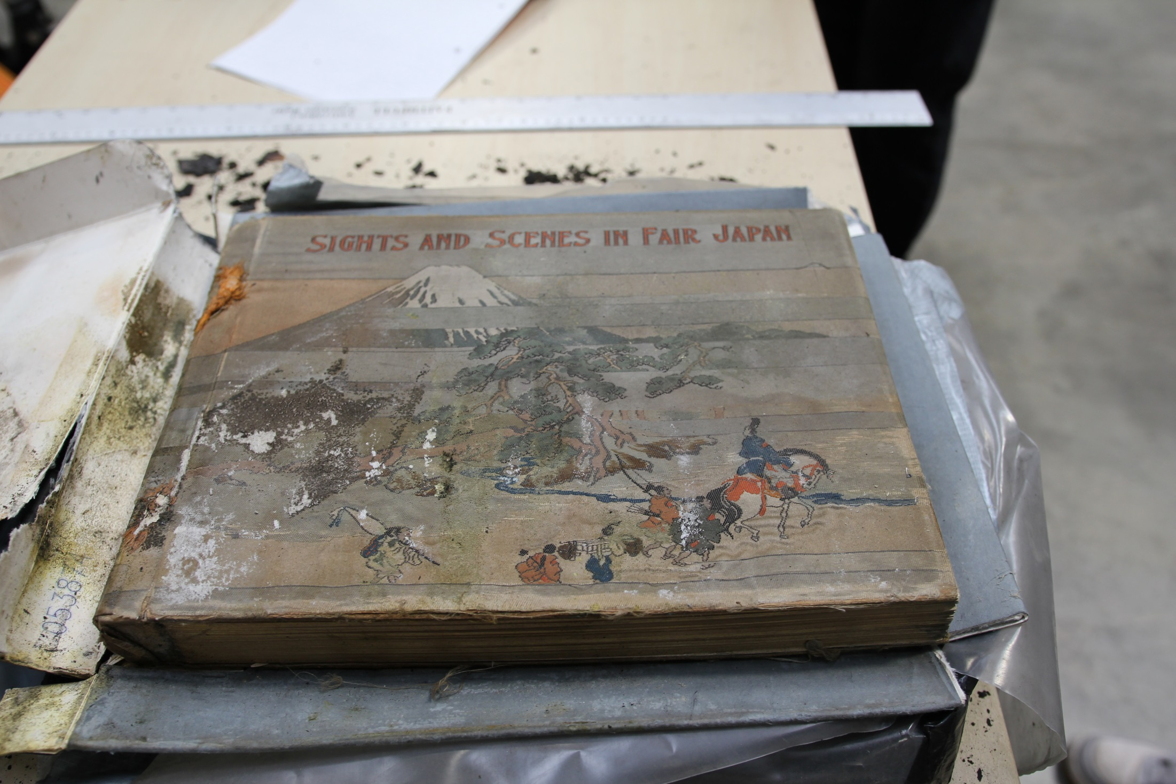
Notes:
We did have some miraculous survivors, such as this 19th century photographic volume of topographical views of Japan, complete in its original silk covers.
Our conservation approach has been to stabilise but retain evidence of the fire and its damage, viewing this as an important part of a volume’s history
This reflects the teaching and research methodologies of the School, in which emphasis is placed upon object analysis and materiality
Indeed, one of our PhD candidates has now chosen to base her thesis on the phenomenological qualities of these salvaged volumes and how they can act as a crucible for new artistic responses

Slide 18
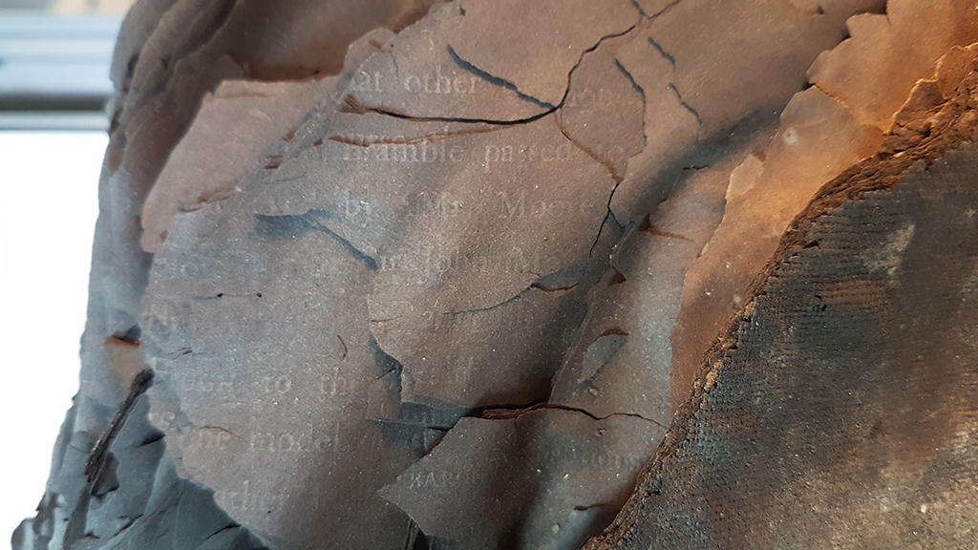
Notes:
This ‘Burnt Books’ collection will be just one of the discrete collections that returns to the restored library when it reopens in 2019

Slide 19
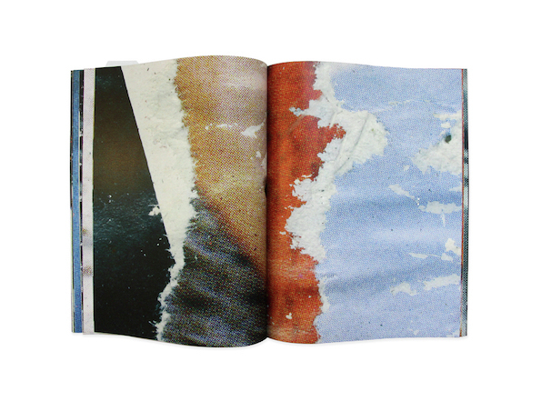
Notes:
Even those volumes that were viewed as impractical or uneconomic to conserve acted as artistic stimuli
The bookwork 51170 by Erin Scott and Kate Loudon references the original library accession number of a volume that was damaged by the fire and subsequently disposed of.
Its images are collected from a men's fashion magazine published in the 1970's, that was stored on the library's mezzanine. The pages had suffered from both fire and water damage.

Slide 20
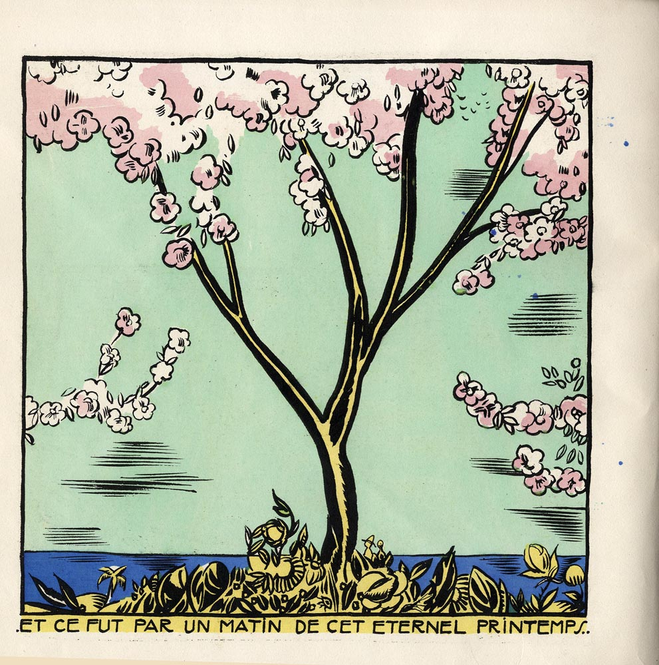
Notes:
Almost immediately after the fire, it became clear that the GSA Executive and all our partners were committed to restoring the Mackintosh Building and its library in full
And so it also became clear that as a library service we needed to plan and strategise the collections that would eventually return to this restored space
We received significant offers of donations and, keen to capitalise on this good will, we recognised that it provided an opportunity for us to begin to rebuild our lost collections very quickly
We were also aware however that we had lost a significant proportion of our storage space, and that any collections rebuild therefore needed to be highly focused
We therefore decided to pursue a targeted rebuild, tightly aligned to both the illustrious history and future direction of the Glasgow School of Art.
We did of course receive many offers of books, or even whole libraries, that we were just unable to accept, and we were required to employ tact and diplomacy in rejecting these offers
We found it imperative to understand where our strategic objectives lay, both as an institution and a department, though strategizing in such a fast-moving and often traumatic environment was not always easy

Slide 21
https://lib.gsa.ac.uk/special-collections/help-rebuild-our-collections/
Notes:
Once we were clear in only seeking very specific titles that hold particular relevance to our history, our alumni, and our learning, teaching and research activities...
We published a wants list of about 700 titles on our website, and publicised this list widely to academic mailing lists, library communities, and other institutions
We could then refer potential donors to this list and solicit only those donations that were key to us
To date, this approach has proved very successful, and we were able to replace 22% of our priority volumes in the first 3 months after the fire
Many of your own institutions will have gifted volumes to us, and I’d like to take this opportunity today to thank you all for the kindness you have shown towards us
We are still seeking volumes for our collection, and if any of you have titles on our Wants List that you can spare, they would of course be very gratefully received

Slide 22
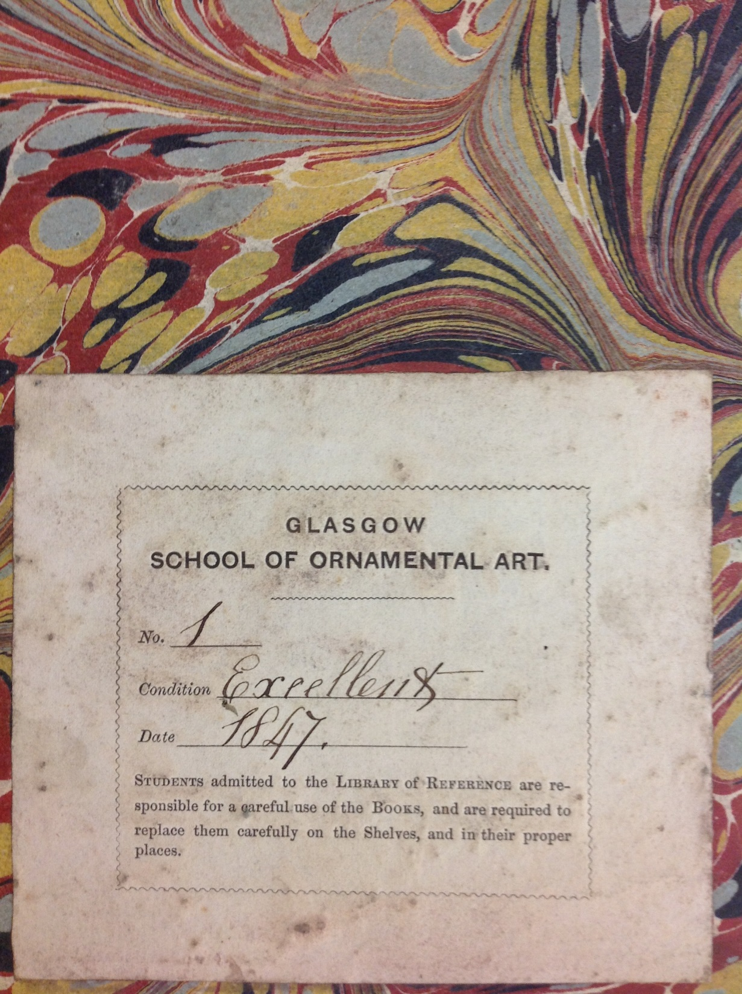
Notes:
Key to our ability to strategise and compile our Wants List was that our library catalogue was complete – we had excellent computer-readable records for every single item we held
Our task would have been infinitely more difficult had we not possessed the ability to interrogate our catalogue so completely and had we not had such in-depth knowledge of our collection as a totality
Within just a few days of the fire we had a complete list of every single item that was lost from the library
Through happenstance, just prior to the fire we had also completed a project to digitally recreate through our catalogue the library’s Foundation Collections, using our very first manuscript catalogue, still held in our Archives
This meant that we had an excellent and comprehensive knowledge of the volumes that would have originally populated the library when it first opened in 1909
This has proved a useful counterpart to the architectural ethos of the restoration project as whole, which is based upon returning the building to its authentic 1909 state as far as possible

Slide 23
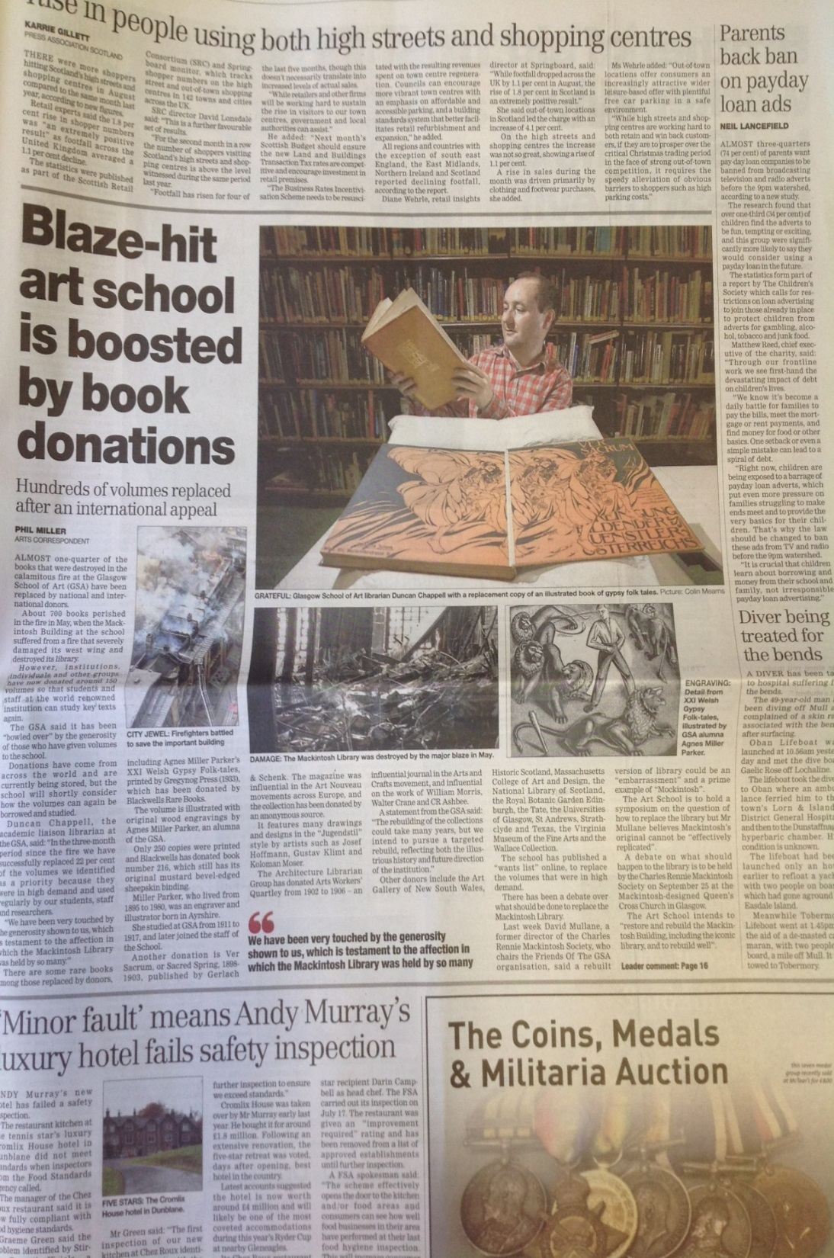
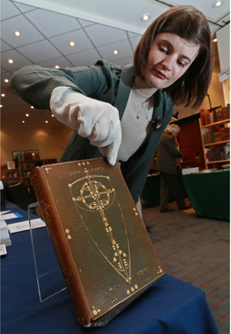
Notes:
We have worked closely with our colleagues in the Press Office, to publicise our collections-rebuild campaign and to mark successful milestones
This article on the left appeared in The Herald in September 2014 to celebrate our receiving 22% of our priority volumes in just 3 months
We’ve also enjoyed coverage in The Times BBC News, Telegraph, Design Week, and The Guardian
To the right is my then colleague Jennifer accepting a donation of a rare Glasgow Style binding by former GSA Head of Embroidery Ann Macbeth, kindly purchased on our behalf by the Antiquarian Booksellers’ Association
This volume is currently on show at Kelvingrove Art Gallery in Glasgow as part of the current Mackintosh exhibition
All this, I hasten to add, was achieved at zero cost to the institution, and demonstrates I think what can be achieved through collaboration, outreach and sector engagement.

Slide 24

Notes:
The collections that are to move into the restored Mackintosh Library in 2019 are currently being catalogued using DCRM(B), slightly adapted for in-house use
Those of you that have catalogued using DCRM(B) in the past will know that these rules can place as much emphasis on the design qualities of a book as on its informational content
So we are employing fields that describe a book’s binding, or other design aspects, for example
Working with our students and academics in the past, we have found that they are interested as much in the materiality of our books as in the information they contain
And this is perhaps not surprising for an art school
So our approach to cataloguing these collections has been a little different perhaps to an institution dealing in purely historical or social scientific research for example

Slide 25
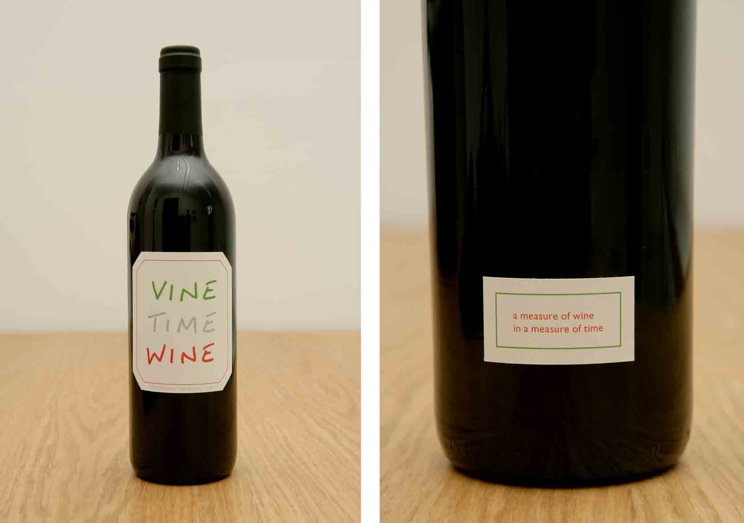
Notes:
The need for such a cataloguing approach is perhaps illustrated most vividly by our Artists’ Books Collection, which is by far one of our most popular and well-used collections
Artists’ books are most often defined as ‘books produced by an artist through reprographic means for mass distribution’
They are books that are conceived and designed by artists, rather than books written on or about artists
Hence, they exist as art in their own right, rather than documenting pre-existing art
For some theorists and commentators, something can be defined as an artist’s book regardless of its form, as long as it explores or evokes in some way the experiential qualities of the book
This work, entitled Vine Time Wine dates to 2011 and is by artist and GSA academic David Bellingham
When cataloguing such an item, we take pains to describe its materiality as far as possible, despite the evident limitations of a text-based MARC catalogue
The Artists’ Books Collection will relocate to a new dedicated reading room currently being constructed in the old bookstore directly above the main library

Slide 26
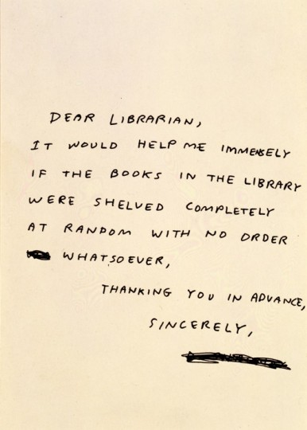
Notes:
Another concern for us when planning the cataloguing and arrangement of these collections was the evident difficulty our users have in navigating traditional library classification systems
This is illustrated in typically humorous form by this artwork by GSA alumni and Turner Prize nominee David Shrigley
The problem has been apparent to us for a number of years, and though it would be impractical for us to un-classify our large lending collection for example, we were keen to explore other options for the Mackintosh Library
The space will therefore be arranged into broad thematically-badged collections, with simple A-Z arrangement within those instead of class numbers
These collections include ‘Arts Pedagogy’, ‘Pattern & Ornament’, ‘Modernist Architecture and Design’ and several others

Slide 27
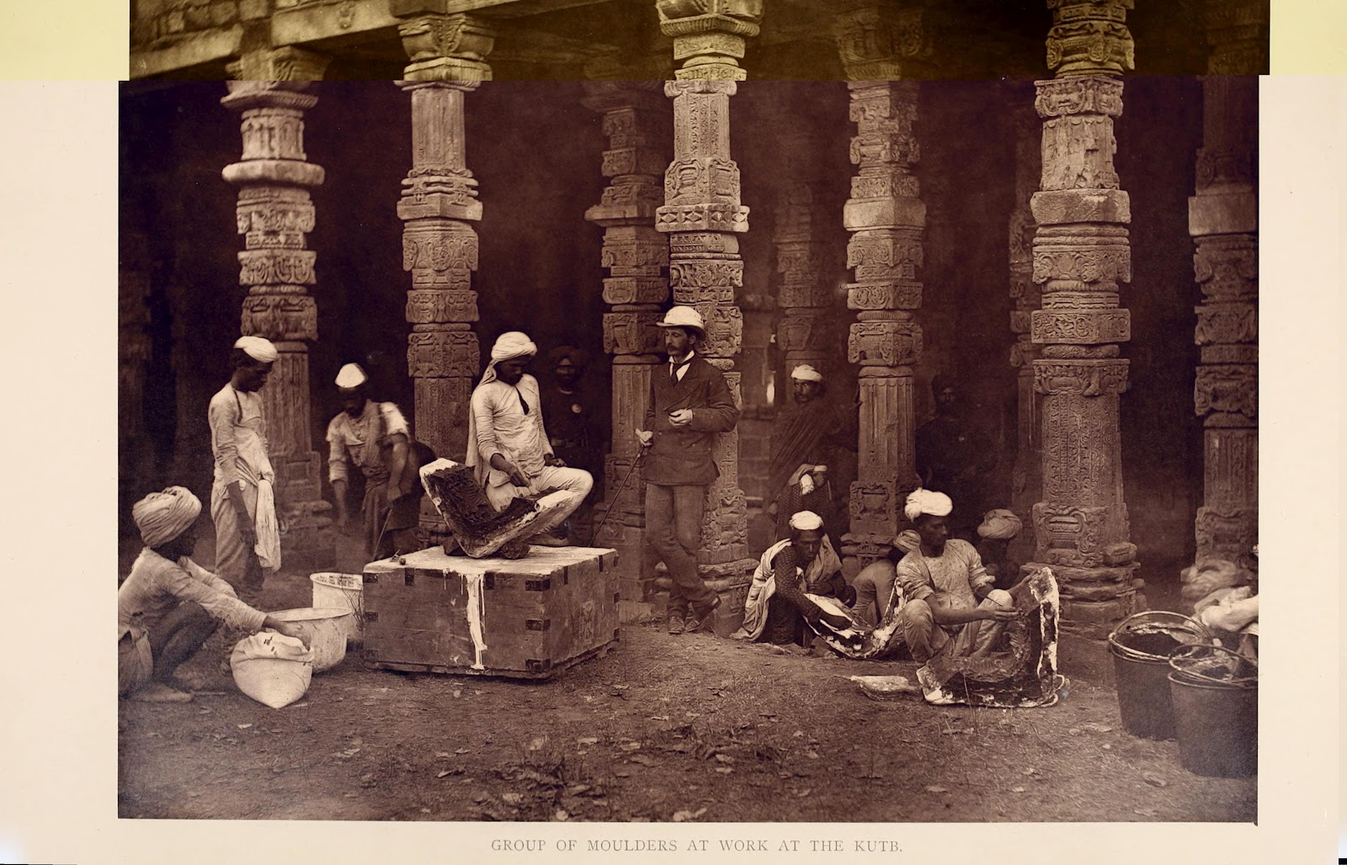
Notes:
Some of these thematic groupings will reflect the curricula of 1909, the year the library first opened, but many look towards the debates and concerns that we know are foremost in student minds today
Of late there has been much discussion institutionally on how we can widen our curriculum away from a purely Western-centric white canon for example
So one of the new collections will showcase World Cultures, and has the potential to be integrated into the new teaching that springs from these discussions
We are also exploring the integration of authentic and contextual voice into our catalogue records
So that when presented with a 19th century volume whose colonial paradigm is perhaps problematic for modern audiences, we seek to engage with student bodies such as our People of Colour group to incorporate their responses to the book in our catalogue record or shelf labels.

Slide 28
https://lib.gsa.ac.uk/special-collections
Notes:
You can read full descriptions of all the thematic collections that will occupy the restored library at this link here

Slide 29
Notes:
To return to the restoration of the space itself and our plans for its future use…
It is fair to say that immediately after the fire there was wide public debate about the future of the Mackintosh building and its spaces
What is clear though is that the School committed very early on to restoring the space to Mackintosh’s design as a working library
The restoration debates have concerned the ethics of restoration, the relationship between the original and the replica, and the avoidance of a ‘Mockintosh’ aesthetic
These debates have proved lively and stimulating and will no doubt continue for many years
The restoration ethos that has been settled upon is to return the building as much as possible to how Mackintosh’s design would have appeared in 1909, without the modifications and over-paintings that had occurred across a century
This postcard view of the library by an unknown photographer dates to soon after completion in 1909, and is taken from the School’s Archives

Slide 30
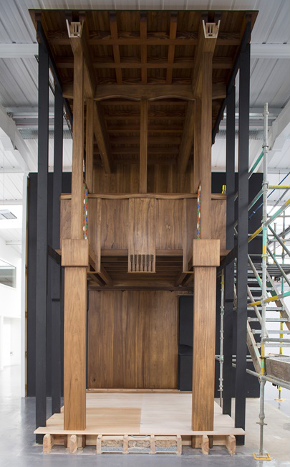
Notes:
Recently a life-size mock-up of one of the six library bays was unveiled by our woodworkers Laurence McIntosh of Edinburgh
If you visited the library before the fire, and visit again when it reopens in 2019, you will perhaps notice many differences
The wood will be lighter, there will be significantly fewer bookcases…
But you will be encountering a space that is significantly more authentic to Mackintosh’s original design intentions

Slide 31
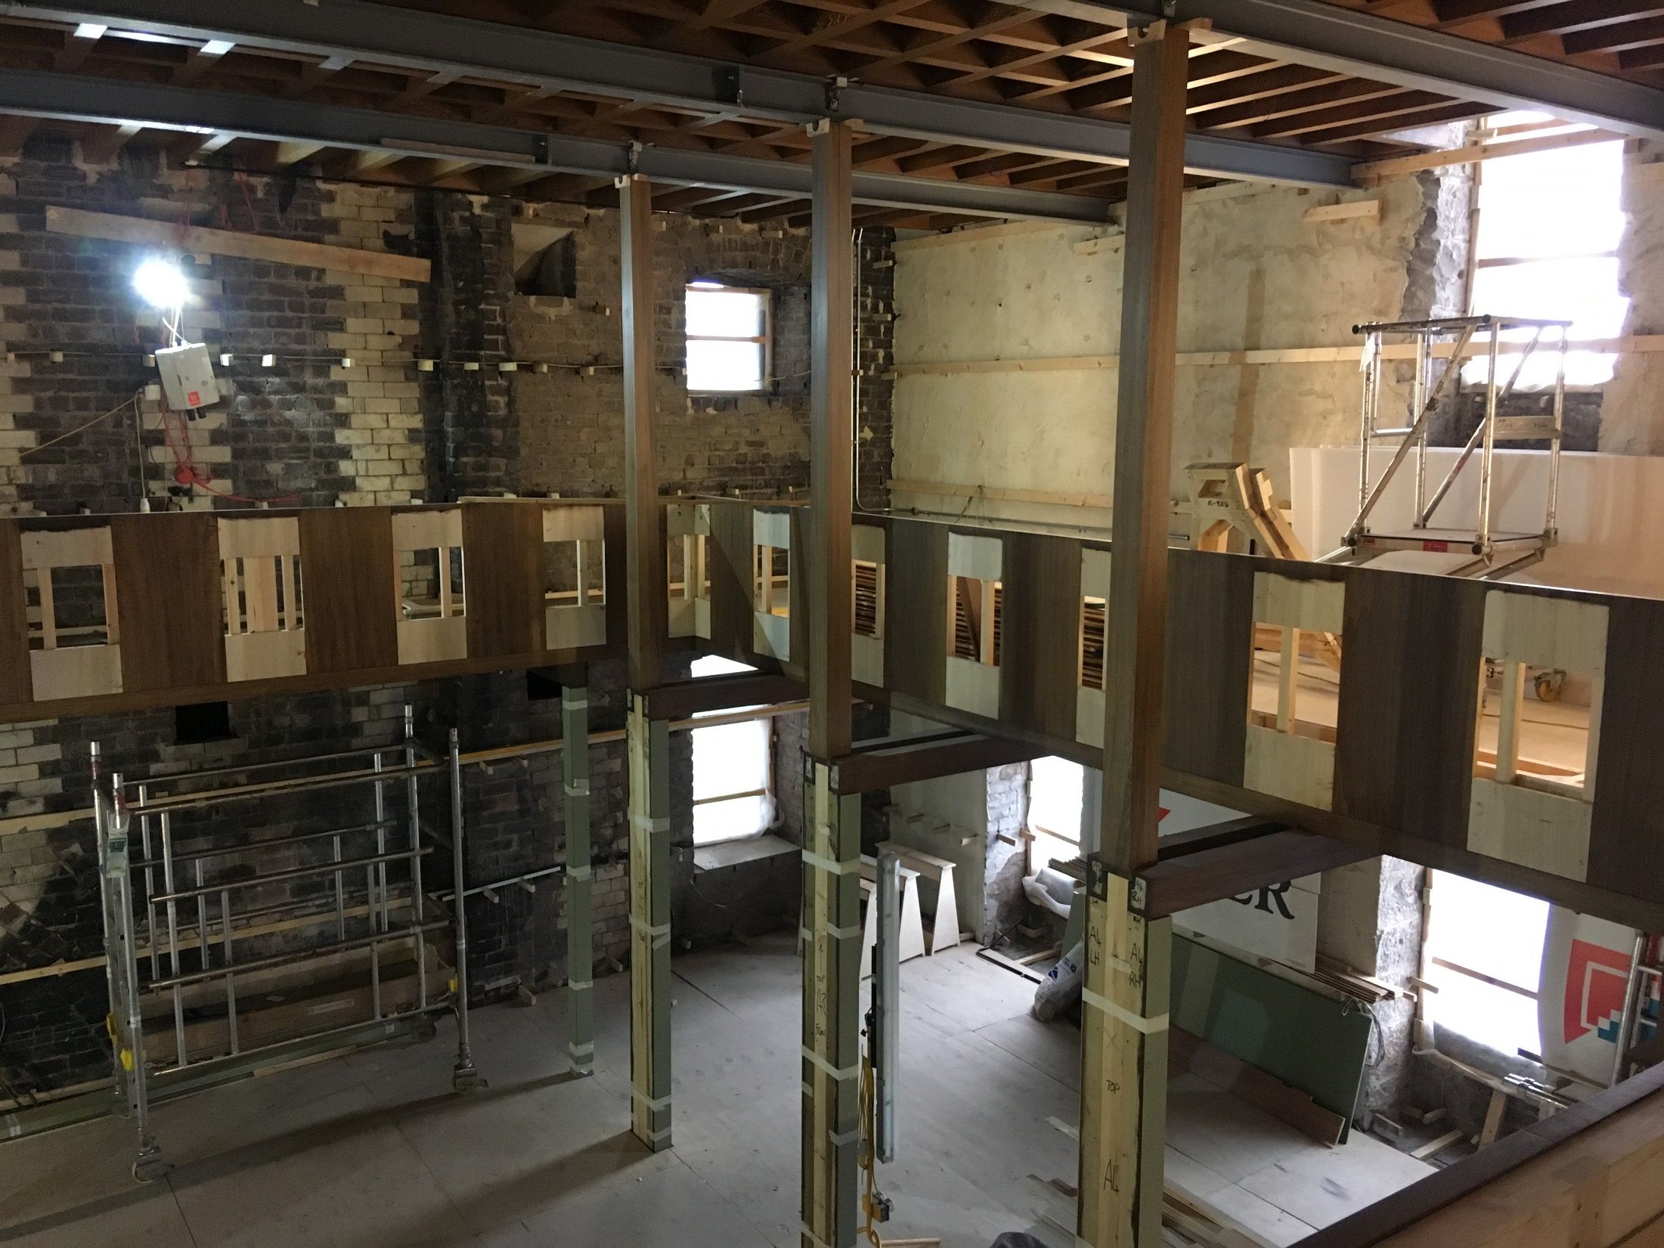
Notes:
Here you see the current stage of reconstruction from a fortnight or so ago
For the first time, all of the library’s special and rare collections will be relocated to this single space, where they will be significantly more visible and accessible to students and researchers both internal and external

Slide 32
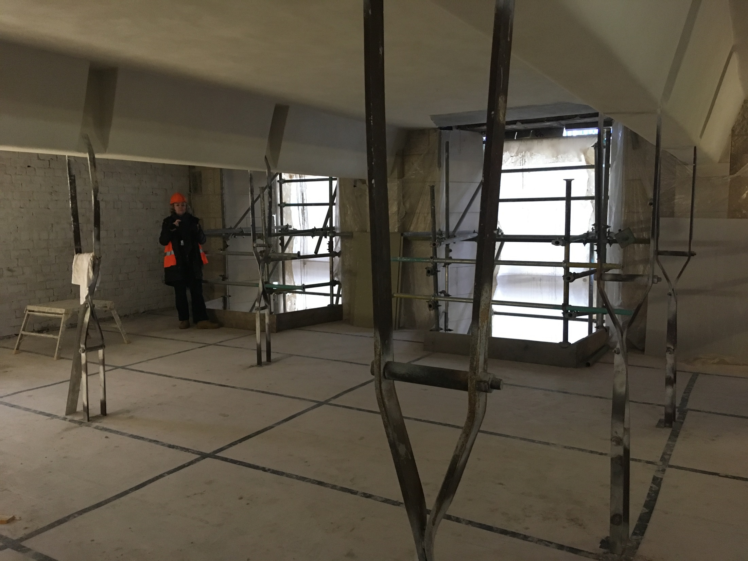
Notes:
The former bookstore above the library will become a dedicated modern reading room, where students can request and view items from collections as diverse as artists’ books, 19th century design folios, and illustrated books
This space will also provide us with the opportunity to run workshops and public events, stage open-days, and install displays

Slide 33
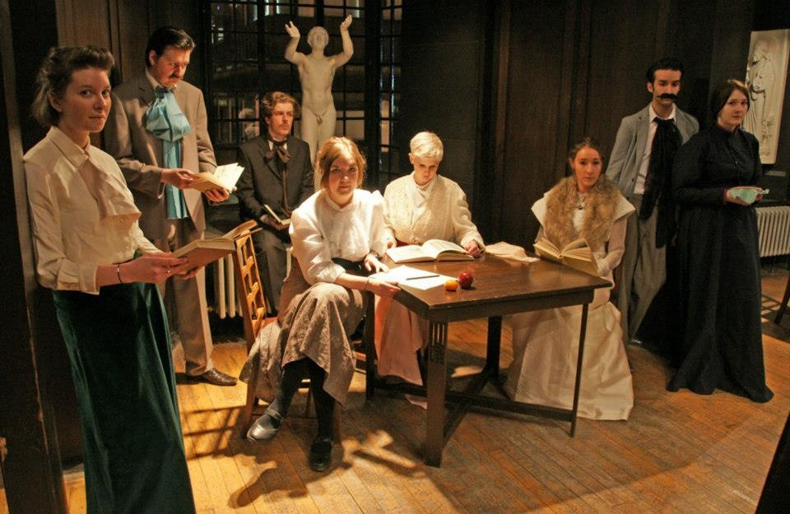
Notes:
Central to the vision for the new library is that is acts as an incubator for new creative practice through exposure to exquisite and unusual collections
Here you see some of our students within the Mackintosh Library about a year before the fire, in early 20th century dress they had designed and made themselves
So we look forward to welcoming you all to experience our amazing spaces and collections for yourself when we reopen to the world in late 2019

Slide 34
Duncan Chappell
Glasgow School of Art
d.chappell@gsa.ac.uk
@duncanchappell

