Slide 1
... For you
(site-specific installation: printed texts, lecterns and a round table)
Susan Brind and Jim Harold
Part of Bitter Rose … Project, at Woodside Library for Glasgow International, 2016

Slide 2
… For you
Susan Brind & Jim Harold
Part of Bitter Rose …
Glasgow International 2016
Over a number of years, artists Susan Brind and Jim Harold have been collaborating on an artwork that takes the form of a series of letters that reference events witnessed since the turn of the 20th Century. They are written by an anonymous ‘I’, from different years and various locations, to an anonymous ‘You’, a beloved whose location is unknown. These letters reveal a tender relation reaching across continents.
In this iteration of the work, the texts operate within the space of a site-specific installation designed for Woodlands Library that responds both to the architecture of this Carnegie Library, and to the focus of the Bitter Rose … project. A reading of a selection of the texts, performed by the artists, formed an event to accompany the exhibition (14 April 2016, 2-5 pm).

Slide 3
Bitter Rose …
Was an Invisible Knowledges Project (Glasgow Refugee Asylum and Migration Network & Centre For Contemporary Art, Glasgow).
It was a curated project for Glasgow International Art Festival 8-25 April 2016 devised by Tawona Sithole and Birthe Jorgensen with special guests / hosts: Gameli Tordzro & family / The Project Cafe, Sogol Mabadi / CCA, Alison Phipps / Woodlands Community Garden, Susan Brind & Jim Harold / Woodside Library, Life Mosaic / Gal Gael, Mara Menzies / Milk Cafe, Jasper Coppes & Open Jar Collective / Govanhill Baths, Bisan Abu Eisheh / Glad Cafe, Bitter Rose / Walk to Easterhouse and Cecilia Naa Densua Tordzro / Platform.
Sithole & Jorgensen write:
“In French surrealist, writer and poet, René Daumal’s (1908-44) unfinished novel, Mount Analogue, Arthur Beaver recites the mythical tale of The Hollow-men and The Bitter-Rose to fellow voyagers on the yacht Impossible. According to the storey the Bitter-Rose is a magical plant that grows only on the most inaccessible peaks. If eaten, should one be about to tell a lie, one’s tongue will start burning. No one has ever been known, to eat a Bitter-Rose, and few people have ever claimed to have seen it. Legend has it that on sensing the tremors of human fear, the illusive rose will retreat into the rock.”

Slide 4
‘In certain of its aspects, the letter appears as the prolongation (by means of writing) of the literary conversation, scholarly discussions and chitchat that took place in [...] literary salons.’
Touati, Houari, Islam and Travel in the Middle Ages, Chicago: University of Chicago Press, 2010, 233.
‘Saying “I” appears [...] as a means for “motivating” the narrative act. It refers [the subject written about] to a personalized instant, [it acts as a] guarantee of what [the author] is saying, on the one hand, and to give voice (through narrative) to his subjectivity, on the other.’
Touati, Houari, Islam and Travel in the Middle Ages, Chicago: University of Chicago Press, 2010, 239.

Slide 5
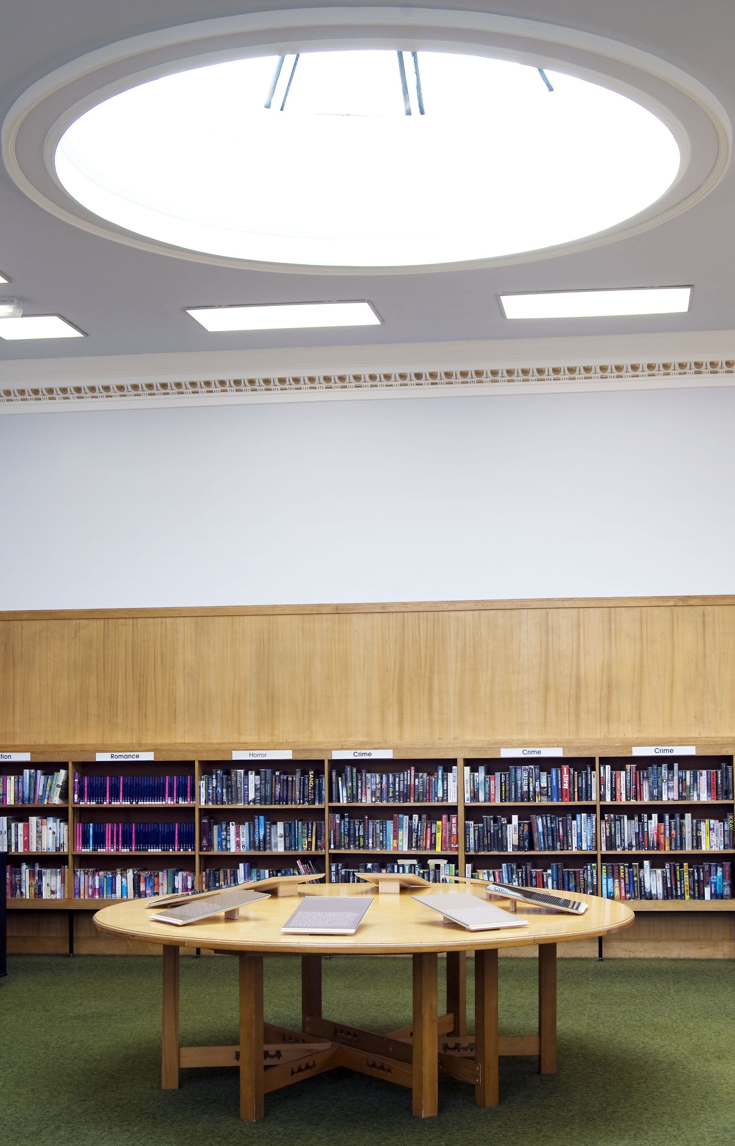

Slide 6
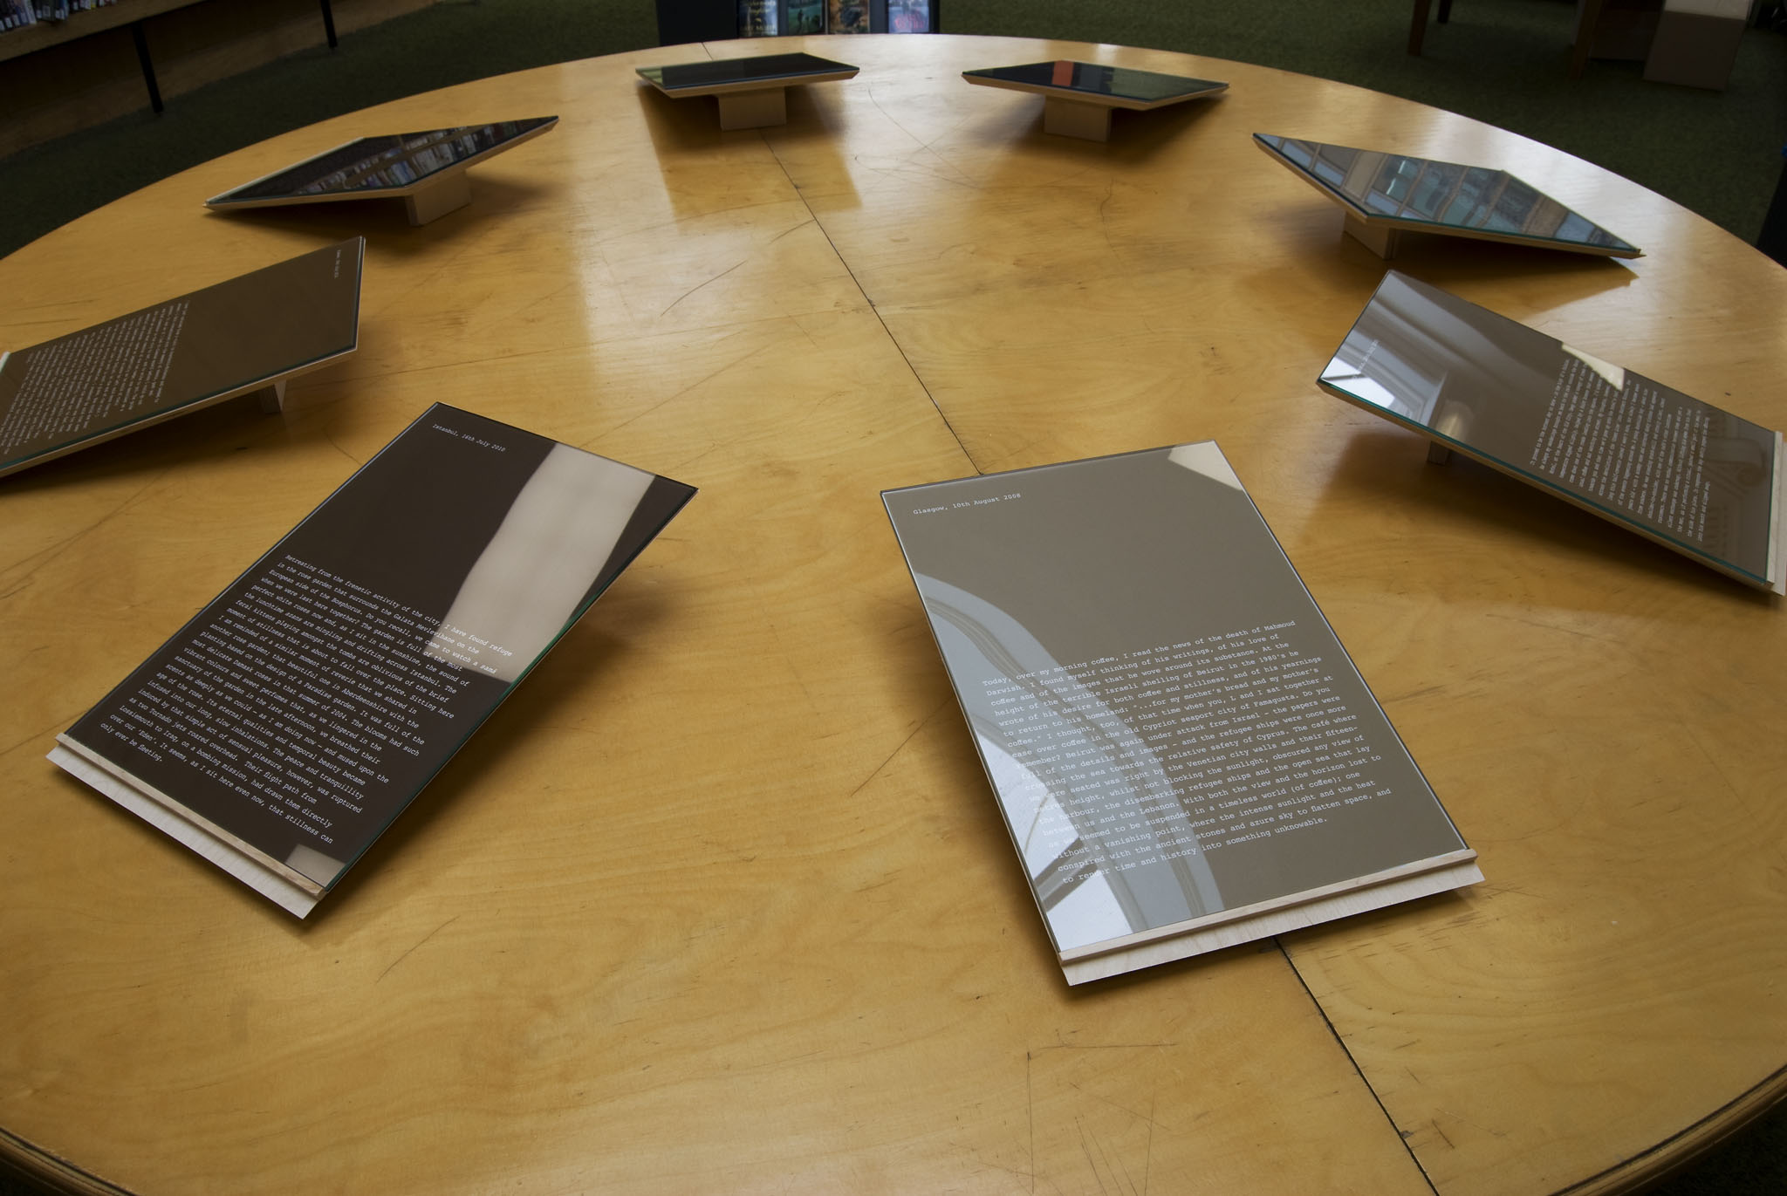

Slide 7
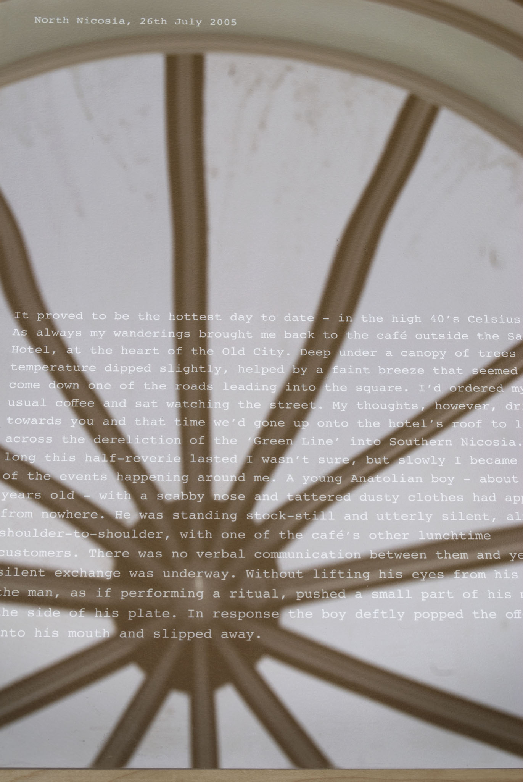

Slide 8
