Slide 1
Agios Sozomenos – Potamia
Susan Brind and Jim Harold
24th-25th March, 2018, Timeless Encounters: ‘Place of Barley’, Cyprus,

Slide 2
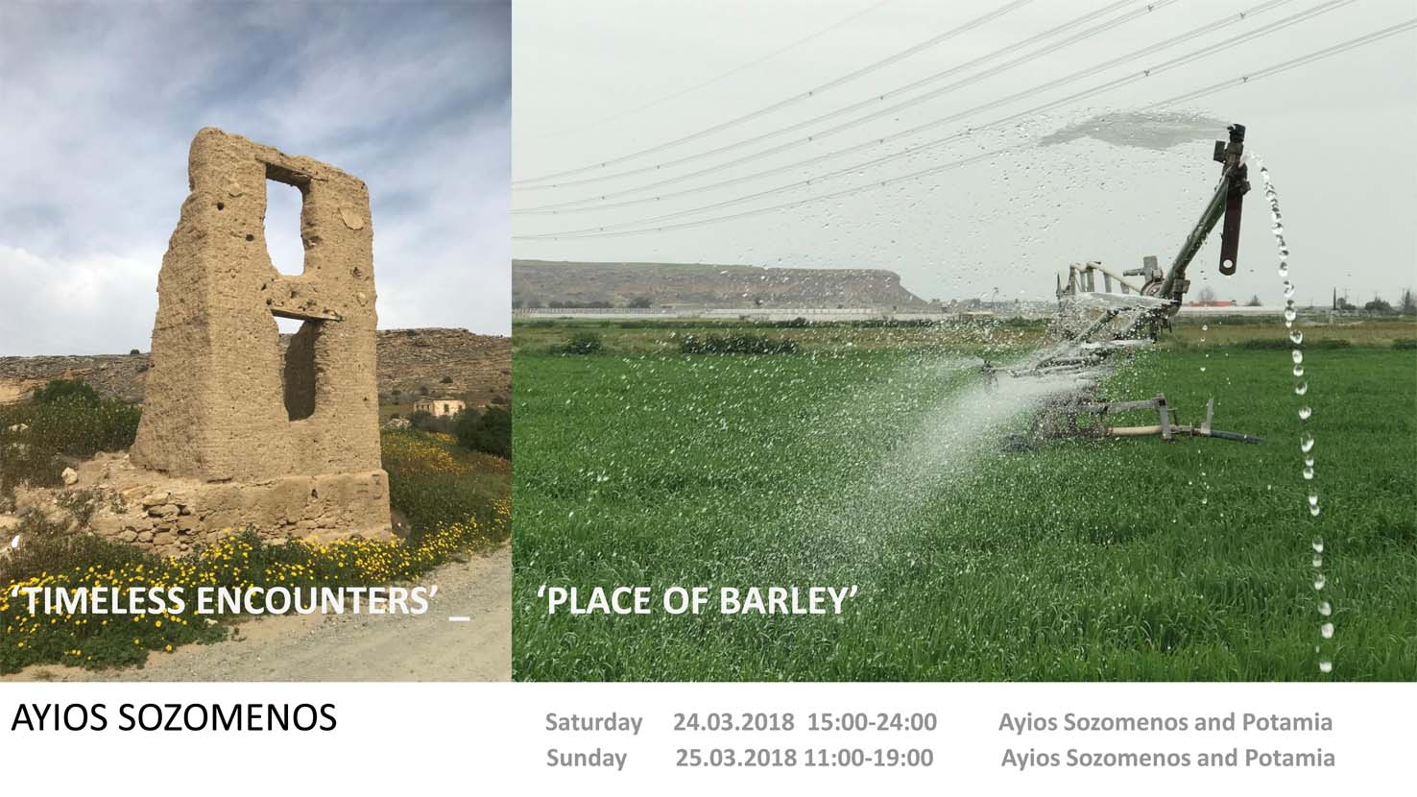

Slide 3
Agios Sozomenos 2018
Timeless Encounters – Place of Barley
A two-day event – site-specific installations, lectures and discussions.
Artists and specialists from the Greek and Turkish Cypriot Communities and members of CCFT.
Co-ordinated by Professor Yiorgos Hadjichristou (University of Nicosia)
24-25th March 2018
followed by a Special Event hosted by The Spanish Ambassador to Cyprus 26th March.
CCFT, Nomadic Dialogues, the Nicosia based NGO, Urban Gorillas, and the Architecture Department of the University of Nicosia
Sponsored by: British High Commission, Nicosia, Embajada de Espana en Nicosia, The Erasmus Programme, EU,
Glasgow School of Art, UK, Institute Cervantes, Nicosia, Nottingham Trent University, UK, Potamia Village, Cyprus,
University of Bergen, Norway, University of Nicosia, Urban Gorillas, Nicosia

Slide 4
Participants included:
Justyna Ataman (artist) Cyprus/Poland
Susan Brind (artist) Glasgow School of Art, UK
Sevina Flourido (architect) Republic of Cyprus
Yiorgos Hadjichristou (architect) Republic of Cyprus
Maria Hadjisoteriou and Angela Petrou (architects) University of Nicosia, Republic of Cyprus
Students of Unit 6, University of Nicosia, Republic of Cyprus
Jim Harold (artist) Scotland, UK
Duncan Higgins (artist) Nottingham Trent University, UK
Kyriakos Kallis (artist) Republic of Cyprus
Serap Kanay (artist) Turkish Republic of North Cyprus
Linda Lien (graphic designer) University of Bergen, Norway
Andrew Locke (artist) University of Bergen, Norway
Duncan McCowan (teacher, and author) Republic of Cyprus
Shauna McMullan (artist), Glasgow School of Art, UK
Peace2Peace (artist/activists), intercommunal group, Cyprus
Nikos Philippou (photographer, artist) Republic of Cyprus
Johan Sandorg (artist) University of Bergen, Norway
Ana Soto (art and architectural historian) Nottingham Trent University, UK
Urban Gorillas (NGO), Republic of Cyprus
Film screening: A Detail in Cyprus (1987) written and directed by Panikos Chrysanthou.

Slide 5
Timeless Encounters – ‘Place of Barley’
(Nomadic Dialogue One)
Between 24th-25th March members of CCFT along with Greek and Turkish Cypriot artists, architects, activists and academics engaged in a series of creative interventions and events within the abandoned village of Ayios Sozomenos and the surrounding area.
Ayios Sozomenos lies in the Republic of Cyprus, just a few kilometers south of the UN brokered demilitarized Buffer Zone, and some 30 kilometers east of the City of Nicosia. Initial interests regarding the locality resulted from fieldwork undertaken by CCFT, and related researches made by architecture students (University of Nicosia) in the area in 2016. This was followed by discussions during the CCFT Colloquium held in the Architecture Department, the University of Nicosia in November that same year.
Given the historic significance of the area (it has proved a rich source of archaeological remains), the village's more recent political history (its abandonment its in 1964 and present proximity to the UN Buffer Zone (established in late 1974)), and its current status as an environmental resource it provides a powerful, multi-layered and poignant location and focus for creative inter-communal and ecological research.
The project was developed through consultations with members of the community, and with others holding specialist knowledge of the locality, its history and ecology.

Slide 6
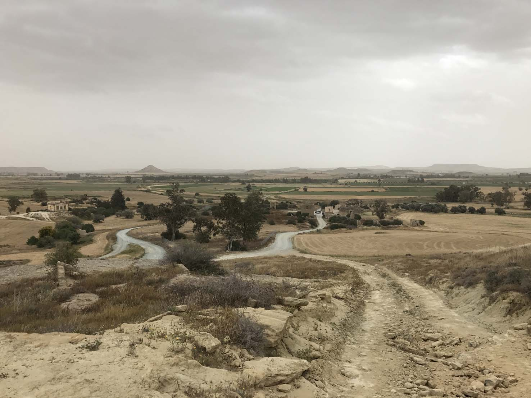

Slide 7
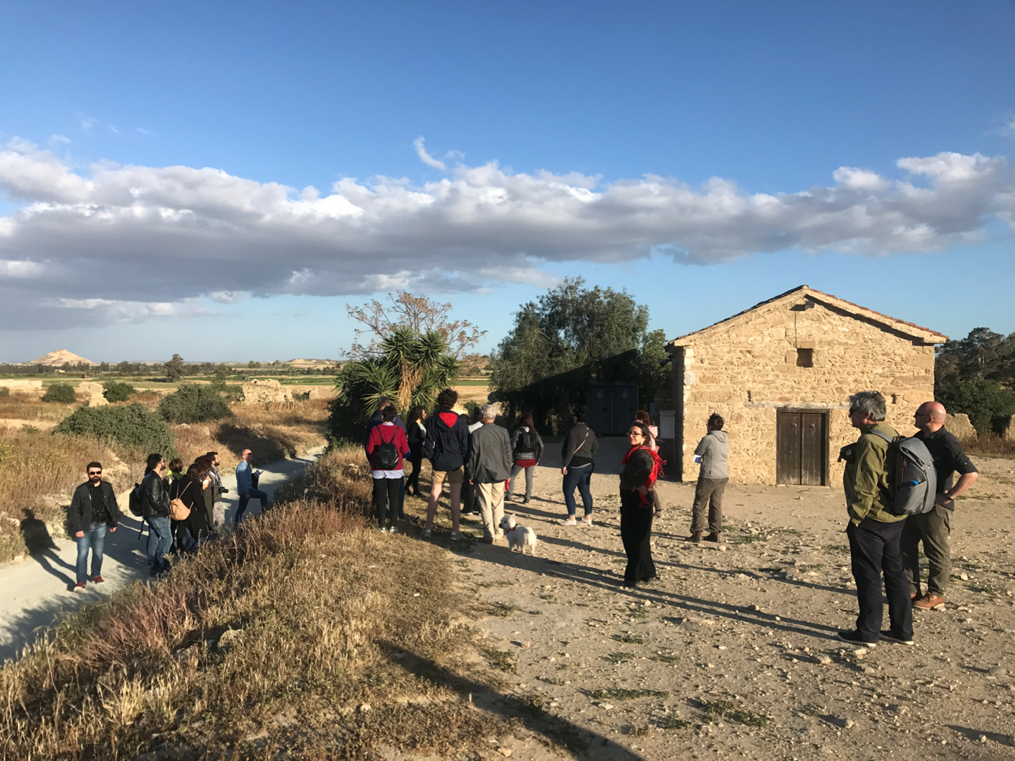

Slide 8
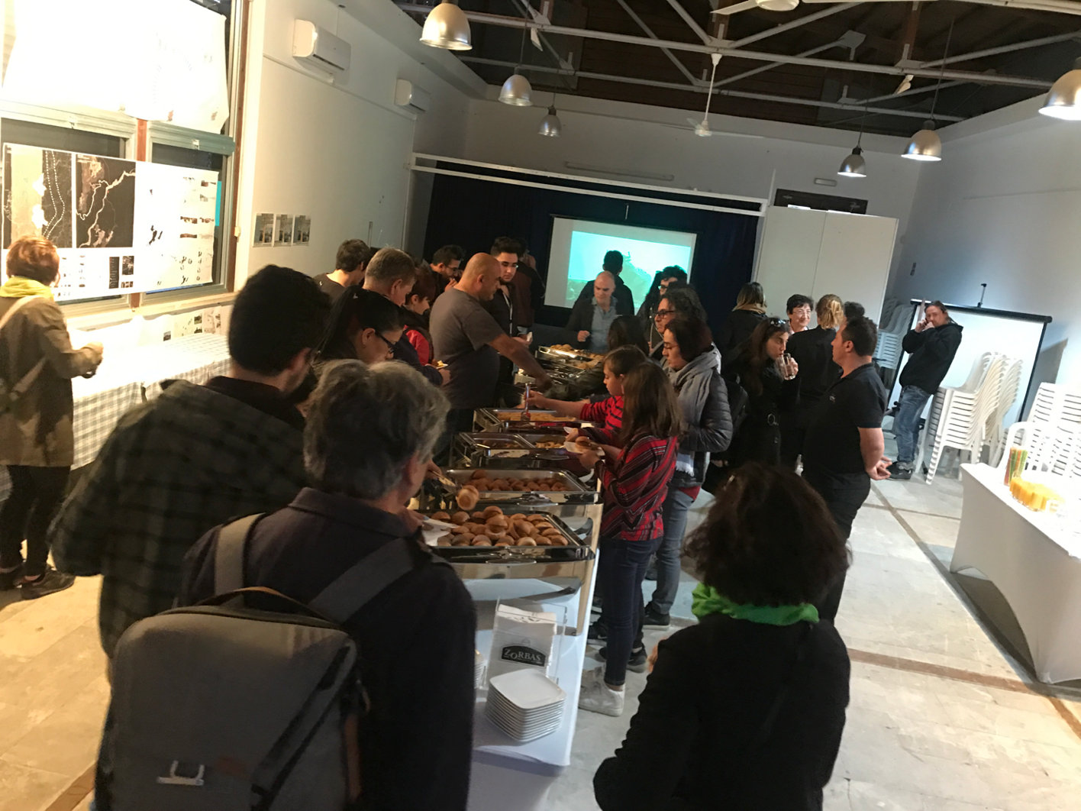

Slide 9
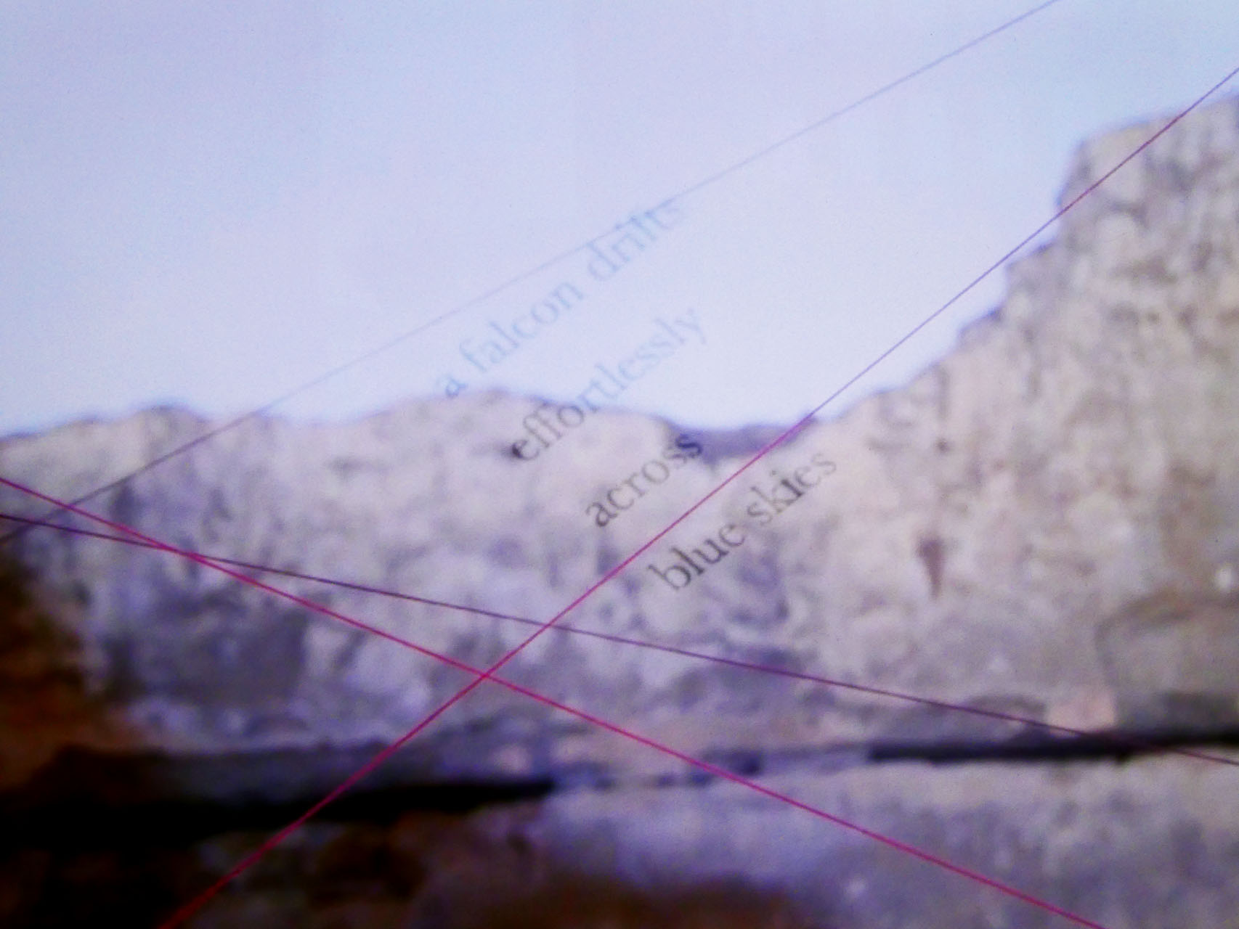

Slide 10
One River – Two Walks
Potamia – Kirklar
2018
(for Duncan and Carina and their generosity and trust in this project)
Susan Brind & Jim Harold

Slide 11
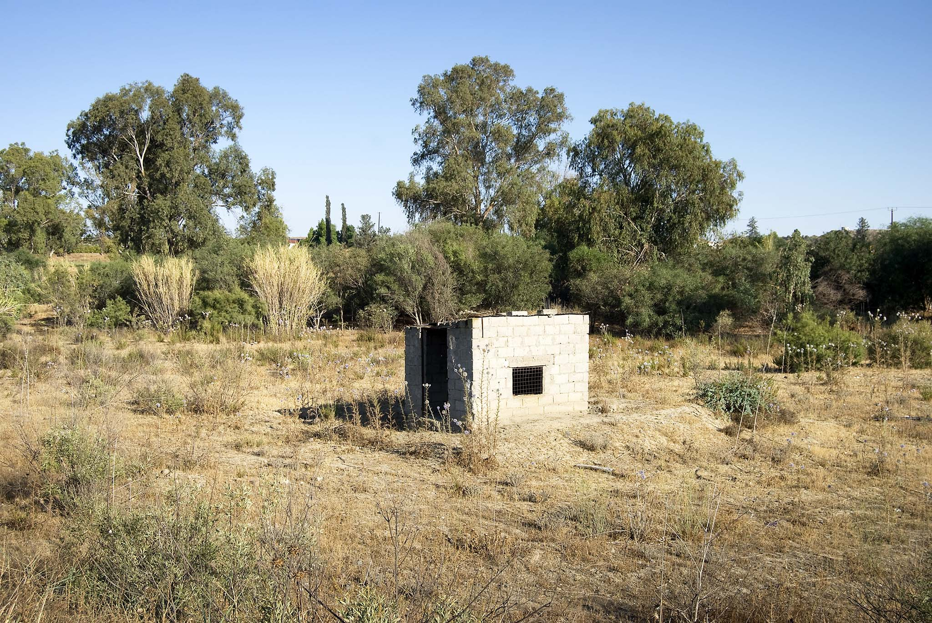

Slide 12
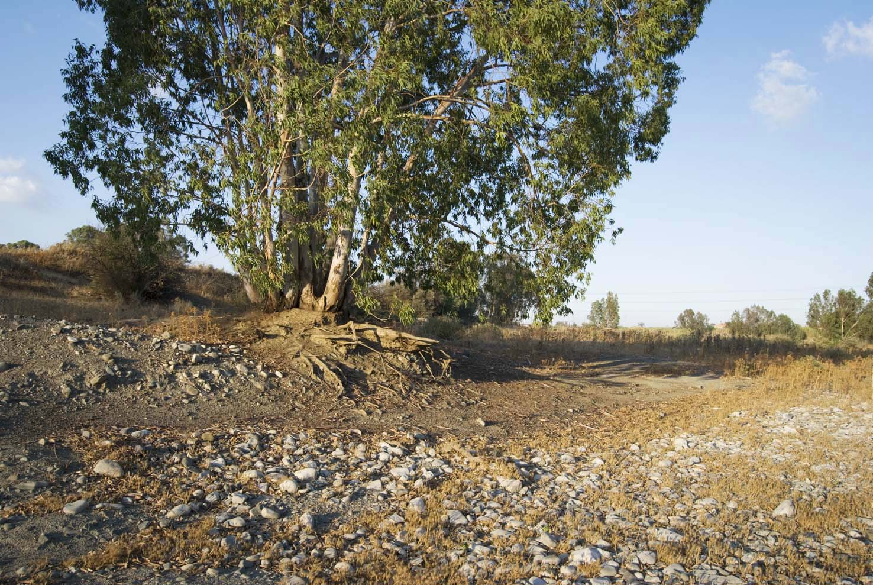

Slide 13
A text work located on two windows of a house designed by Yiorgos Hadjichristou, in the village of Potamia and beside the Gialias River. (White and grey vinyl text, and the performance of a poem (20mins).)
Our sculptural text work came about as a result of our meeting and conversation over sweet figs, peach juice and Cyprus coffee, with the two owners of this house – a beautiful modern building set in a stretch of river-side land on the outskirts of the village of Potamia, which is just a stone’s throw from the now deserted village of Agios Sozomenos.
We talked about the history of Agios Sozomenos, the history of the land, its ownership at various times, of poetry, spiders and of the river which lay just outside – a wâdi, really, of pebbles and scrub bushes –– and its sporadic appearances after very heavy rain.
We were struck by the house’s openness to the landscape, and by our position at its heart, in the living room and kitchen, which as we talked became a liminal realm between a north and a south. A SOUTH and a NORTH. The Gialias’ silent and dry riverbed resonating more and more as a line of connection running down from the Makheras Hills, onto the Mesaoria (Mesarya) Plain and out to the sea off Famagusta.
The work for the north and south facing window’s of Duncan and Carina’s home was adapted from a longer poem entitled, Mesaoria – Mesarya: land between mountains (2018), which attempts a reconciliation with the landscapes around Agios Sozomenos and Kirklar that lie just a few kilometres to the south and the north of the UN brokered de-militarised zone, which runs east to west across the Mesaoria Plain.
The quality of the text changes according to the time of day and the light. During daylight hours it is never fully visible/legible in its entirety at any one time: only fragments, glimpses of meaning, and silences are evident. With twilight and darkness, however, the text may be clearly read: darkness bringing clarity to the work.
During the reading/performance of the complete poem the audience, we too, came to occupy the room’s suggested liminality and – metaphorically speaking – the space of the buffer zone.

Slide 14
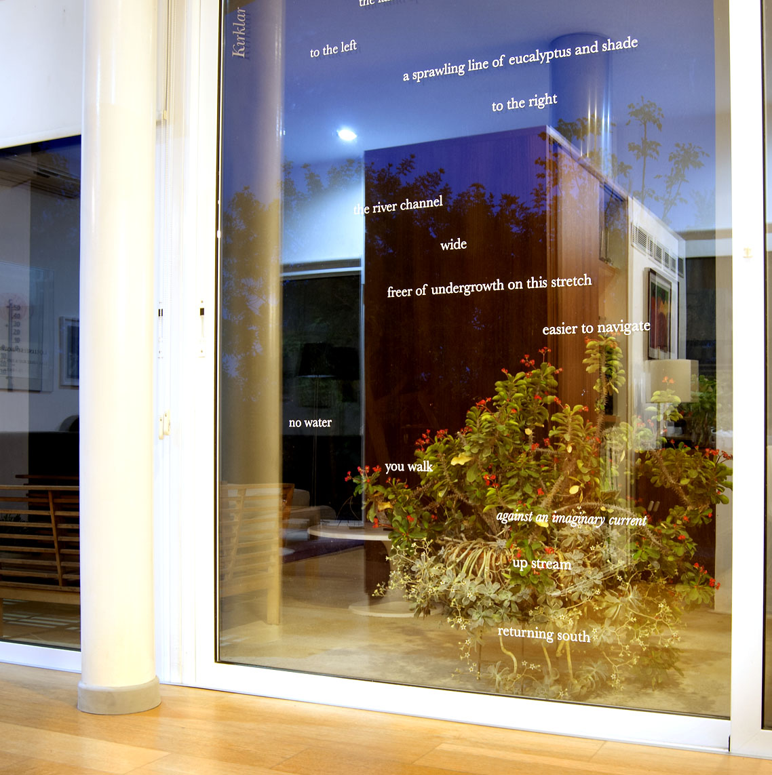

Slide 15
Potamia
    rounded stones
      tell of the water’s roll and action
        bushes and tussocks
        speak of its prolonged absence
    no water
        we walk
        flow
        down stream
        going north
Kirklar
    the land opens
    to the left
        a sprawling line of eucalyptus and shade
        to the right
    the river channel
        wide
        freer of undergrowth on this stretch
        easier to navigate
    no water
        we walk
        against an imaginary current
        up stream
        returning south

Slide 16
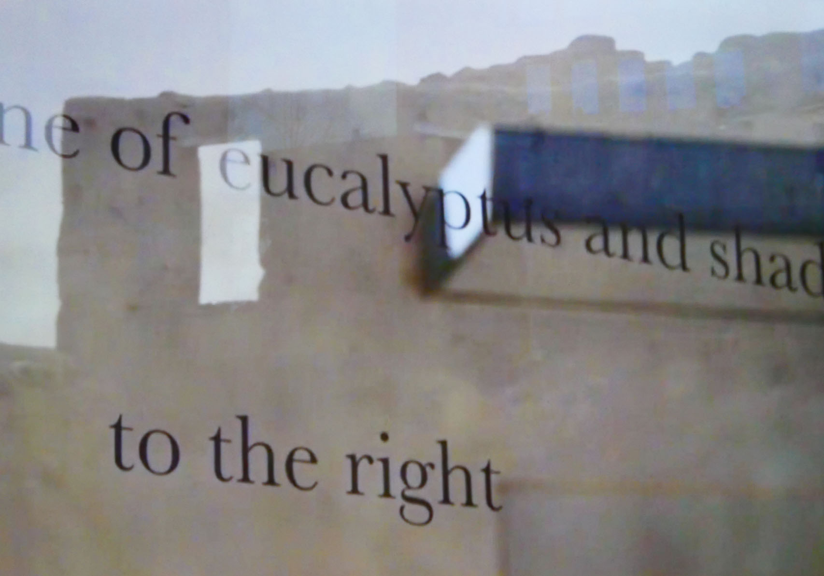

Slide 17
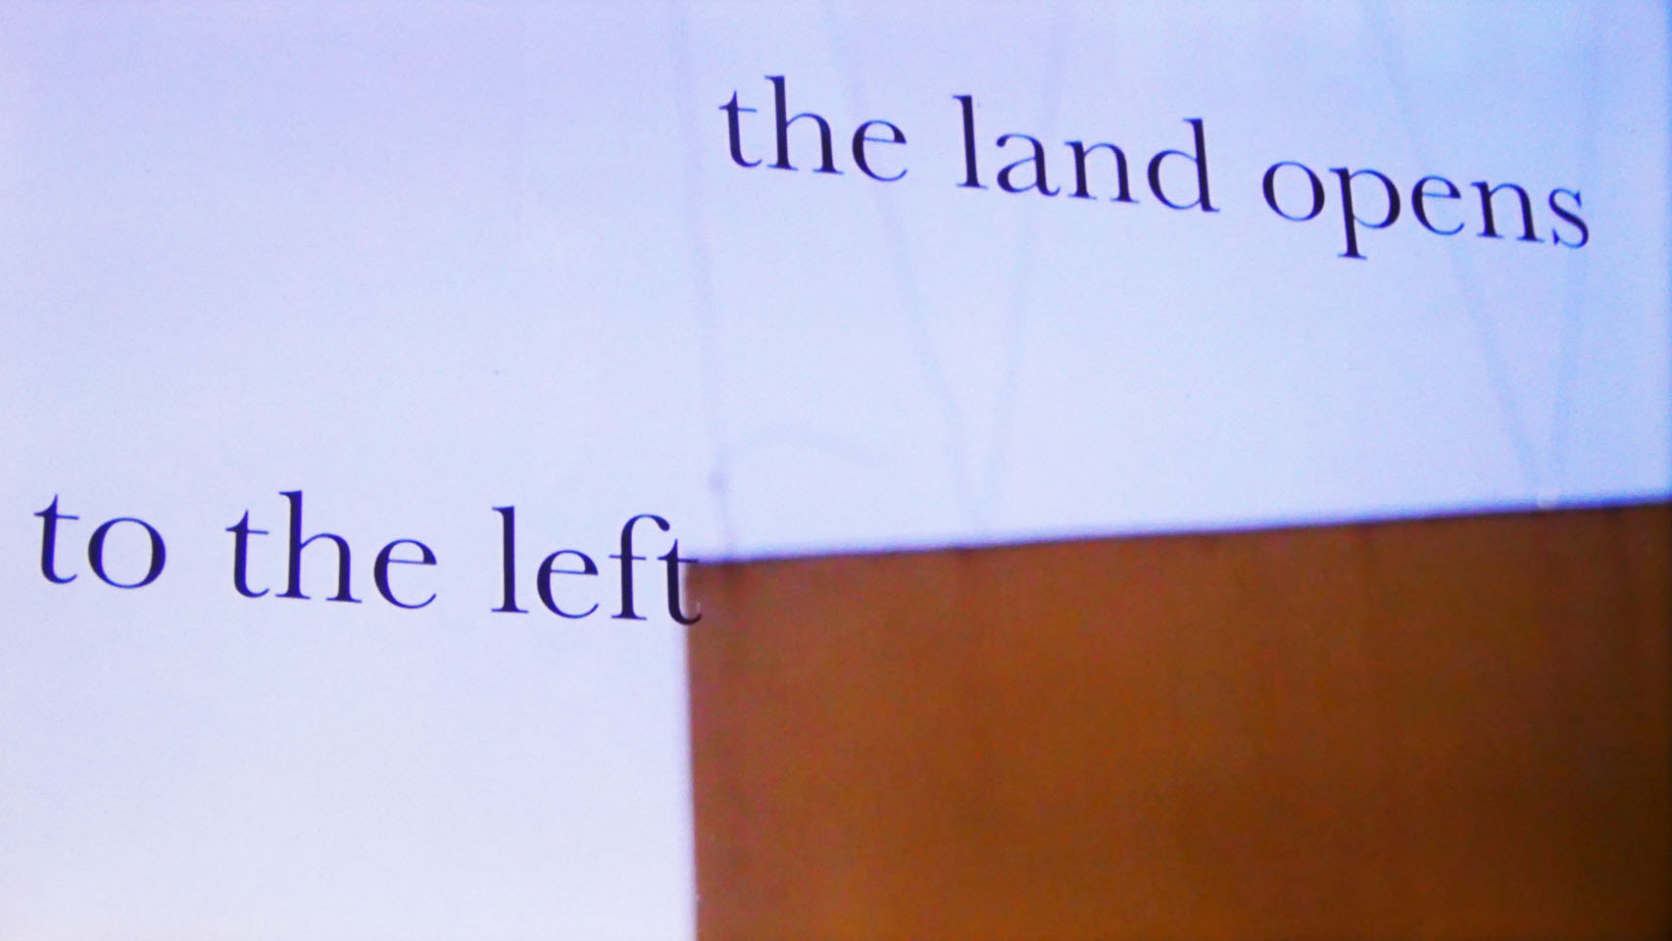

Slide 18
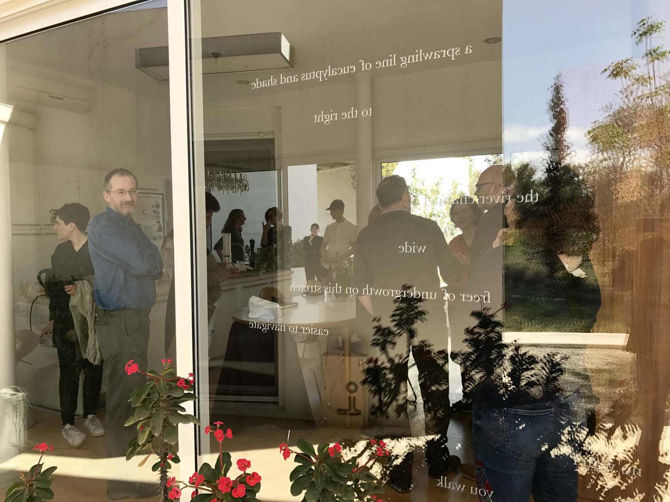
Opening, Reading and Discussion. 25th March 2018. (Photograph: Linda Lien.)

Slide 19
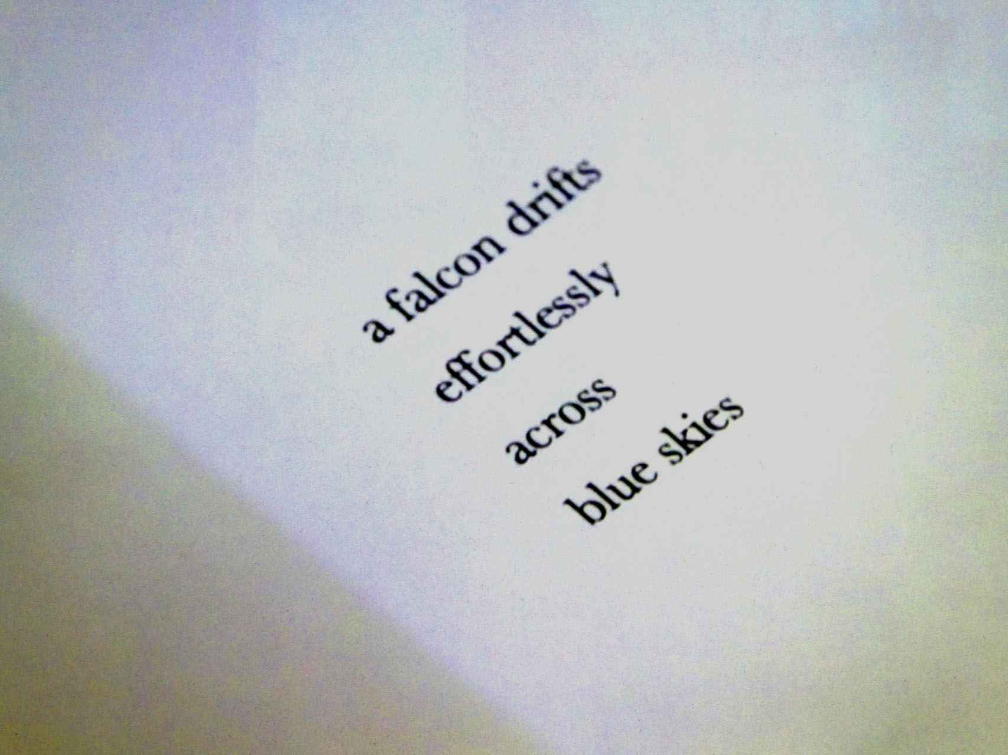

Slide 20
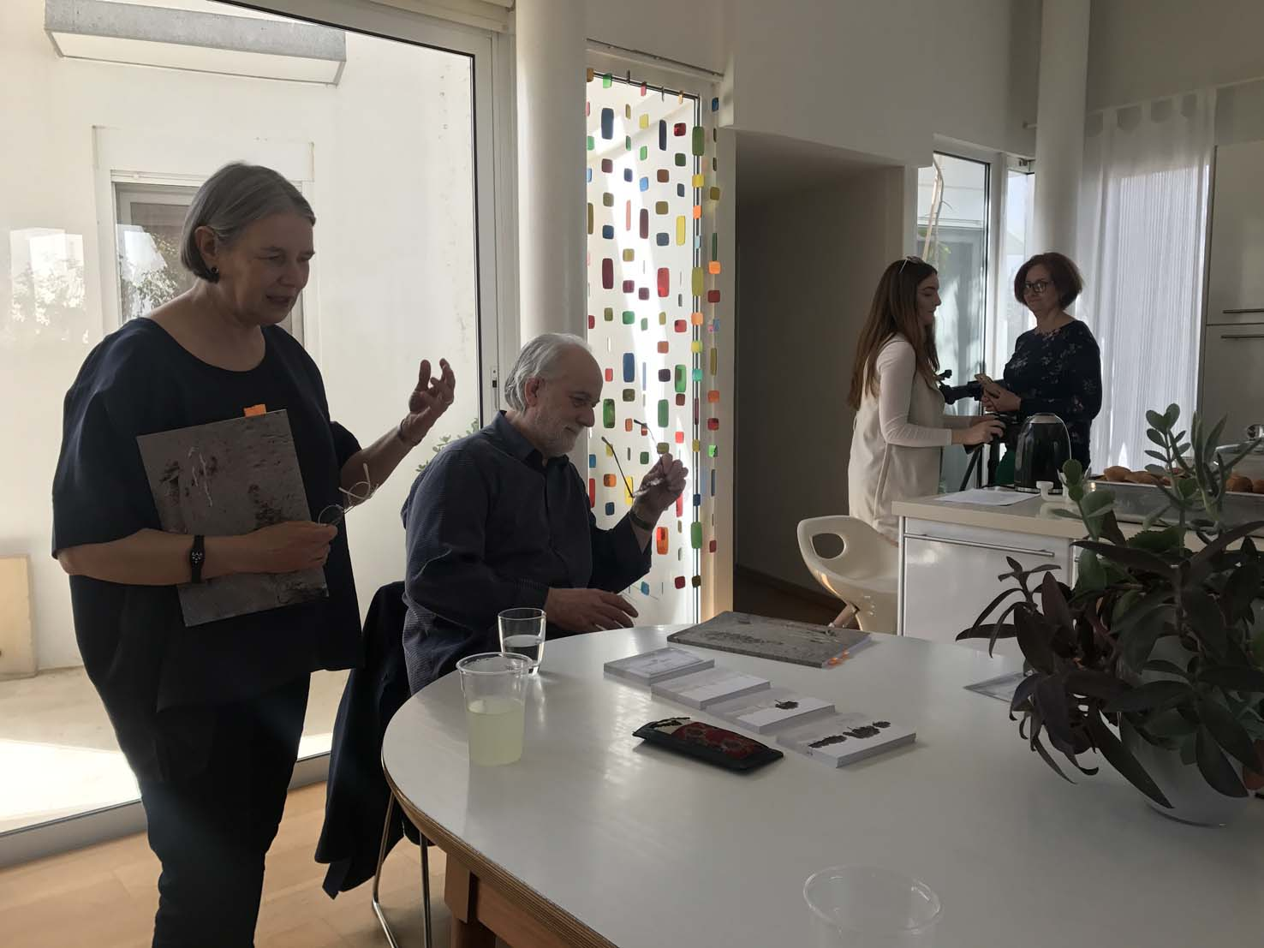

Slide 21
Woodlands, Charcoal and Copper
Agios Sozomenos
2018
Susan Brind & Jim Harold

Slide 22
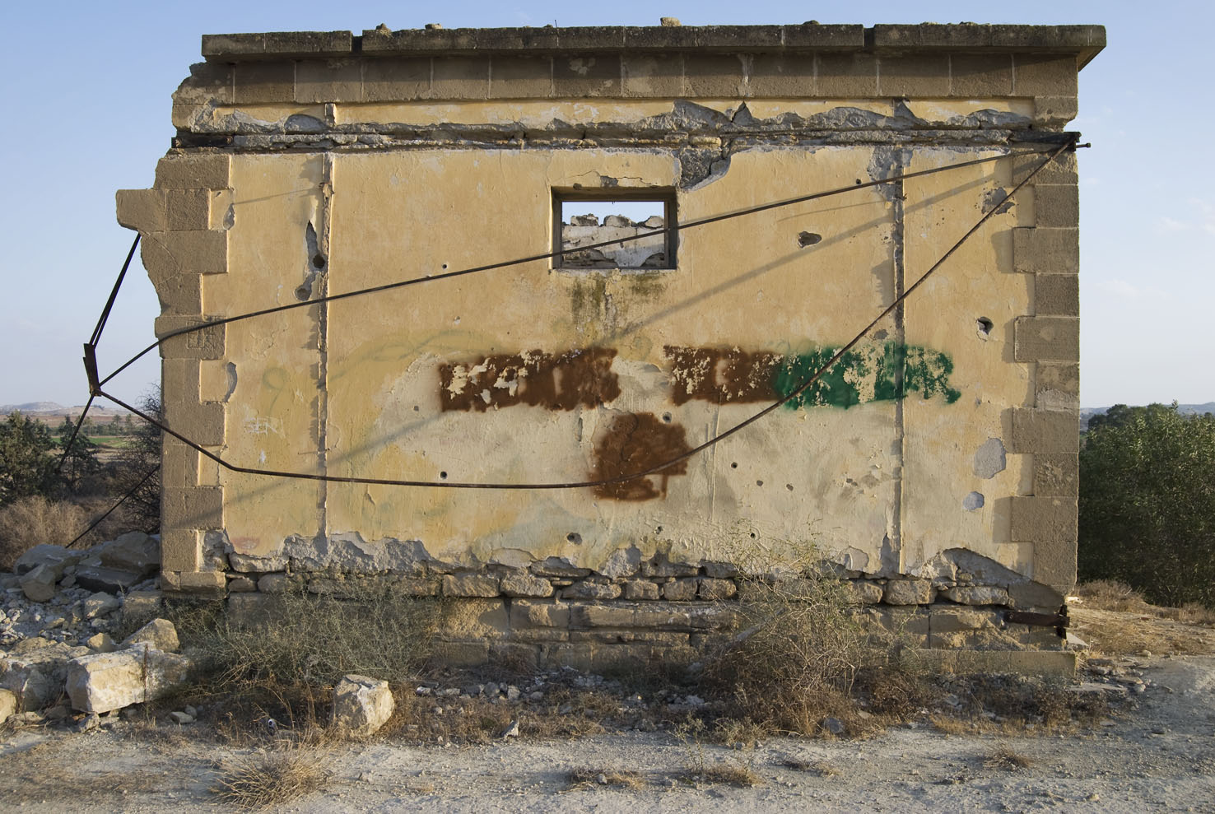

Slide 23
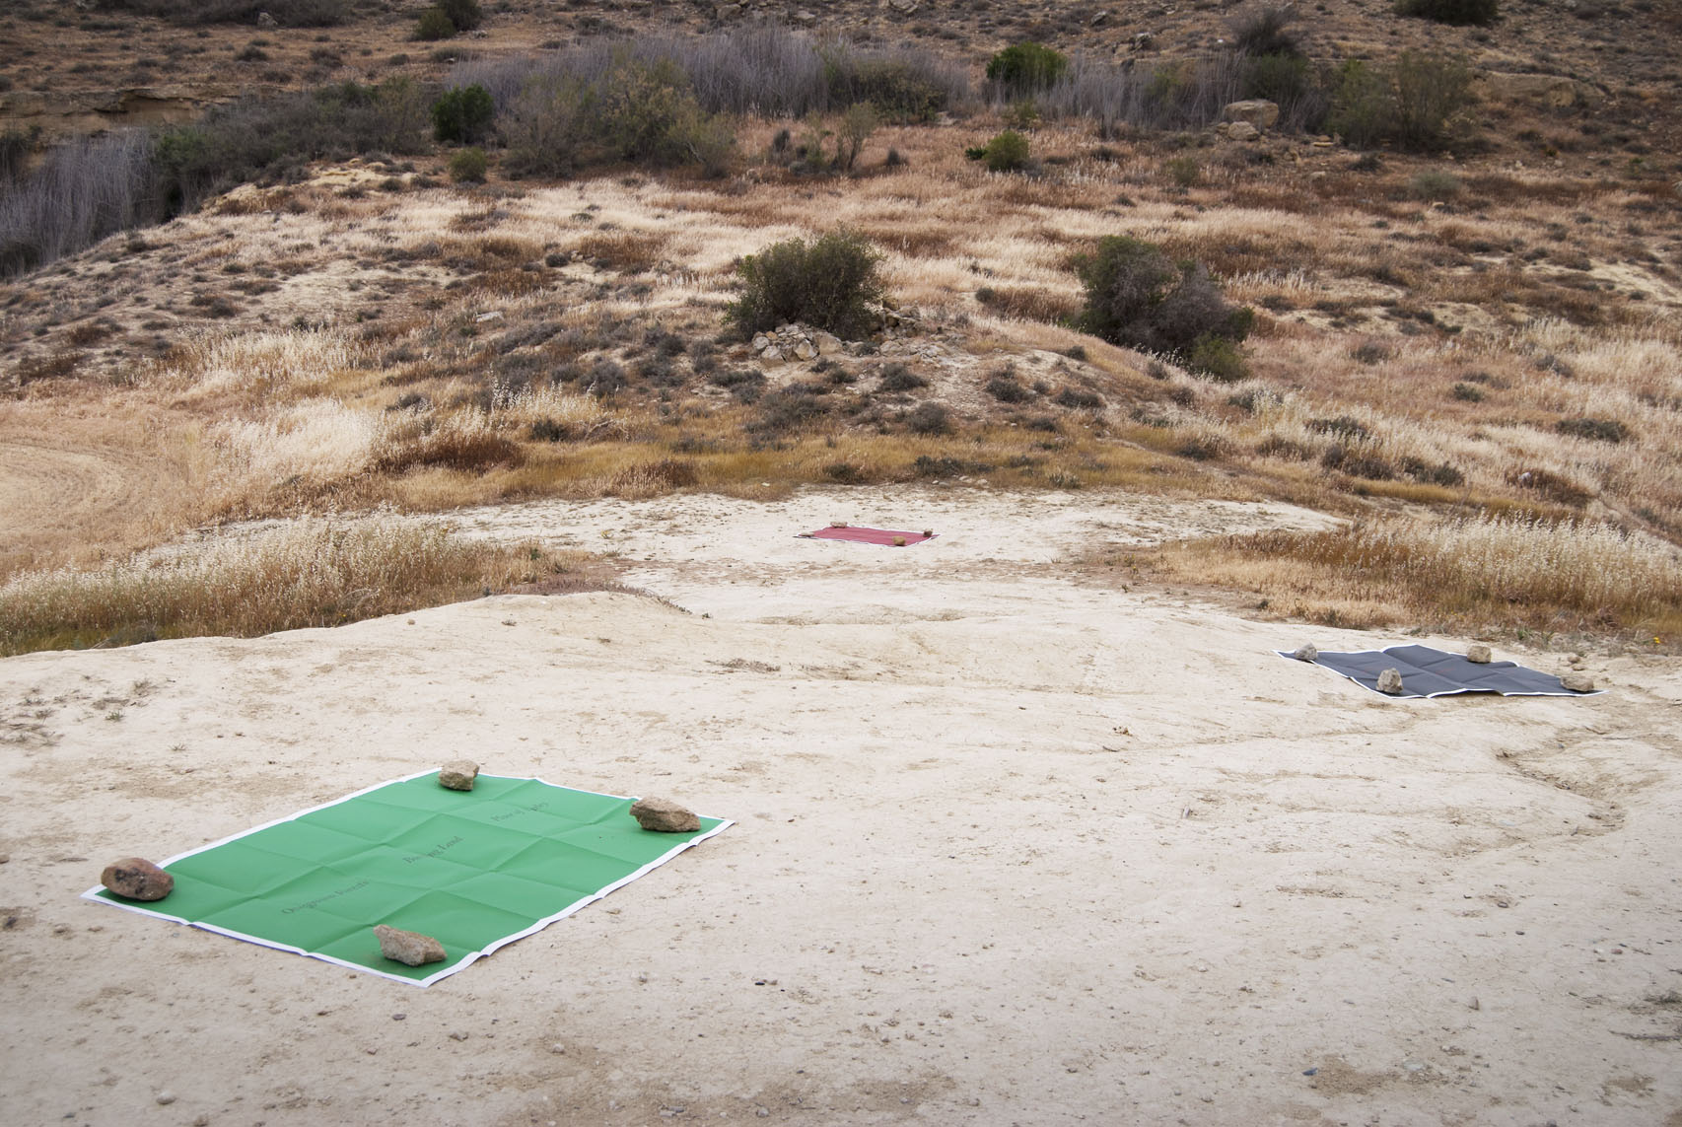

Slide 24
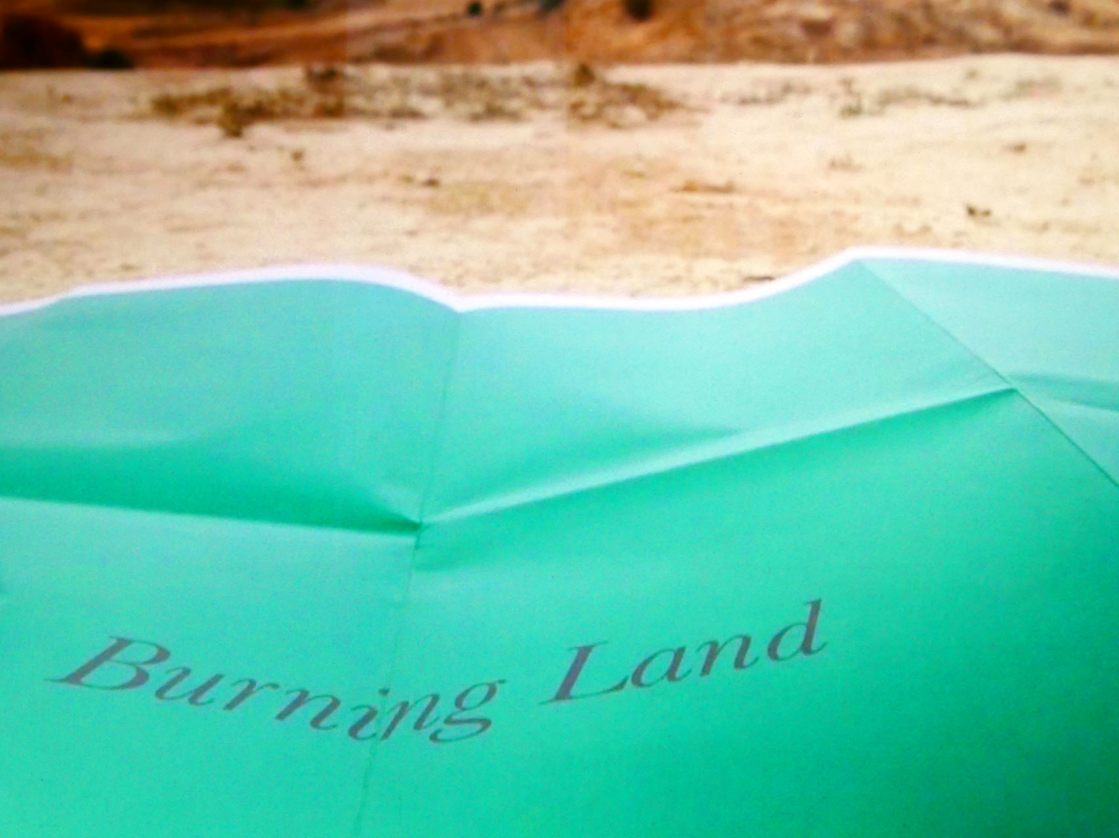

Slide 25
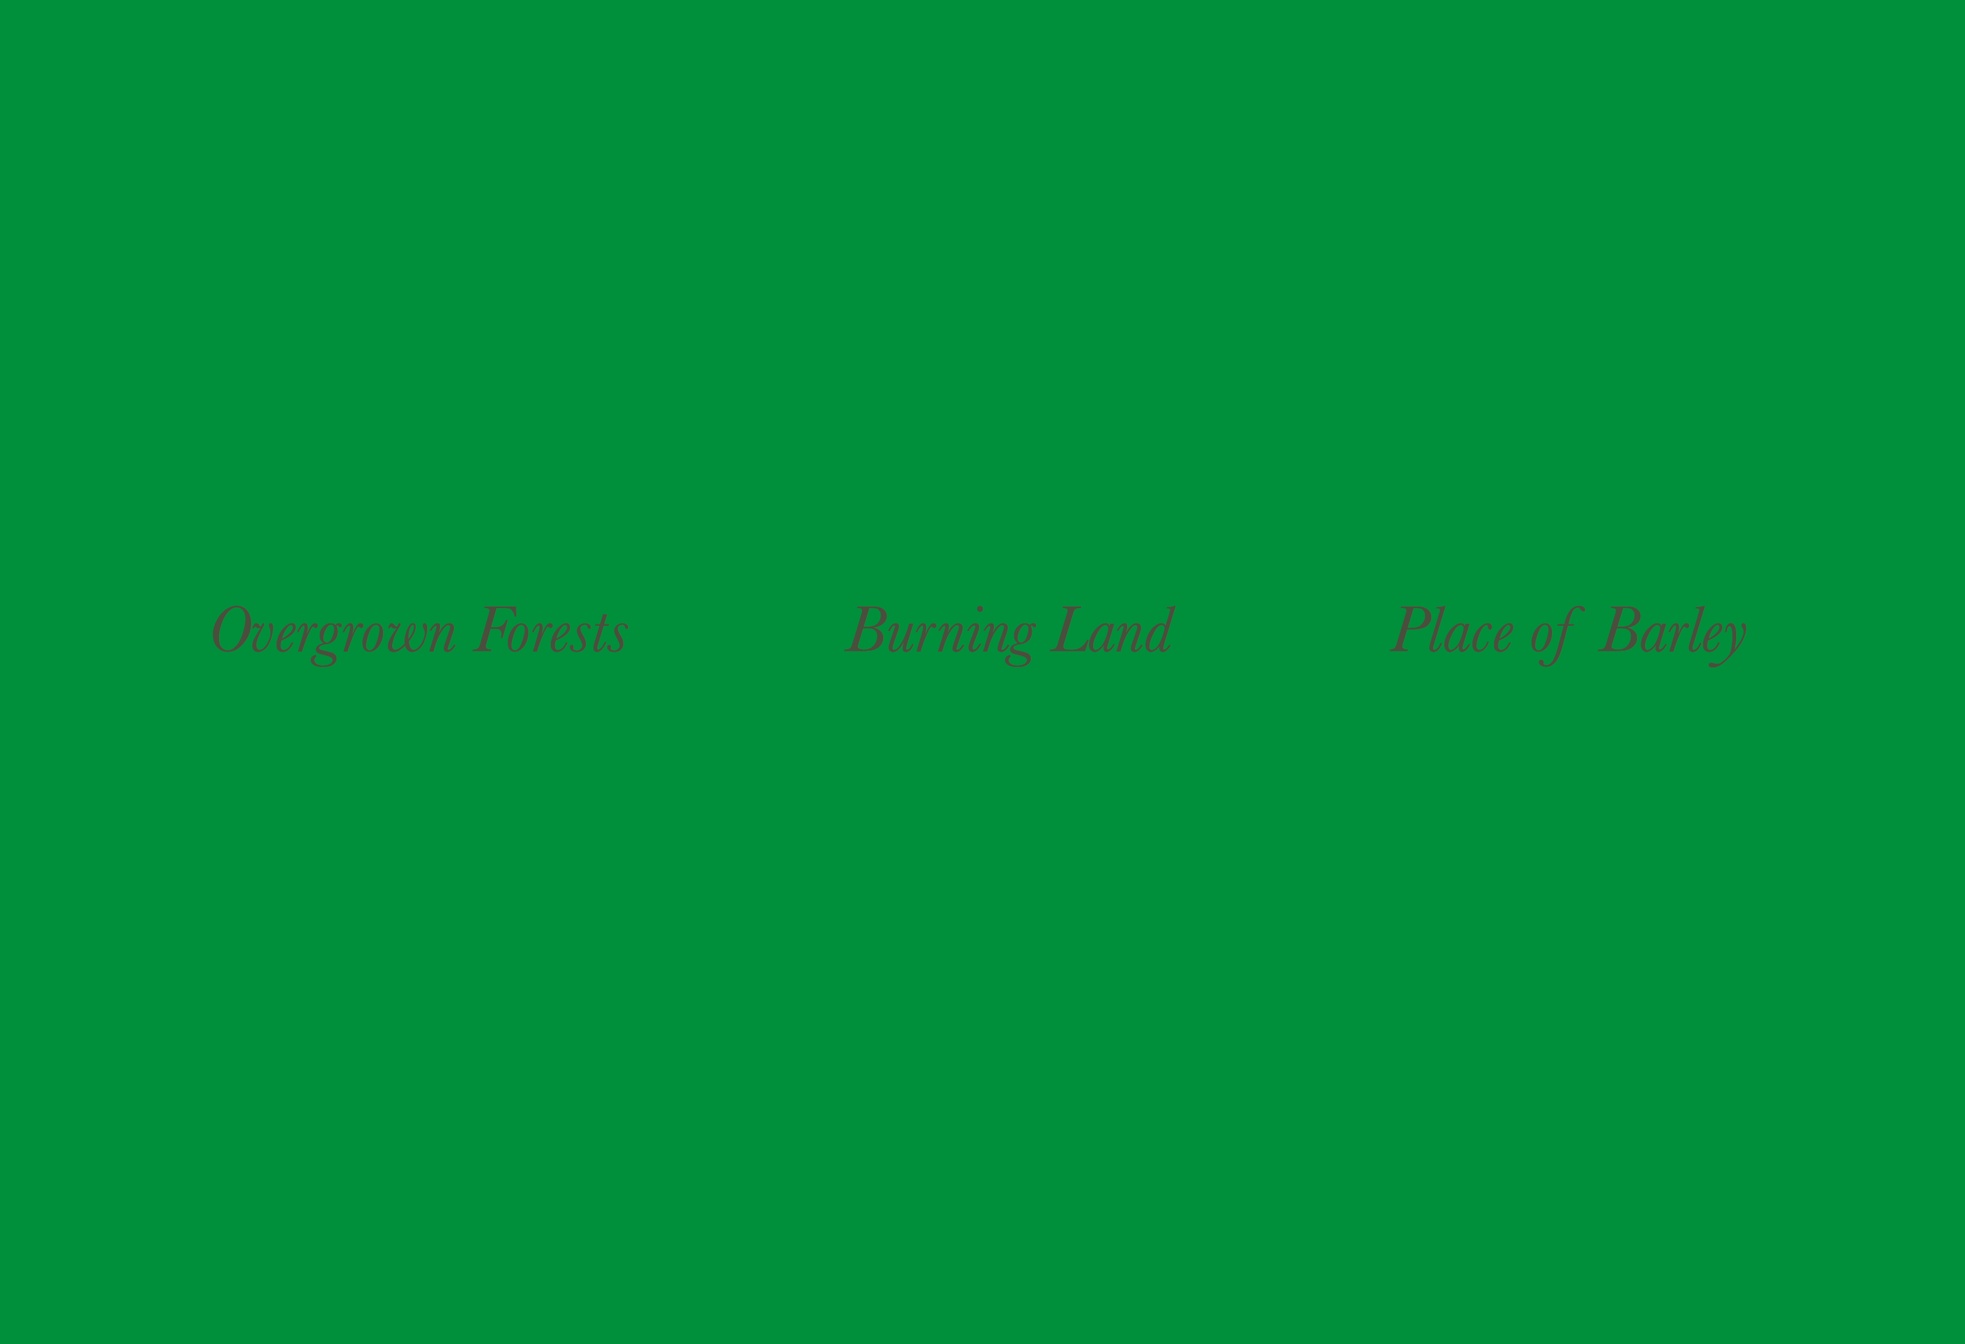

Slide 26
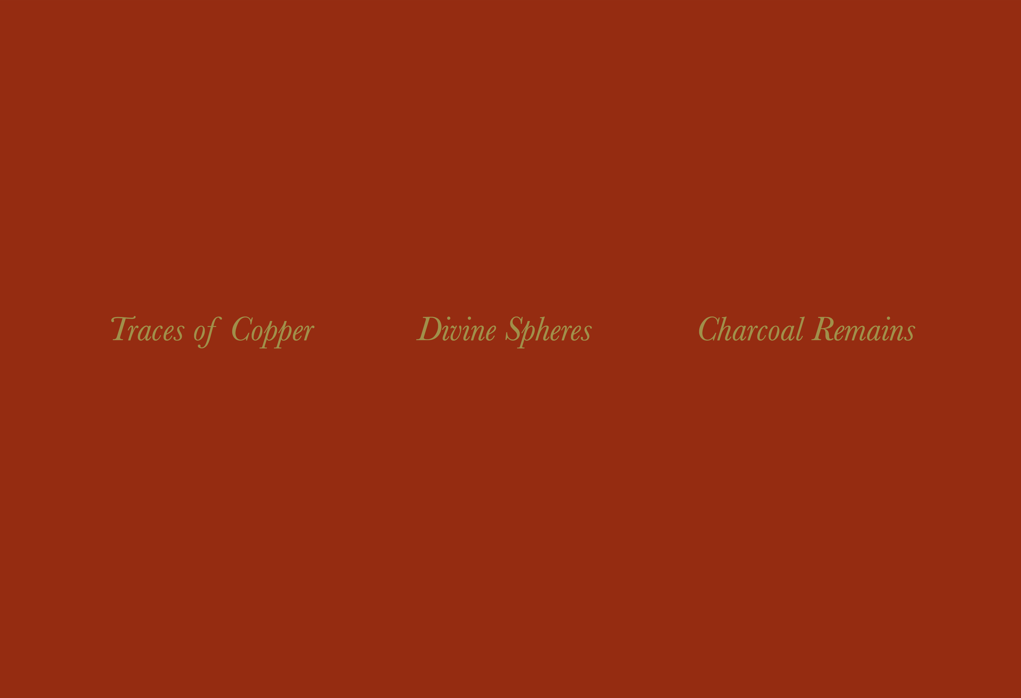

Slide 27


Slide 28
We were inspired to go to Agios Sozomenos as a result of working with students of Architecture at the University of Nicosia who had researched the village. Over the space of a year or so, we made two visits to the place to try to understand the site and its relatively recent history. It is such an atmospheric place. We tried to imagine how it must have been to live there, and how long it had been settled. Discovering more of its longer history, as a place and as a landscape, we came to know that it (and the whole plain) had once been covered by dense forest, that the trees had been felled for ship building and for charcoal necessary to the process of smelting copper, found in the earth: the landscape becoming collateral.
    ‘[The] Island thickly overgrown by forests [...]’
    ‘In the old times there were forests on the plains, and these were so many that covered the whole plain to the point where it was impossible to cultivate [...] people would cut down the trees for the smelting of copper and silver, while the building of the fleets had begun.’ Both quotes from: Eratosthenes of Cyrene (3rd C. BCE).
Three large prints (each 105 x 150 cm) – comprising fields of colour, lines of text, and folded for travel – were laid upon the land, on a knoll occupied by the ruins of the village’s Turkish school, just to the north of what remains of the centre of the village. Situated in this way the works metaphorically bleed into the landscape and out across the plain, which was covered, at the time, by fields of ripening barley. (On previous visits the harvest had been completed and the area took on a desert-like appearance.)
The prints of rich dark green, dark grey and deep brick red, were intended to echo the appearance both of maps and prayer mats – related but not fixed by cartography and slipping towards an imaginary reading of the place. They were held in place, and against the day’s wind, by stones taken from the ruins of the Turkish School, which littered the ground.
DARK GREEN – dark grey text
    Overgrown Forest Burning Land Place of Barley
DARK GREY – brick red text
    Partial Eclipse Blood-red Moon Partial Shadows
BRICK RED – barley gold text
Traces of Copper Divine Spheres Charcoal Remains

Slide 29
Postcards
Agios Sozomenos
2018
Susan Brind & Jim Harold

Slide 30
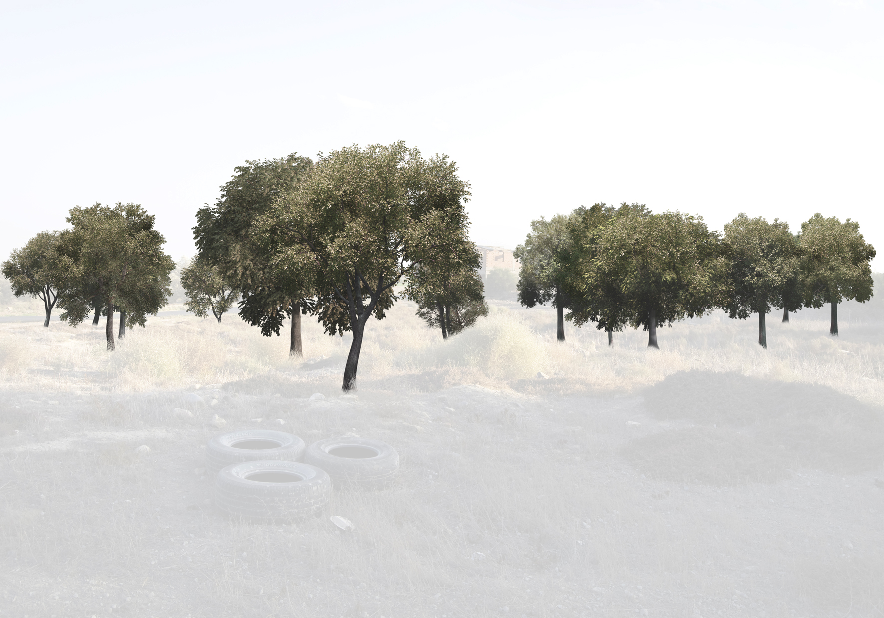

Slide 31
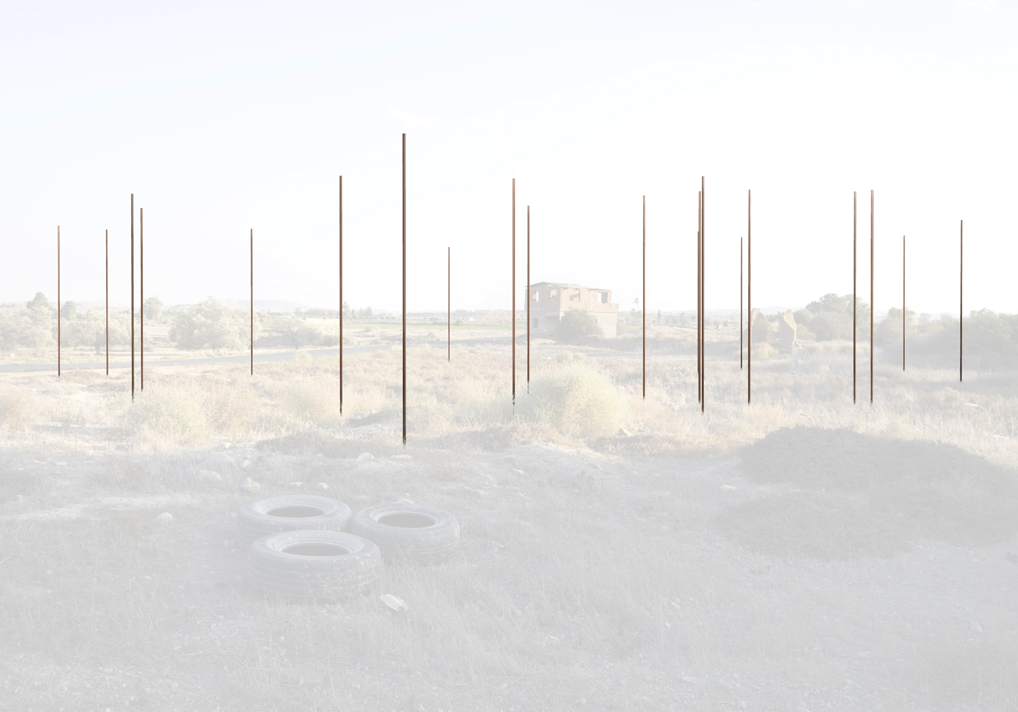

Slide 32
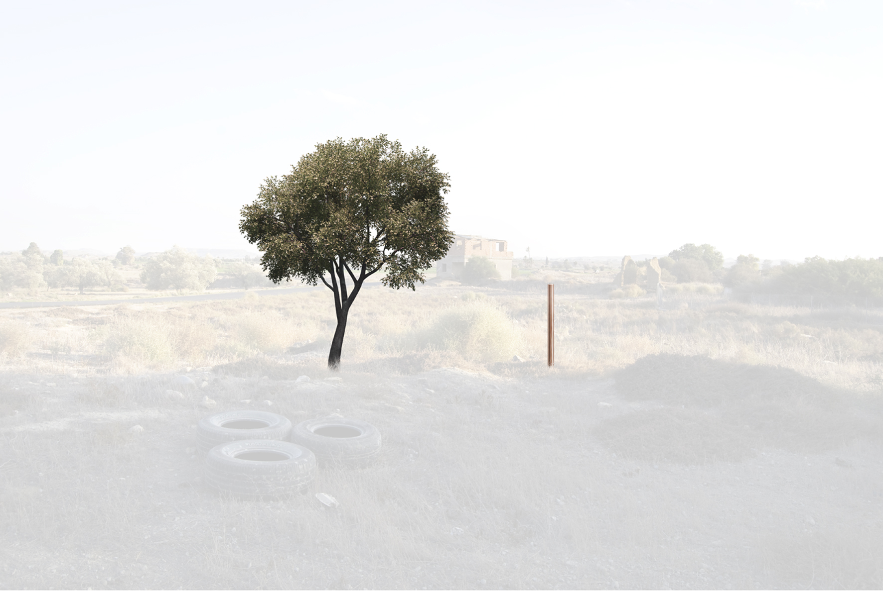

Slide 33
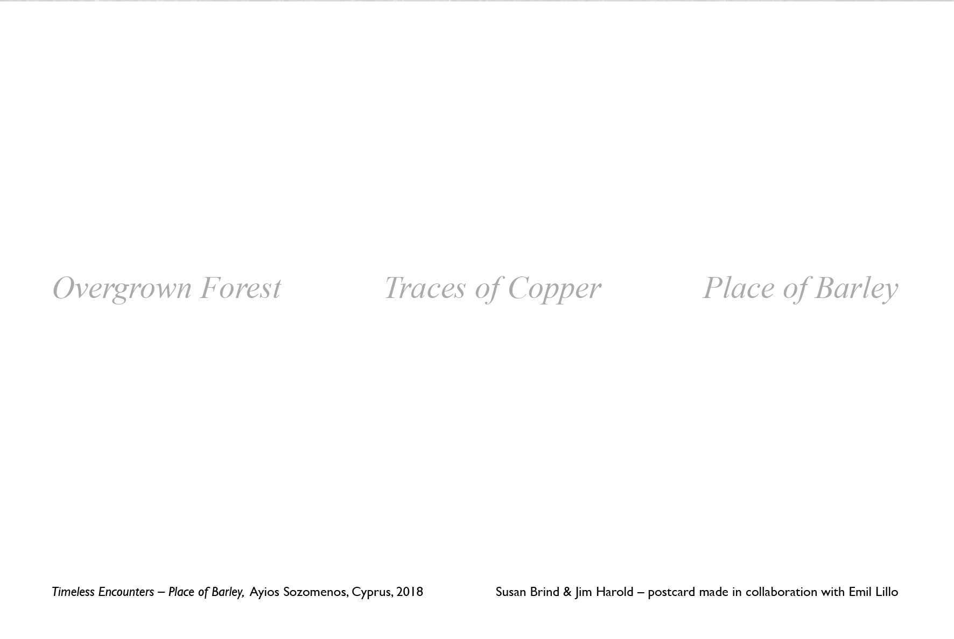

Slide 34
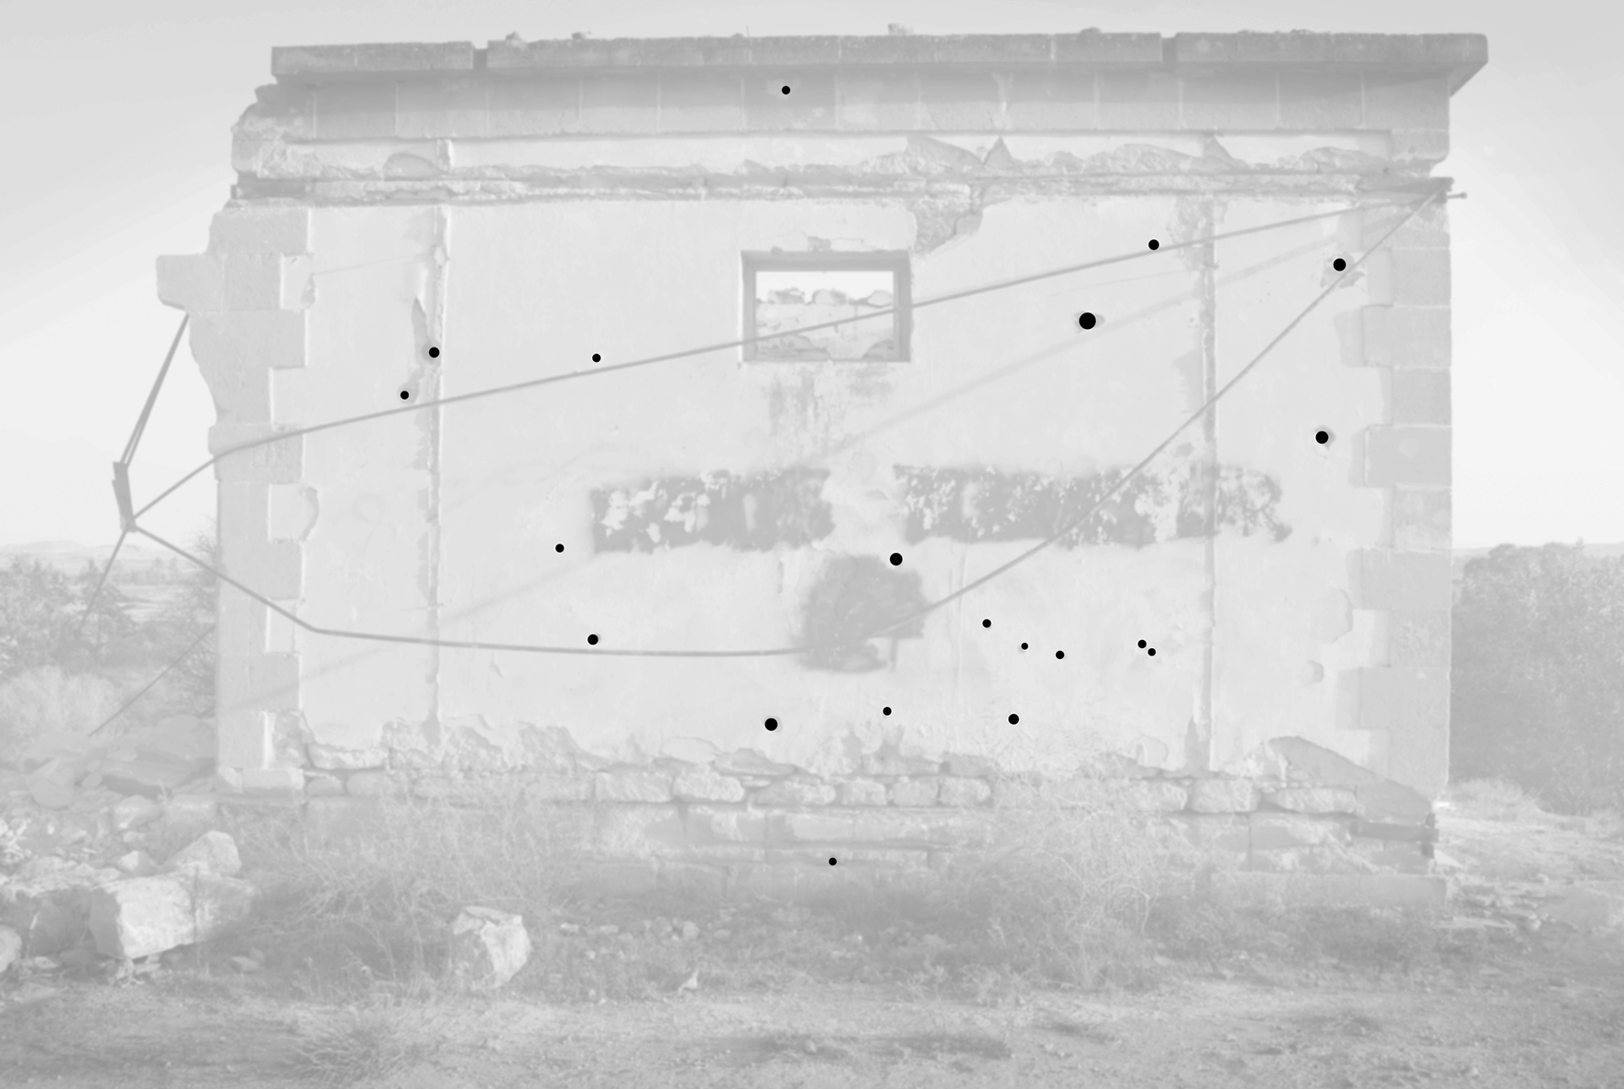

Slide 35
