Slide 1
CCFT – Nomadic Dialogues – Telavåg (2018)
The second in an ongoing series of Nomadic Dialogues organised in collaboration with members of CCFT
Participating Artists:
Susan Brind, Yiorgos Hadjichristou, Jim Harold, Duncan Higgins, Linda Herfindal Lien,
Andy Lock, Marija Miloshevska, Shauna McMullan, Johan Sandborg (curator), Ana Souto
and students from the Faculty of Fine Art, Music and Design, University of Bergen
12-16 November 2018
Sponsored by: University of Bergen (Faculty of Fine Art, Music and Design)

Slide 2
In November 2018 the Creative Centre for Fluid Territories (CCFT) in collaboration with the Faculty of Fine Art, Music and Design, Bergen, and the North Sea Maritime Museum, Telavåg , organised and hosted a colloquium, fieldwork and exhibition exploring questions of place-identity in relation to the particular context and history of Telavåg, Norway. This was the second part of a planned ongooing series of Nomadic Dialogues begun in Cyprus.)
Telavåg is a small coastal village, 25 miles south west of Bergen, where in 1942, during World War II, it was the scene of the Telavåg Tragedy when German soldiers, in reprisal for the death of two prominent Gestapo officers, erased the village. All the men in the village were either executed or sent to the concentration camp at Sachsenhausen. The women and children were imprisoned for two years in the Hardanger Fjord region.
The associated colloquium included contributions from CCFT members as well as from invited international guest speakers: Professor of Comparative Politics, Hakan Gurcan Sicakkan, composer Daniel Peter Biro and performing artist and designer from Macedonia Marija Miloshevska.
Staff and students from the Faculty of Fine Art, Music and Design, Bergen alongside CCFT members undertook fieldwork in Telavåg and its surrounding landscape which culminated in an exhibition and presentation of research, artworks, texts and performances on 16th November (Gallery 61, Faculty of Fine Art, Bergen).

Slide 3
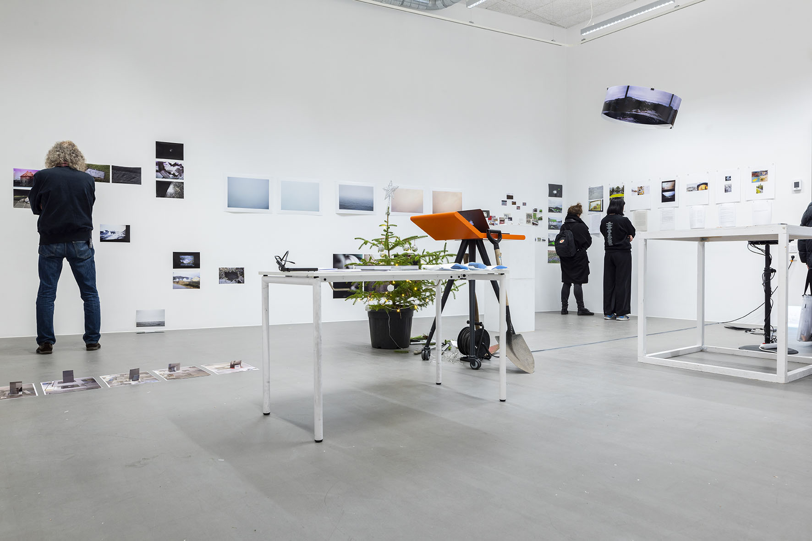

Slide 4
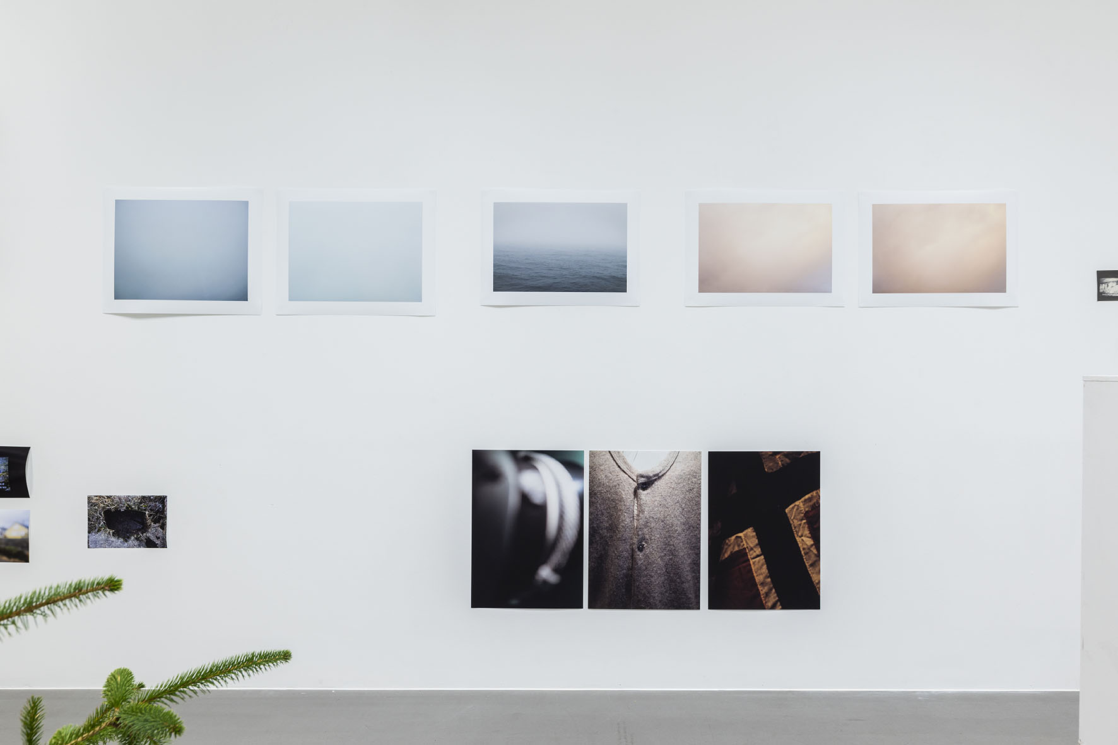

Slide 5
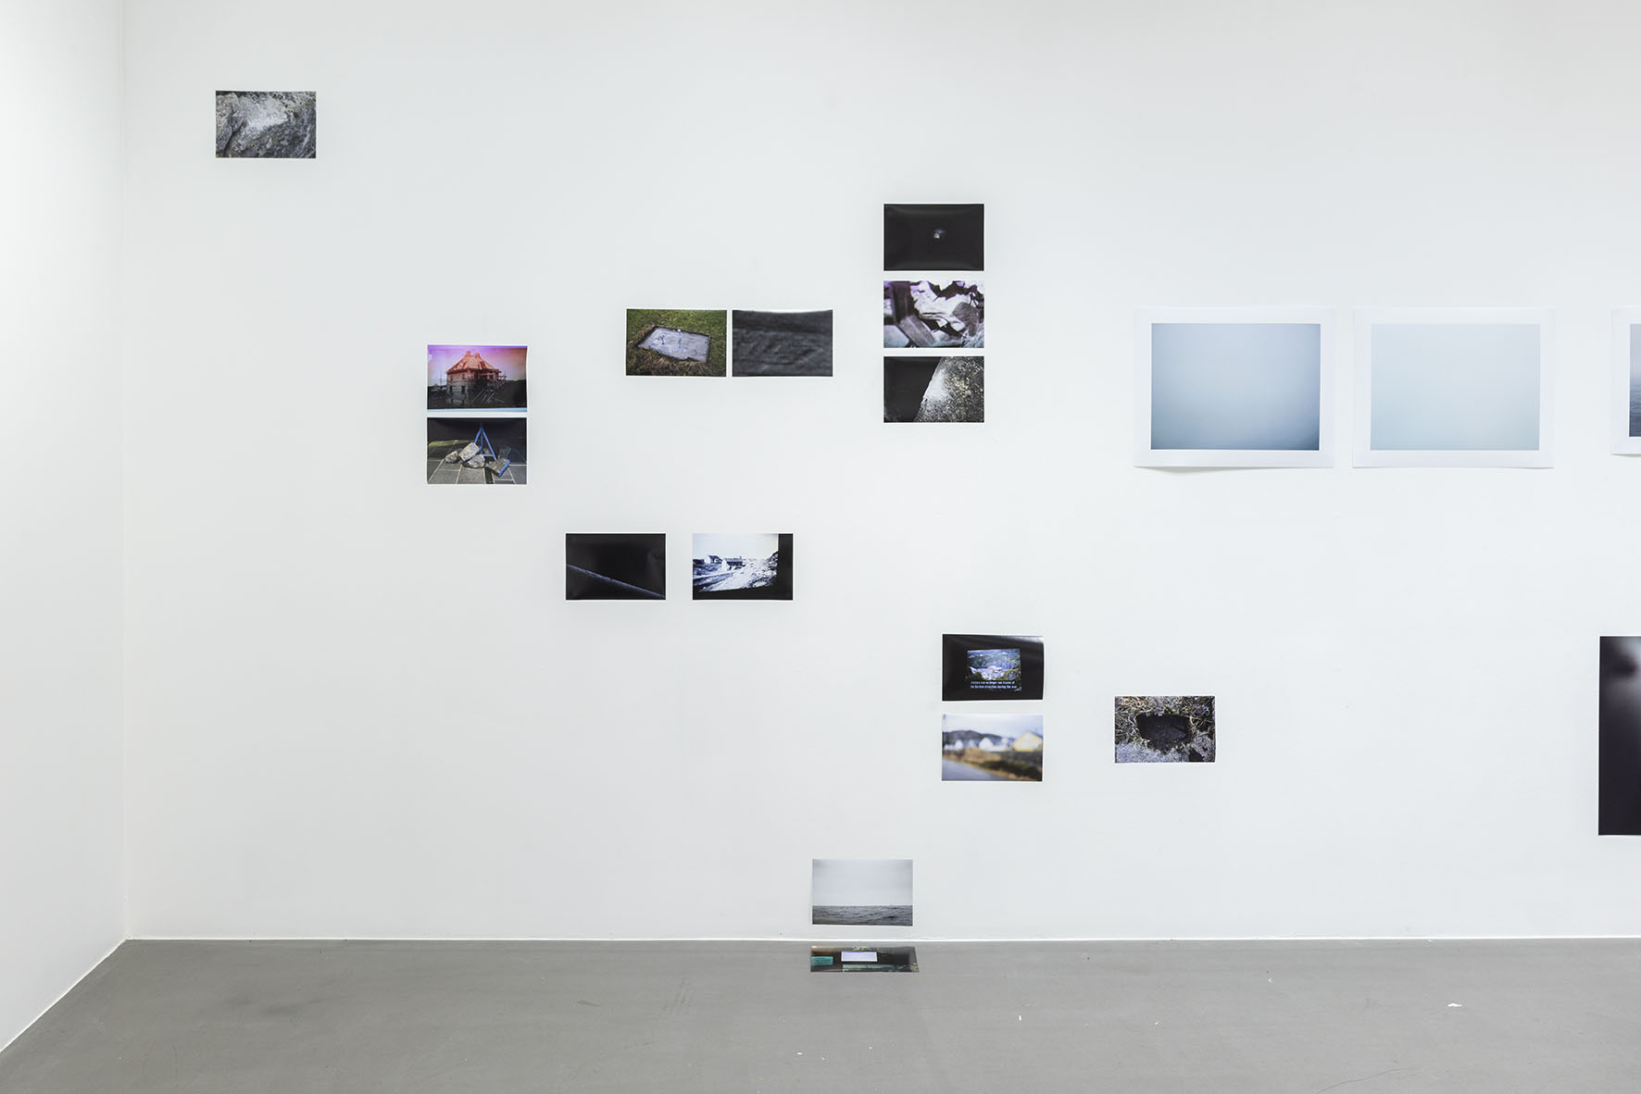

Slide 6
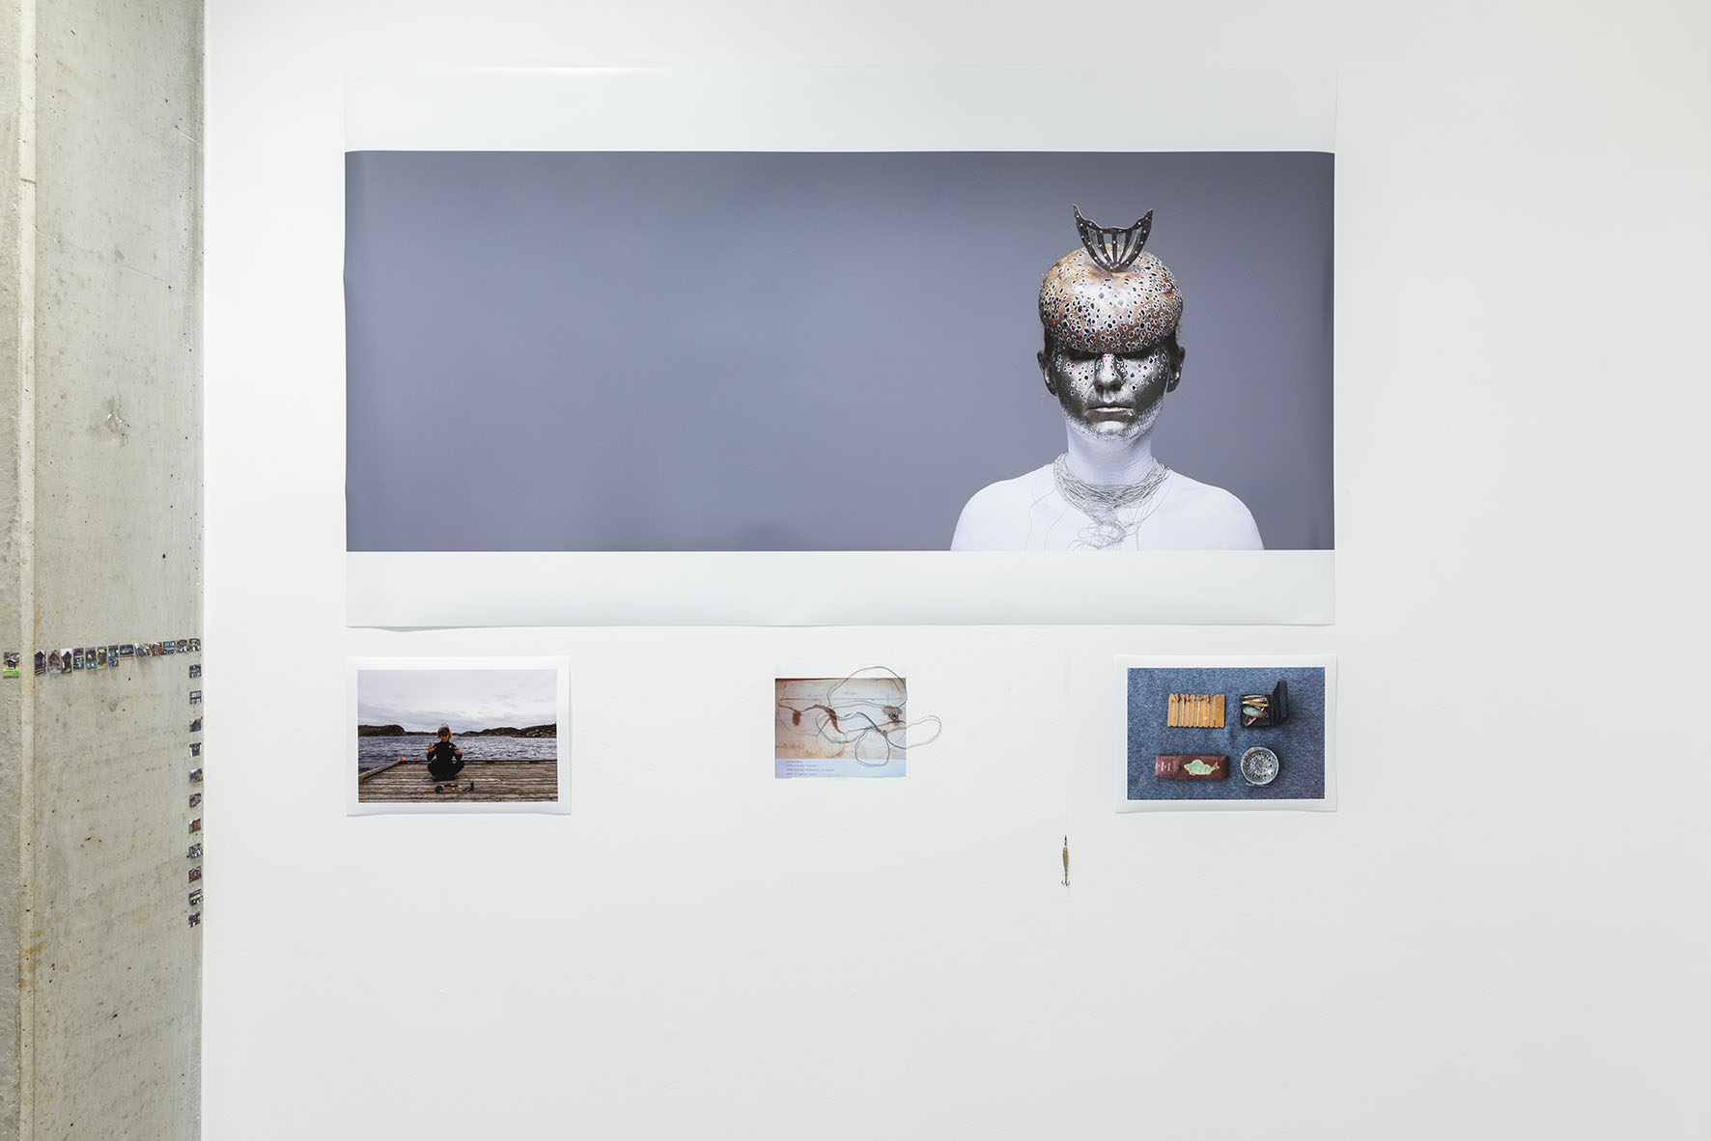

Slide 7
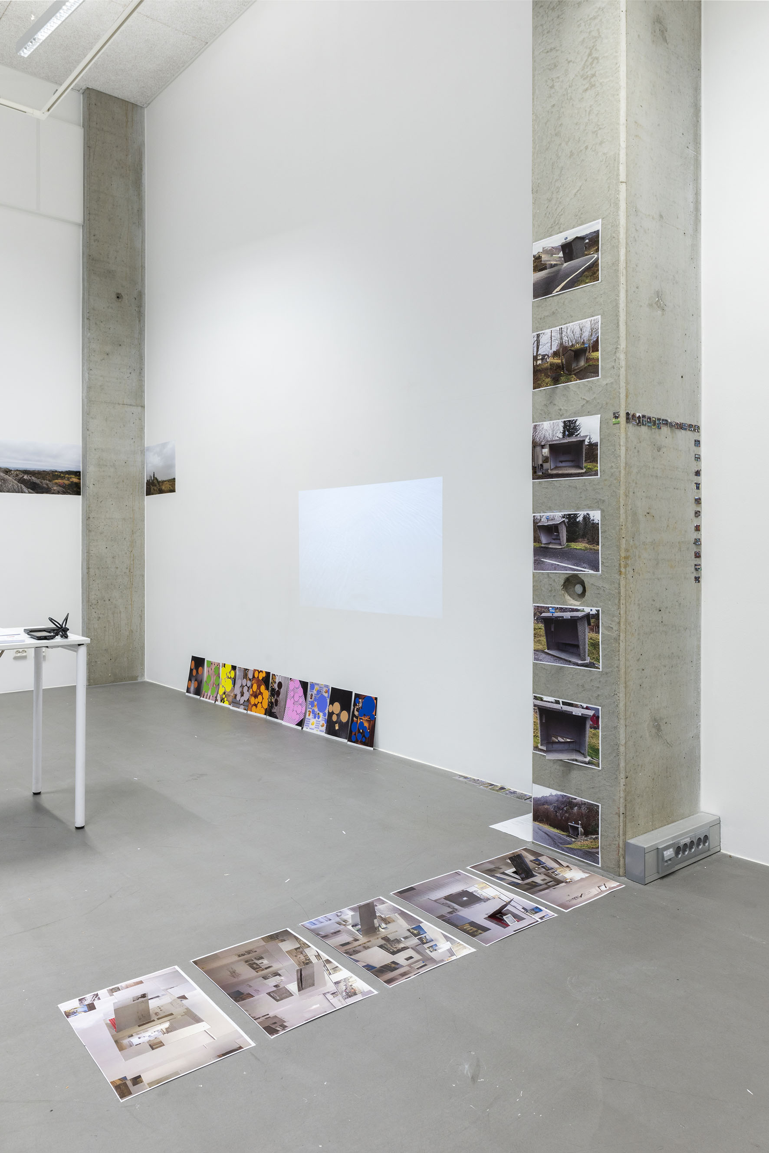

Slide 8
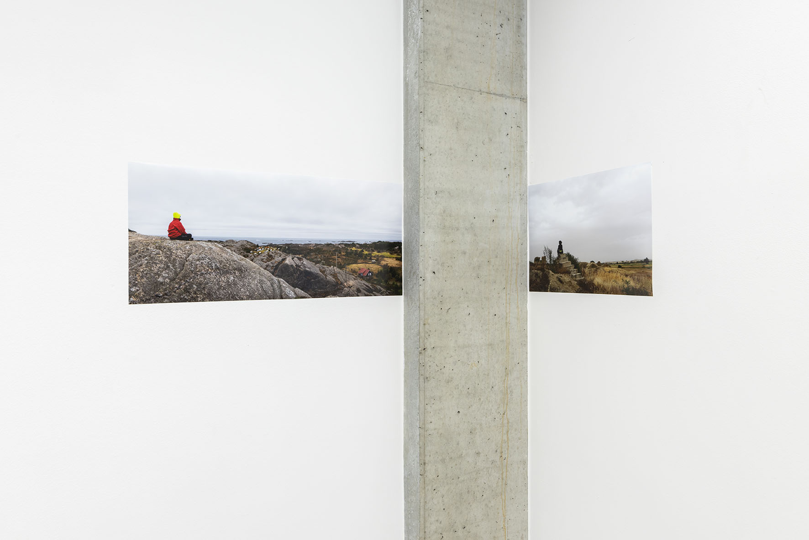

Slide 9
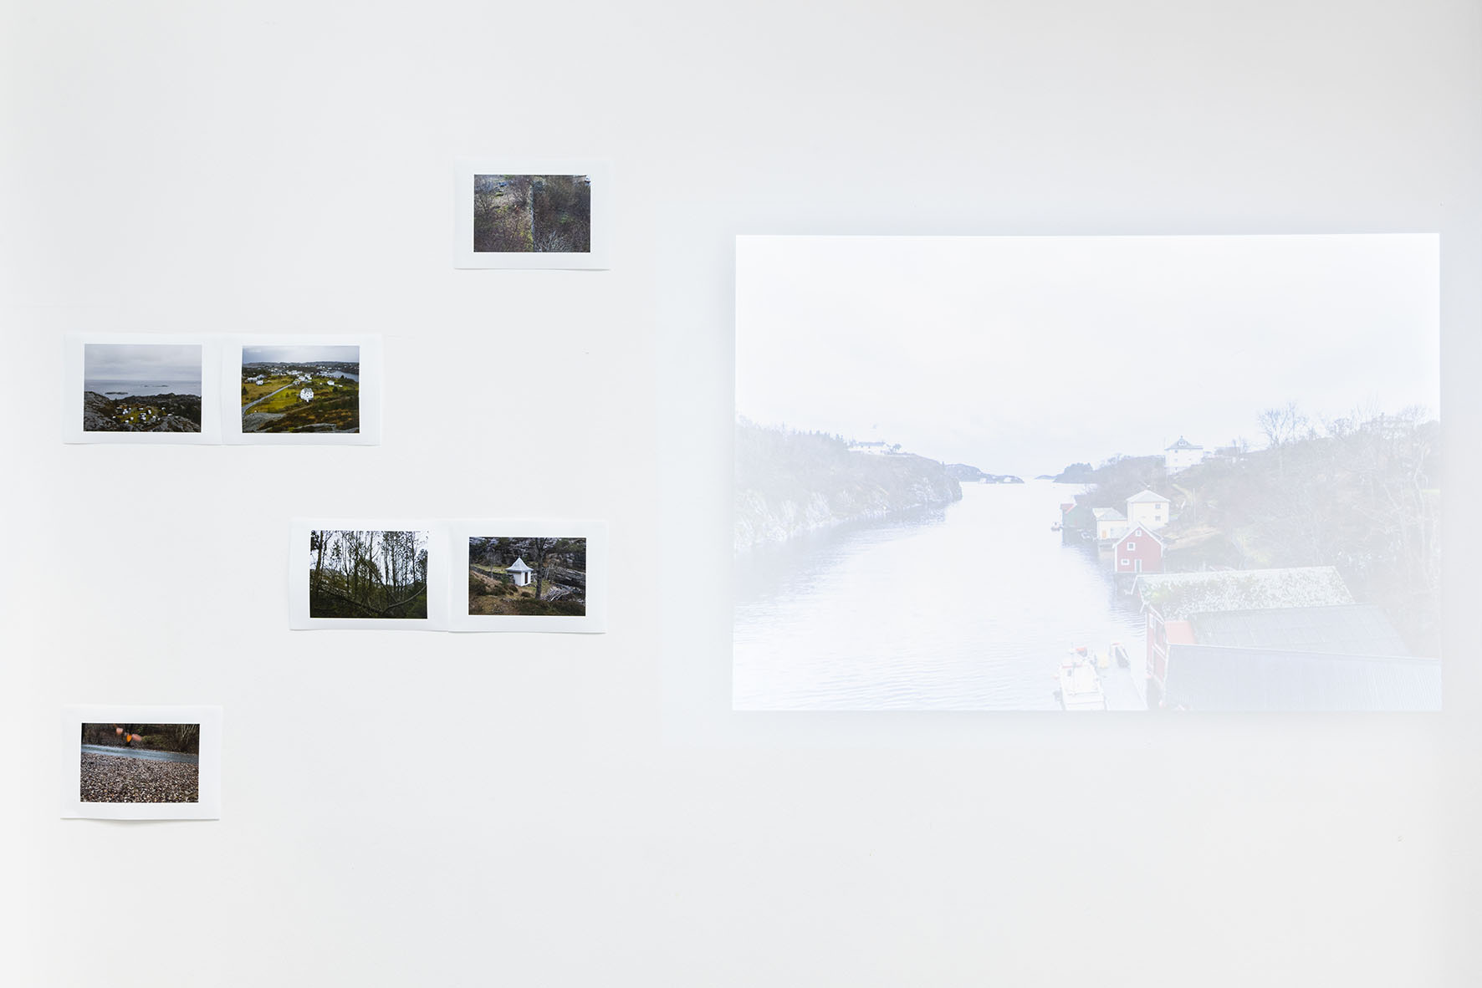

Slide 10
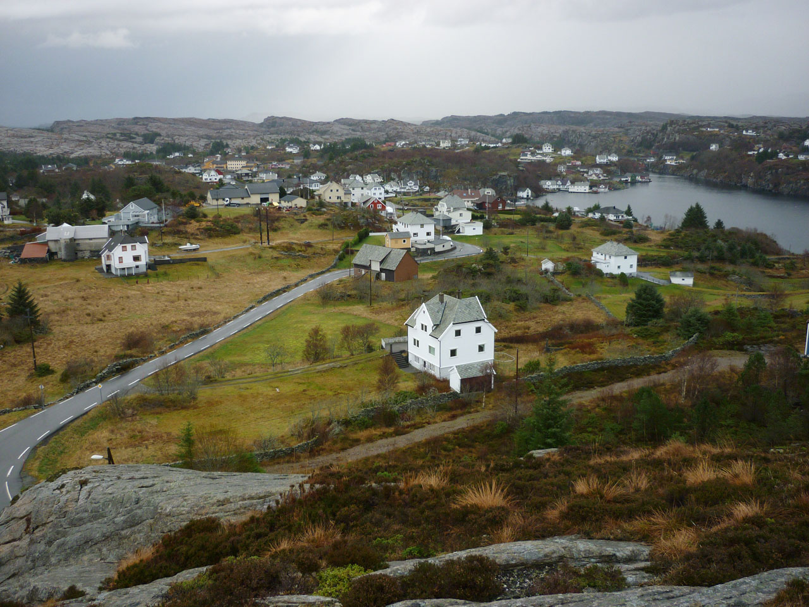

Slide 11
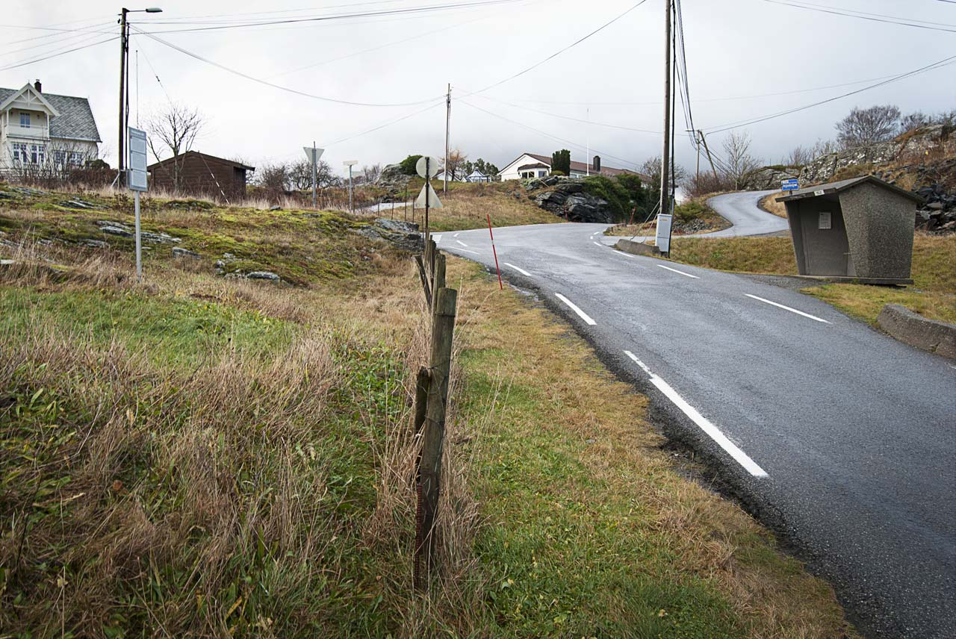

Slide 12
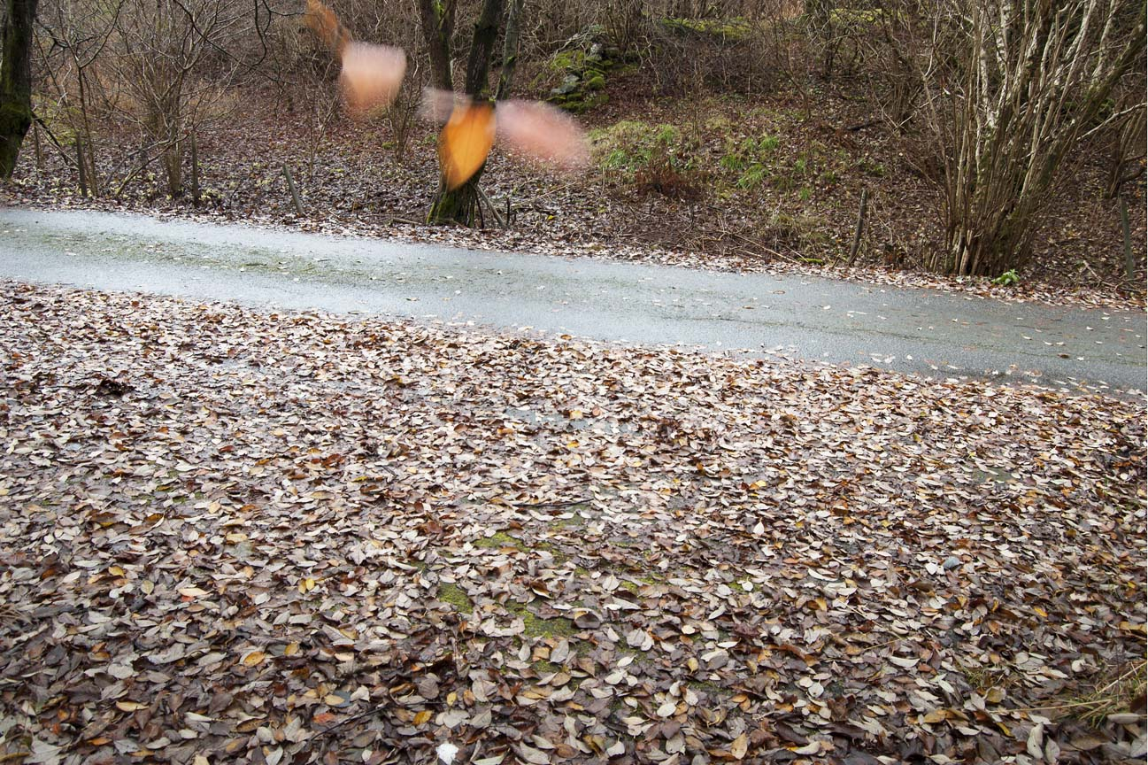

Slide 13


Slide 14
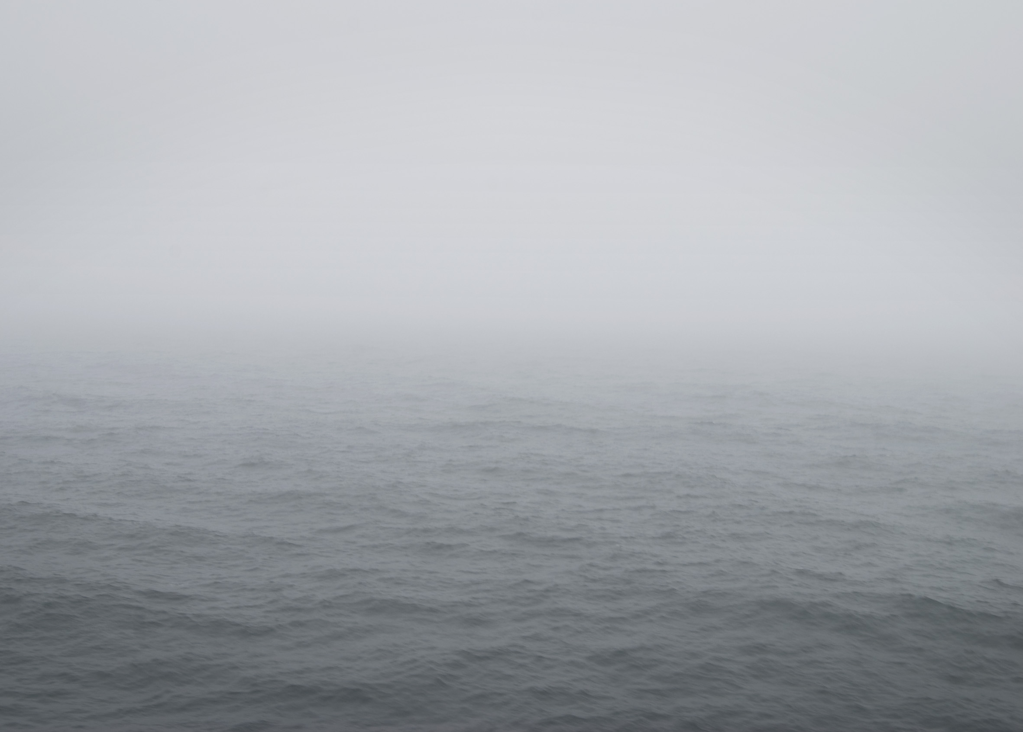

Slide 15


Slide 16
In relation to the conceptual and physical properties of place, Miwon Kwon identifies the dialectic between “the authority of […] uncontaminated and pure idealistic spaces”, and “the materiality of the natural landscape or the impure and ordinary space of the everyday” (1) as real places. For the geographer Tim Creswell, the study of place has become a ‘place’ in its own right where the dynamics of many disciplines are able to come into meaningful dialogue (2). Our interdisciplinary approach as artists is both: theoretical, focused on the aesthetics, cultural archaeology and representation of space and place; and practical, in the consideration of how such spaces might be represented and transformed through creative practices and cultural interaction. The research also acknowledges Gilles Deleuze’s analysis of Jean-François Lyotard’s proposition (3) that while a place may be defined by a knowledge base and/or language, it is also a figural space that prefigures imposed meanings (4), thereby constituting place as both a fixed and nomadic space. Consequently, as Nikos Papastergiadis asserts: “Art that has come from a place, and which refers to a place, must also acknowledge its own [state of] exile” (5) thereby allowing for a nuanced reflection upon the nature and meaning of place as both physical and abstract; This state of ‘exile’ offers opportunities to devise innovative ways of approaching creative practice in relation to ‘audience’ in specific cultural and political contexts.
(1) Kwon, Miwon, One Place After Another: Site-specific art and locational identity, MIT Press, 2004, 11.
(2) Cresswell, Tim, Place an Introduction (second edition), West Sussex: WILEY Blackwell, 2015, 1.
(3) Lyotard, Jean-François, Discourse, Figure, Antony Hudek, & Mary Lydon (trans), Minneapolis: University of Minneapolis Press, 2011.
(4) Deleuze, Gilles, Remarks (on Jean-François Lyotard), in: Desert Islands and Other Texts 1953-74, David Lapoujade (ed), Pasadena, Cal: Semiotext(e), 2004, 214-215.
(5) Papastergiadis, N, ‘Spatial Aesthetics: Art, Place and the Everyday’, Rivers Oram Press, 2005.

Slide 17
Subsequent iterations of the works developed as part of Nomadic Dialogue – Televåg, 2018

Slide 18
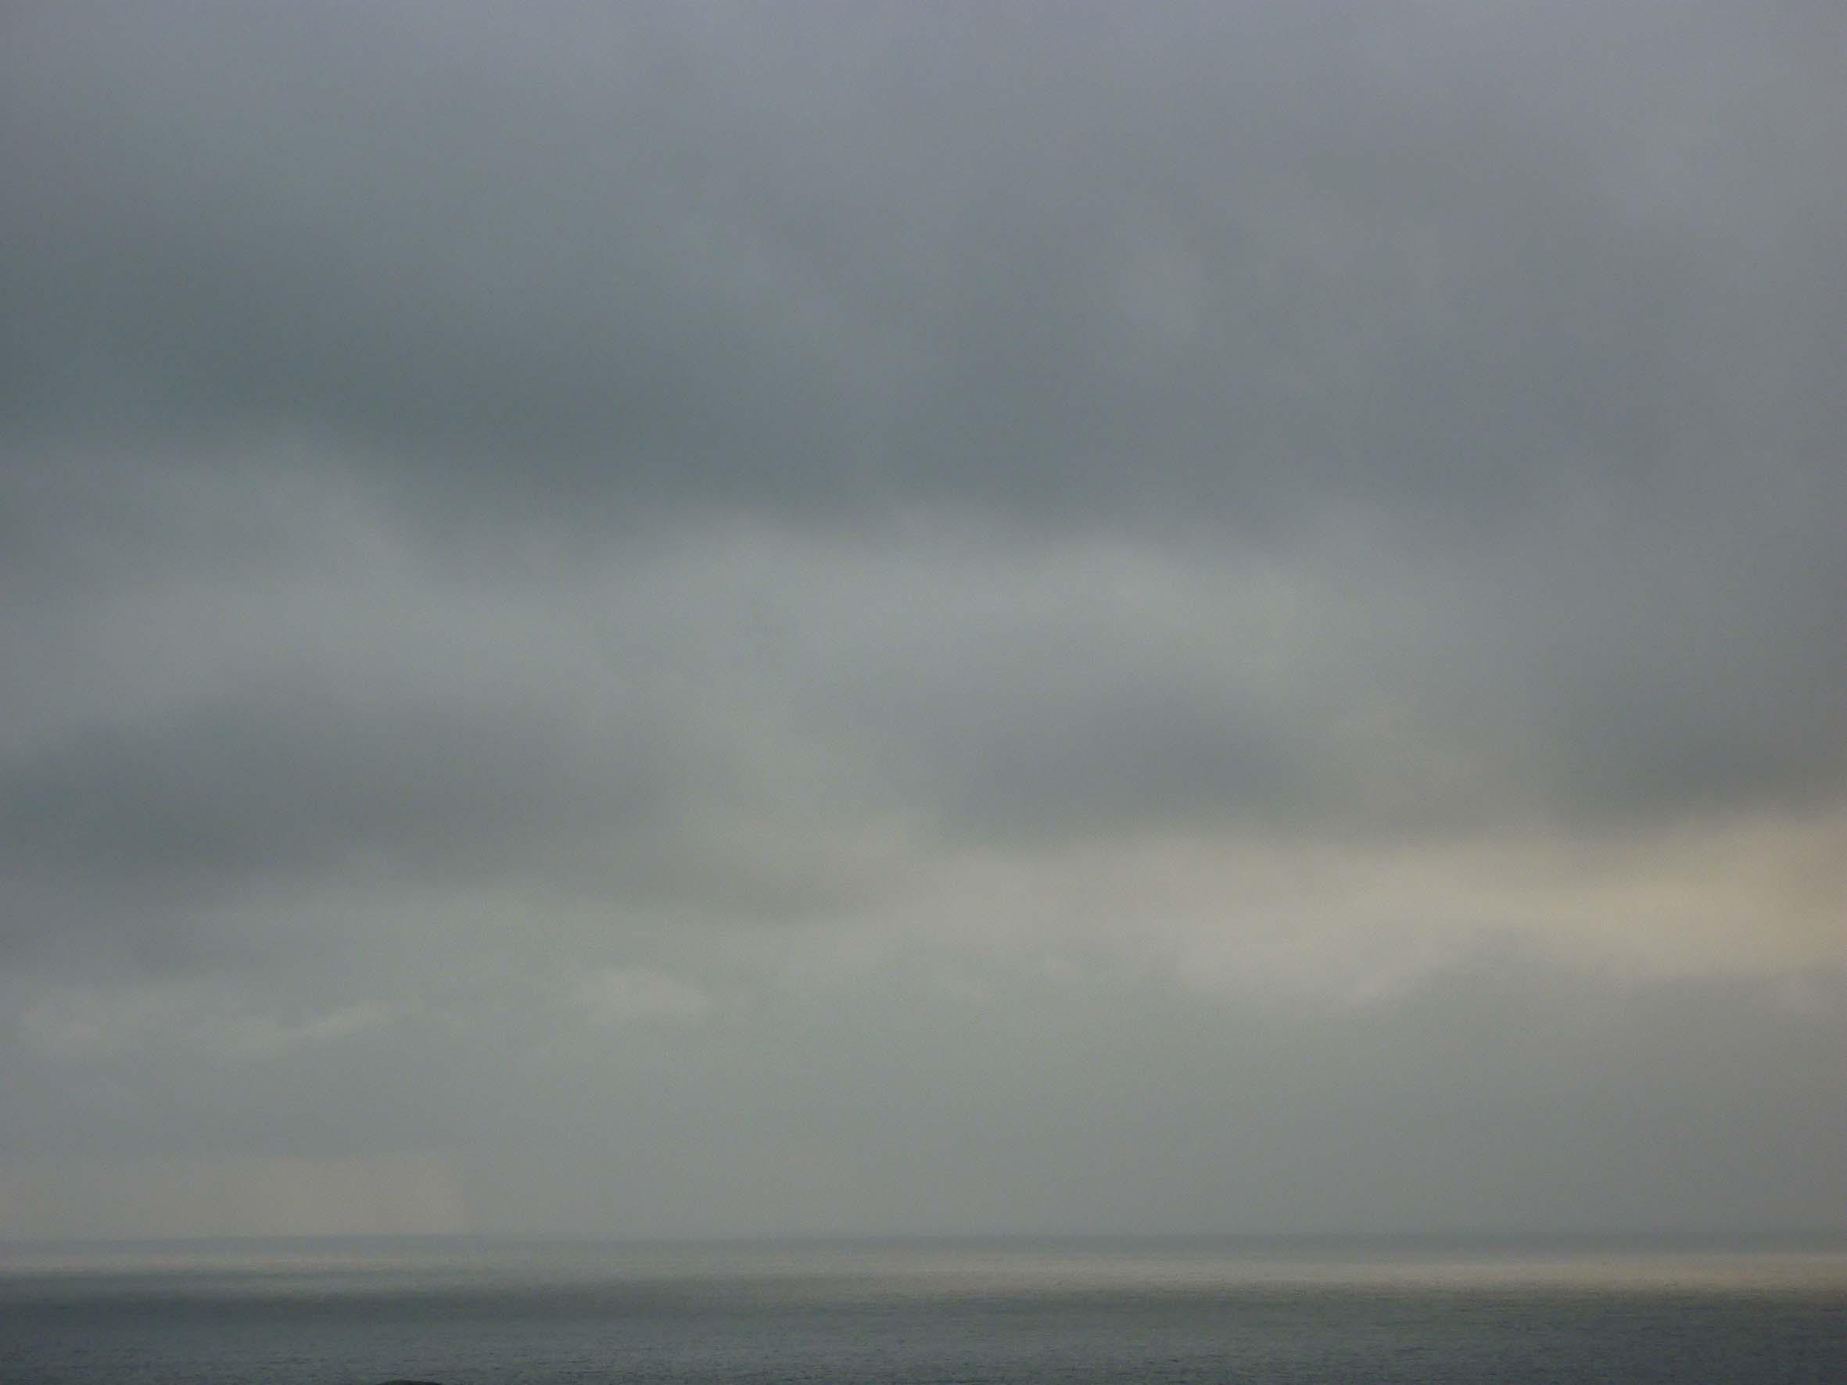

Slide 19
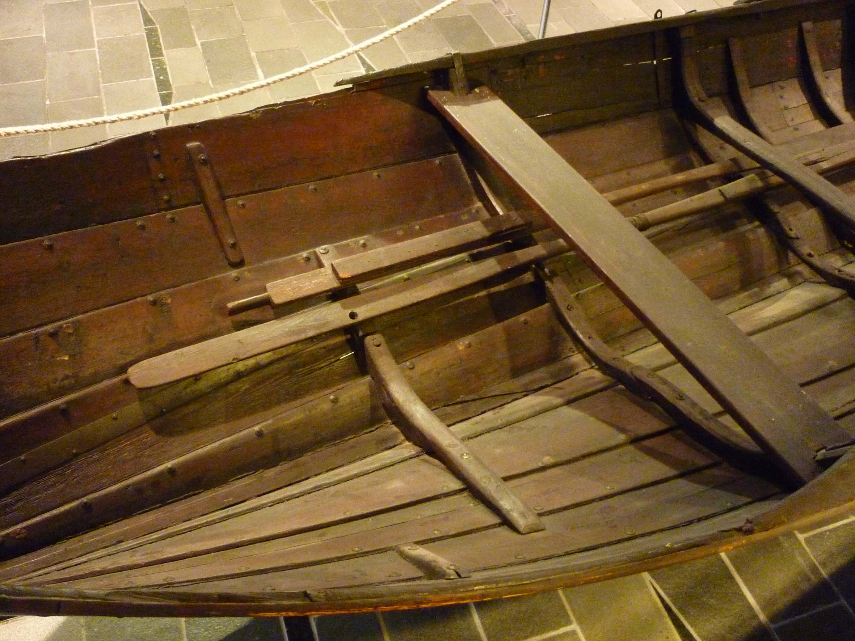

Slide 20
