Slide 1
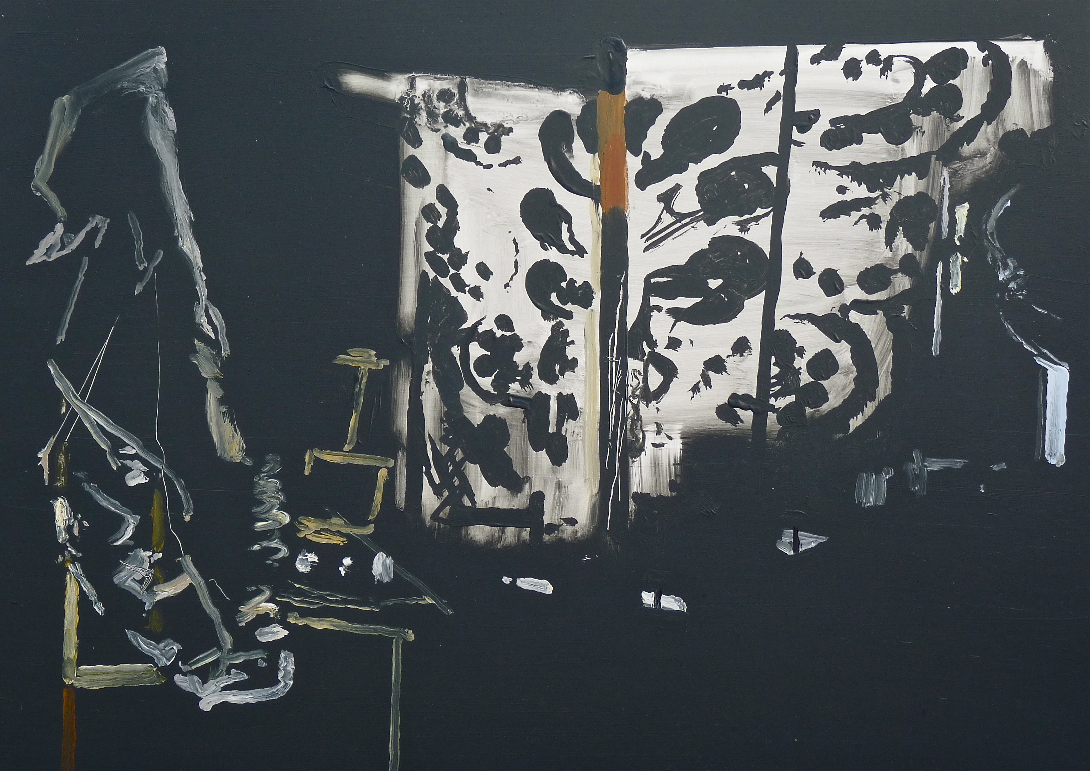
Research Output
My work over the last few years positions itself in relation to other art forms or methods of representation, tangentially to sculpture and installation; more specifically to photography, theatre and cinema. I use installations, akin to film or stage sets, dramatically lit, as subject matter for the work. I engage with paintings long history, with a particular interest in working from direct observation; but also explore how painting’s field can be expanded by engaging with technology, such as portable phones, digital photography, digital manipulation and data projectors.
Richard Walker
Title: Rose
Dimensions: 43 x 61cm
Medium: Oil on Board

Slide 2
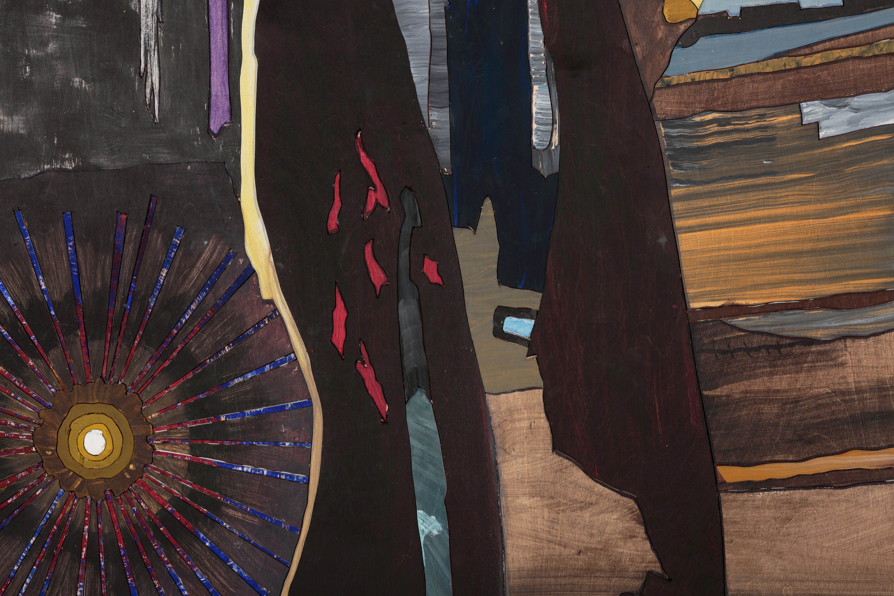
Context
The work of the last year continues this ongoing research, but explores it in fairly radical methods in terms of scale and process. It carries forward aspects of the speed and immediacy of the smaller work from life but has a more Classical approach in the initial stages. The initial stage is a drawing on plywood, which is then cut and painted.
Richard Walker
Title: Jones Underground (detail)
Medium: Pigment and Emulsion Medium on Plywood

Slide 3
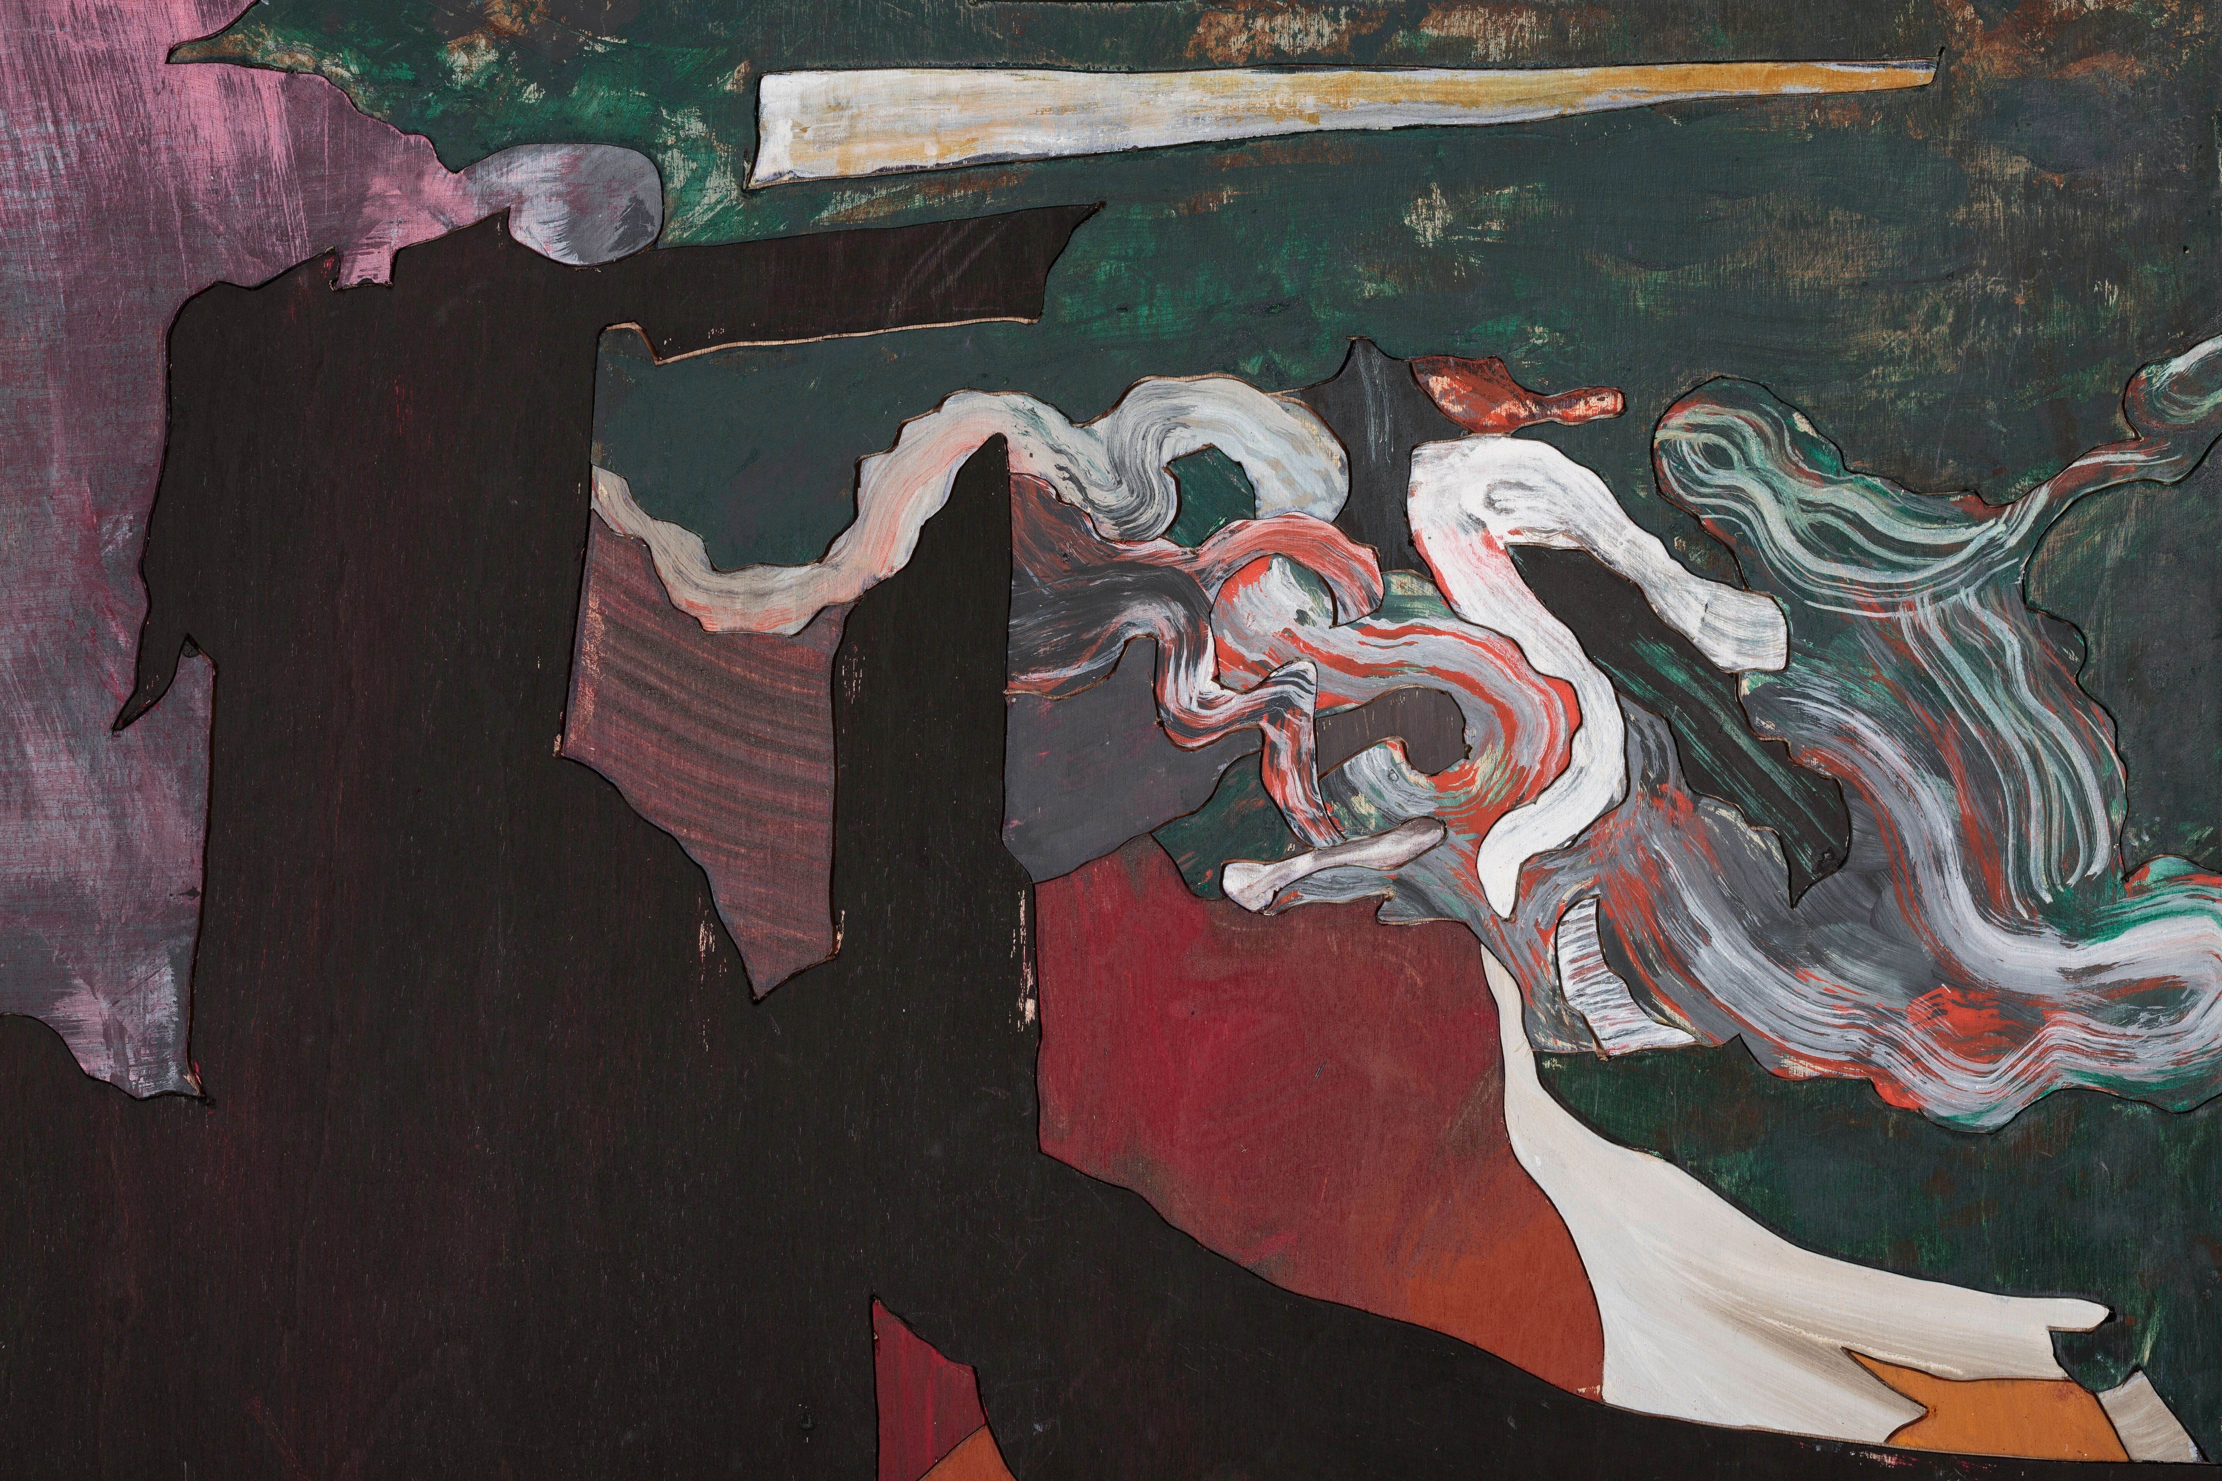
Research Output
The drawing is cut out with a jigsaw from single sheets of plywood. Once the boards are cut, the drawing/jigsaw pieces are reassembled and stuck down temporarily. Each plywood piece of the painting is painted separately, usually very quickly and intuitively but in reference to the original, then placed back in position. Once the painting is completed the pieces are glued down permanently on to the backing plywood board.
Richard Walker
Title: Jones Underground (detail)

Slide 4
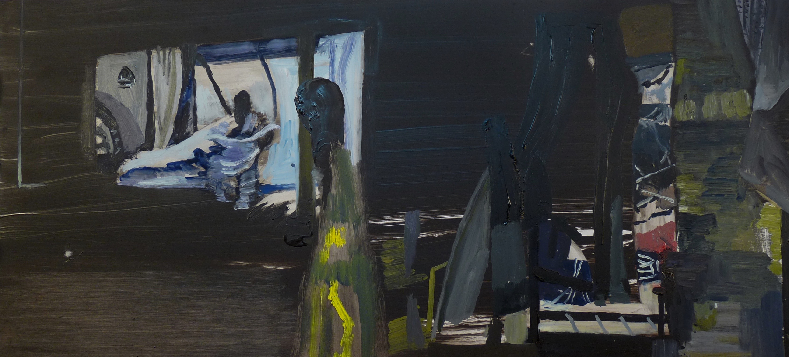
Context
The representation of light in painting is a key focus and this extends to the use of the projected photograph as light, rather than printed image. The images in my recent paintings often emerge from the darkness of the wet ground that I apply to the surface of the support. Darkness seems at the root of cinema, photography and theatre; the light proof box in which the images are formed and the movements performed, the dark chambers and rooms where films are made and shown and the spotlights that illuminate the stage. My work is also made in a light proof chamber, the blacked-out studio.
Richard Walker
Title: Scout
Dimensions: 31 x 85.5cm
Medium: Oil on Board

Slide 5
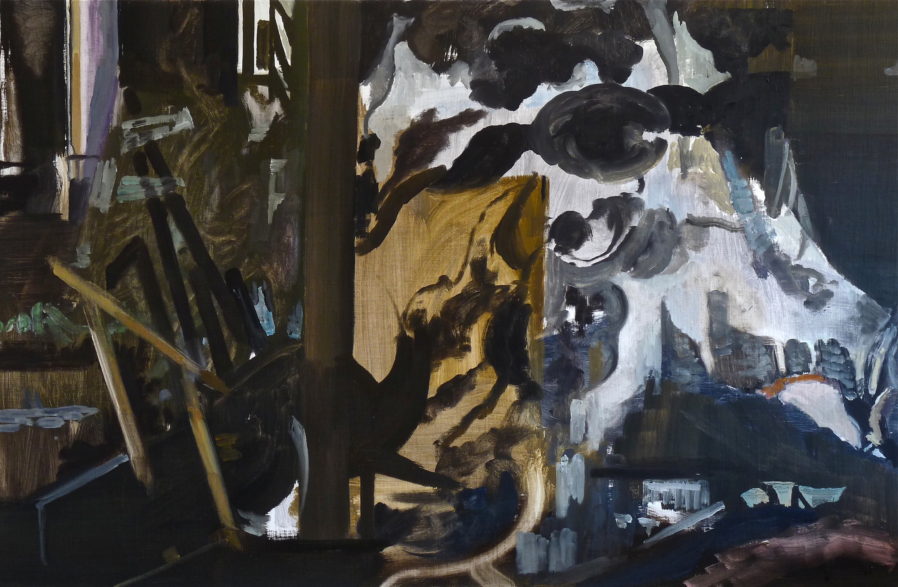
Context
The more recent research, Attic Goes Boom at the Iota Gallery, Studio Paintings at the Reid Gallery in 2014 and House Paintings at the Alexandre Gallery in New York 2012, explored the use of darkness as a subject, and how the viewer, given quite minimal clues, will invent what is not shown. The subject matter is more theatrical - tableaus or installations, lit by projections, and often suggesting figures or creatures.
Richard Walker
Title: The Uglies
Dimensions: 106 x 163cm
Medium: Oil on canvas on board

Slide 6
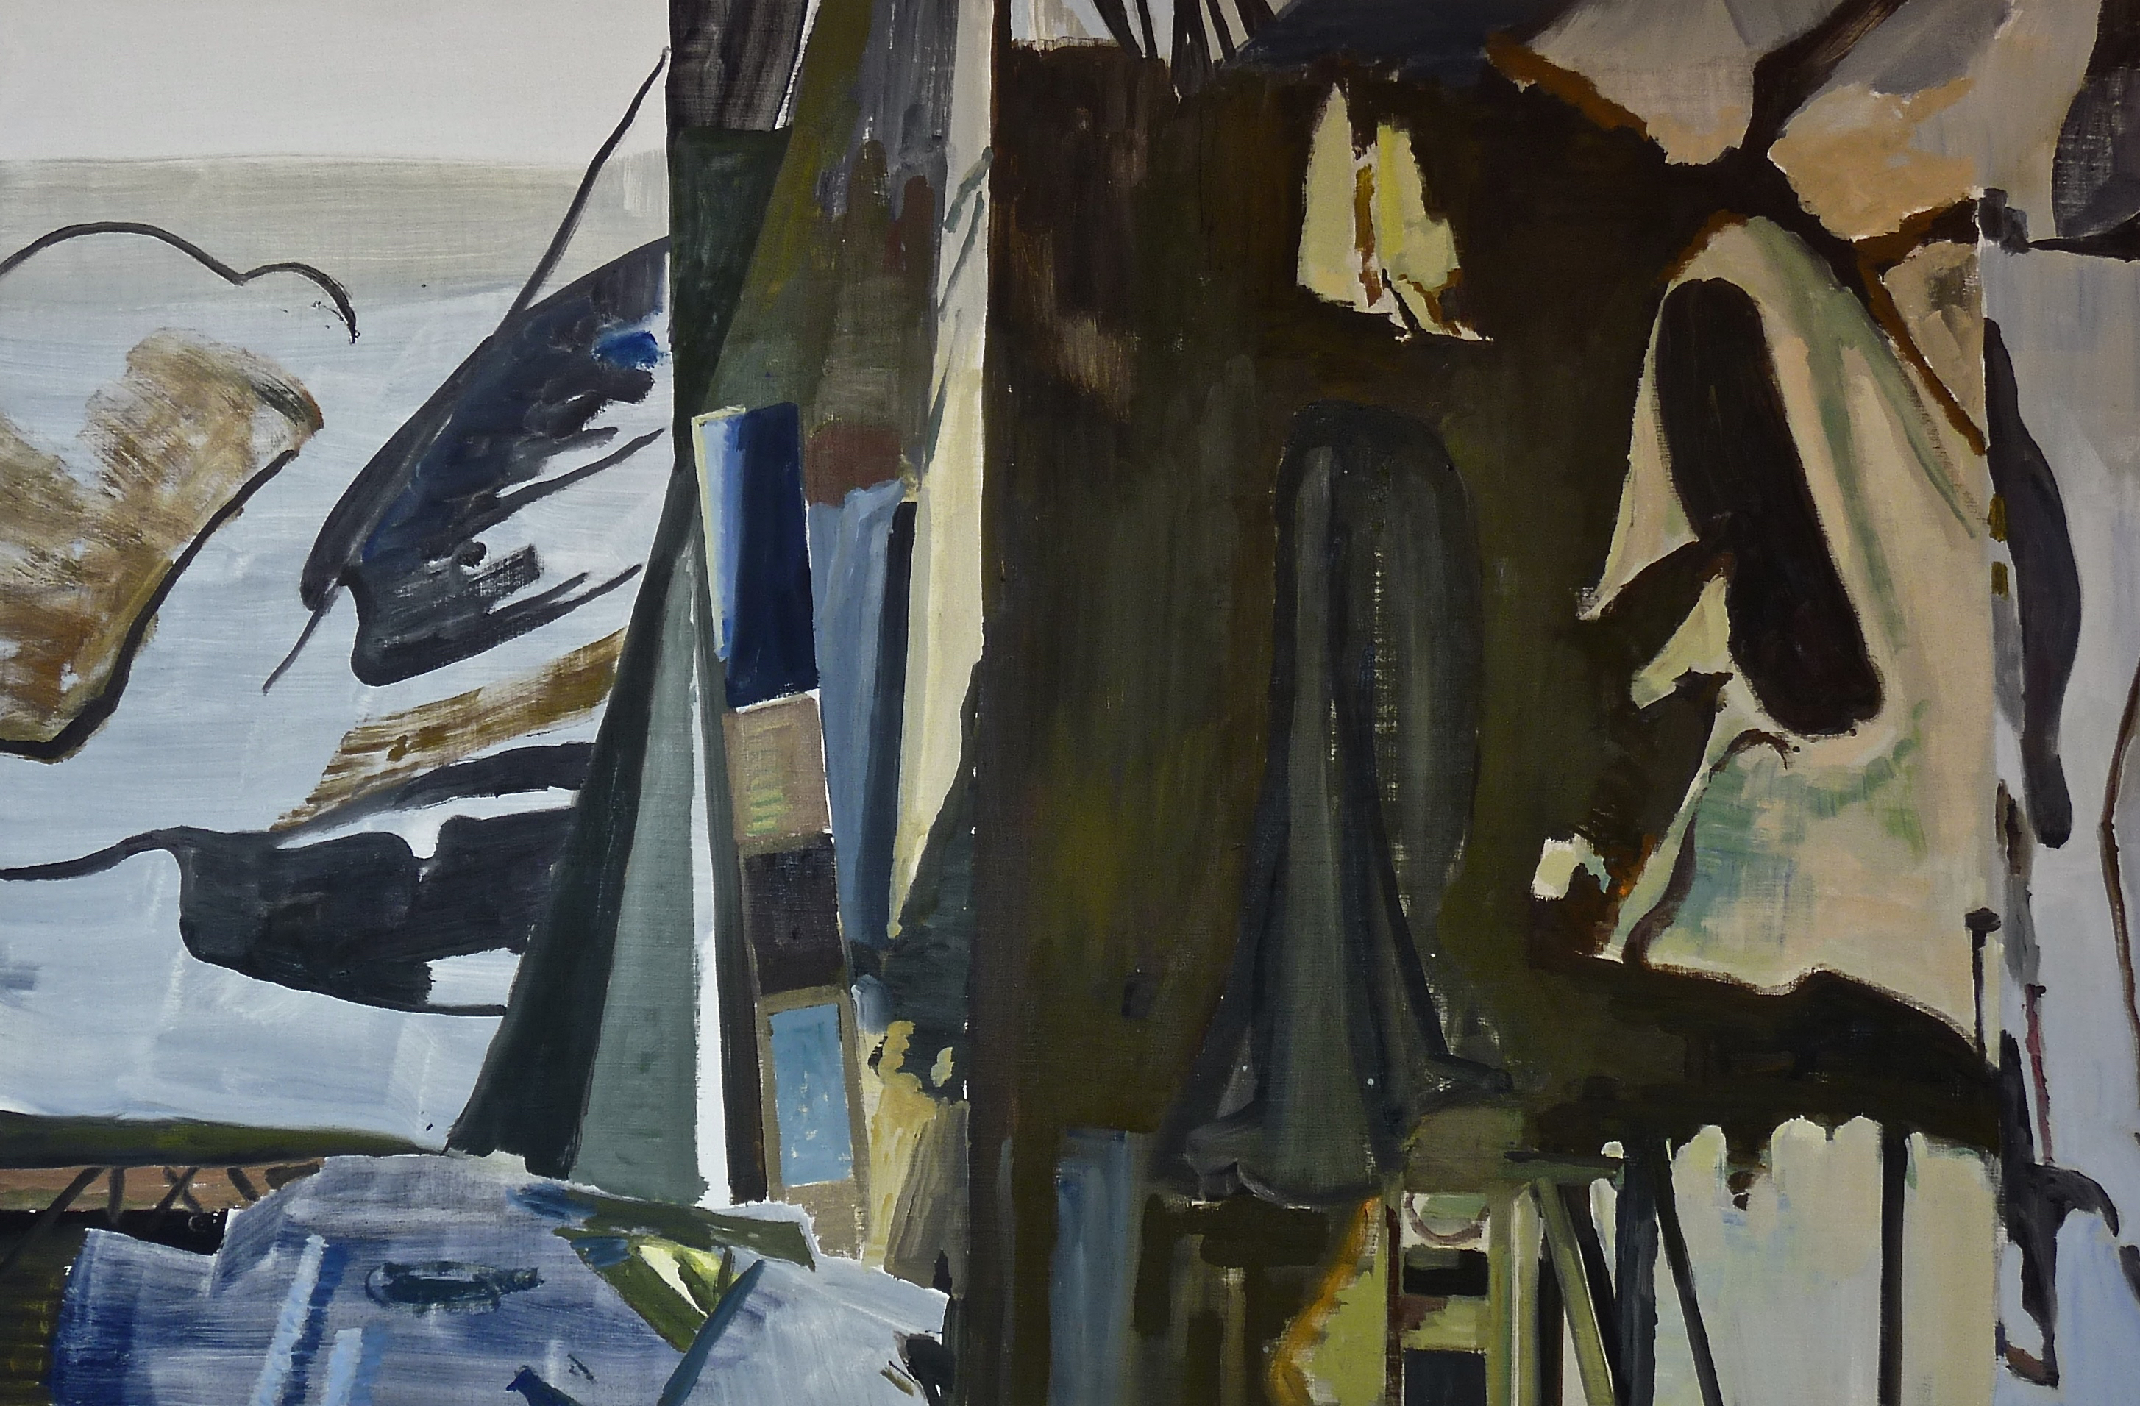
Context
The recent work to a large extent the recent work takes its inspiration from Japanese Ukiyo-e prints, particularly the triptychs of Kuniyoshi and Kunsida. In recent work I am also thinking much more about the relationship that the work has to music and in particular genres of music that embrace improvisation and wildness. The work has become more connected to that idea of invention within a given structure that you find in music of singers like Oum Kalthoum and Nusrat Fateh Ali Khan as well as some jazz music.
Richard Walker
Title: Lucks Up
Dimensions: 108 x 164cm
Medium: Oil on canvas on board

Slide 7
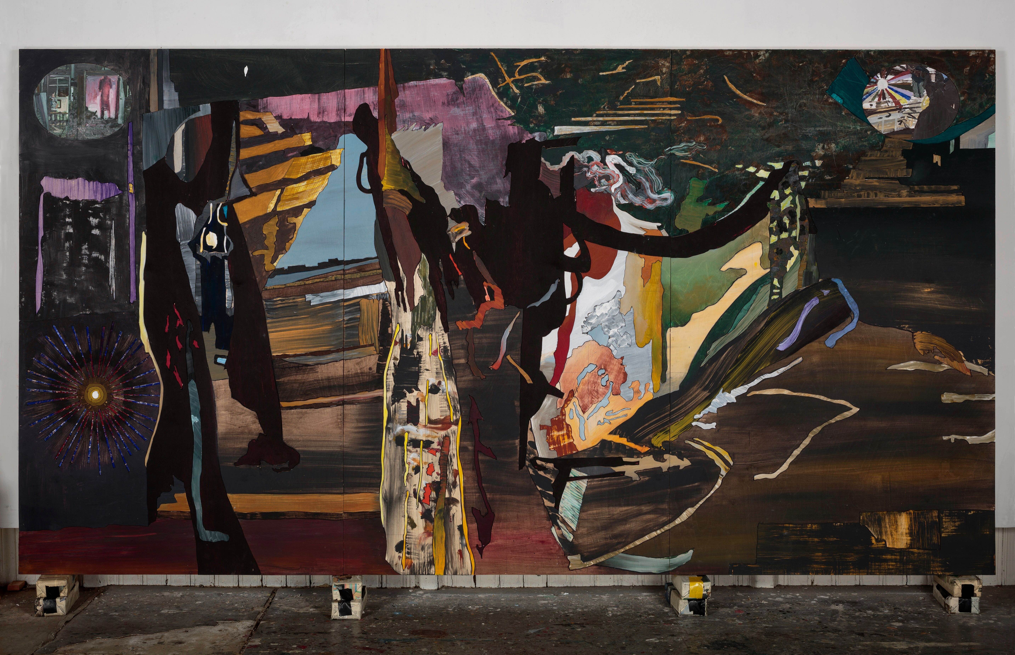
Question
The new large work (dimensions are 198 x 366cm), opens up a new aspect of my practice, which deals with physical scale. I am exploring the transition that is required, from the smaller works to the larger one on which the large one is based, trying to maintain the immediacy, initial energy, speed and spontaneity that comes from the practice of working “from life”. The larger work will open up a new aspect of the image, helping me to further consider the visual reception of the work in terms of non-photographic vision; binocular and peripheral, mark making and facture as well as colour and composition.
Richard Walker
Title: Jones Underground
Dimensions: 198 x 366 cm
Medium: Pigment and Emulsion Medium on Plywood

Slide 8
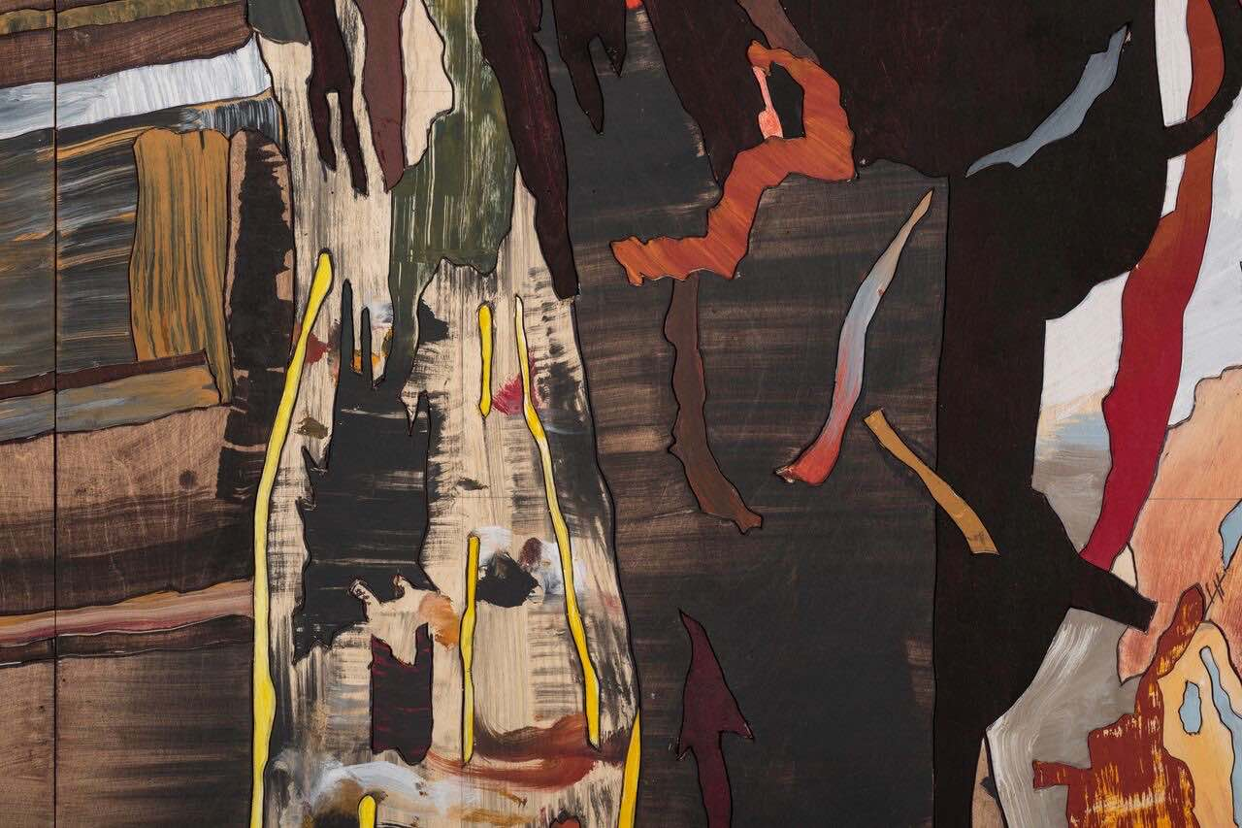
Context
The work has become more connected to that idea of invention within a given structure, (the structure given by the drawing and cut plywood pieces of the painting), that you find in singers like Oum Kalthoum and Nusrat Fateh Ali Khan as well as some jazz music.
Richard Walker
Title: Jones Underground (detail)

Slide 9
Methodology
The work from last year continues ongoing research, but explores it in fairly radical methods in terms of scale and process. The initial drawing on three large plywood panels is based closely on a pre-existing painting, which is squared up and the image transferred. Drawn initially with charcoal and then the finished drawing is inked with a marker. Painted with pigment, bound with co-polymer emulsion glaze.
Richard Walker
Title: Jones Underground (detail)

Slide 10
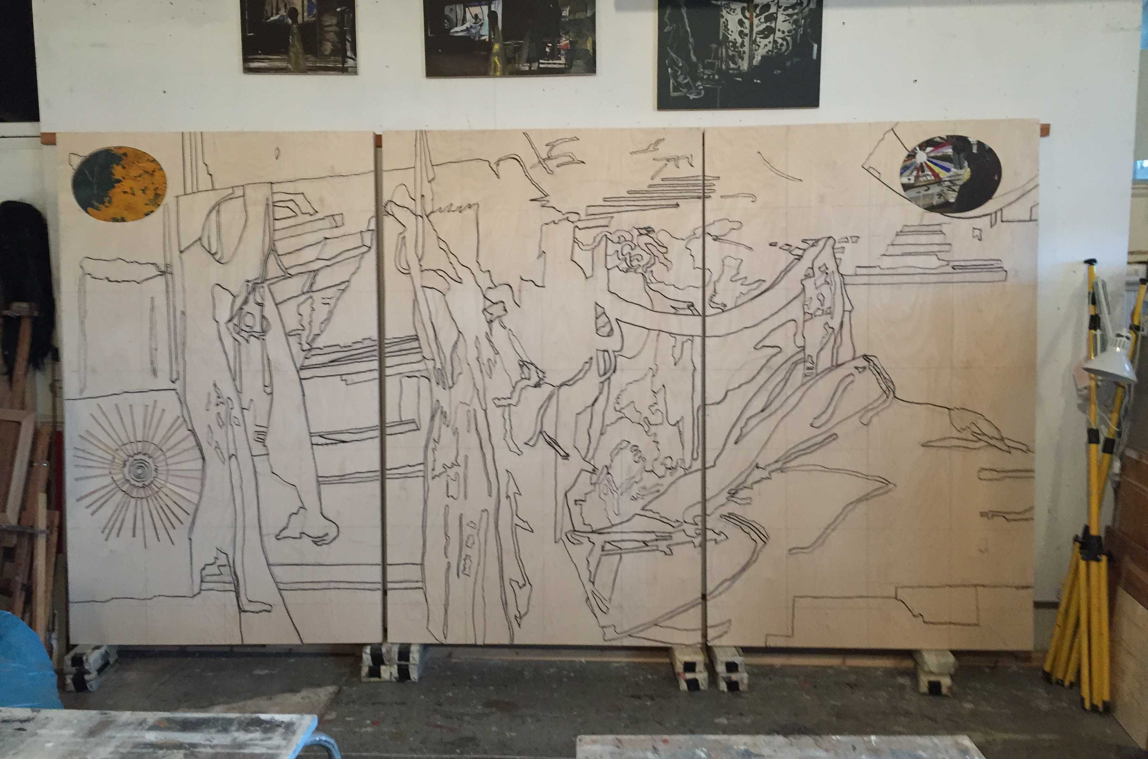
Methodology
The drawing is cut out with a jigsaw from single sheets of plywood. Once the boards are cut, the drawing/jigsaw pieces are reassembled and stuck down temporarily. Each plywood piece of the painting is painted separately, usually very quickly and intuitively but in reference to the original, then placed back in position. Once the painting is completed the pieces are glued down permanently on to the backing plywood board.
Richard walker
Title: Jones Underground (drawing stage)
Dimensions: 198 x 366cm

Slide 11
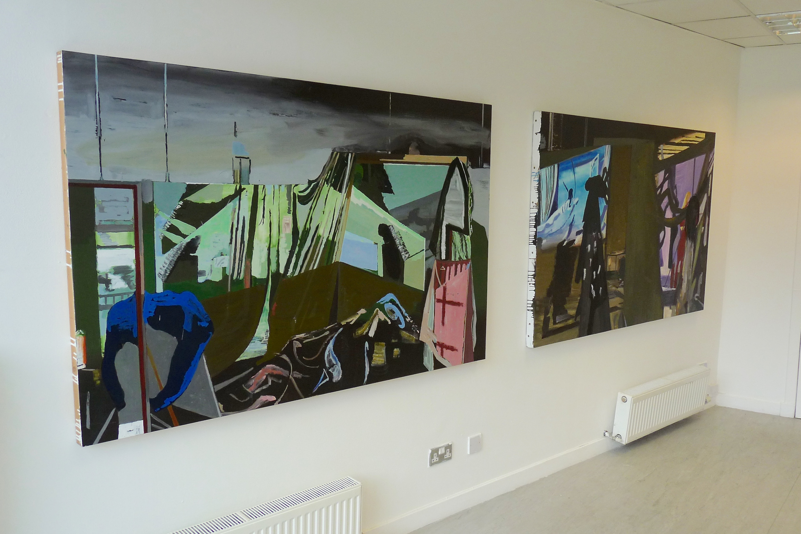
Dissemination
The exhibition Attic Goes Boom was a solo show of 10 paintings. I gave a public talk about the recent work, in the gallery on the 3rd April 2018. The studio, or workshop, has been a consistent motif of my paintings for the last two decades, the recent work is based on complex studio installations and digital projections. They are usually painted directly in front of the subject and the specifics of composition, the description of space and particularities of light and colour are important concerns.
Richard Walker
Installation shot from the exhibition Attic Goes Boom, at the Iota Gallery, Glasgow March/April 2018.

