Slide 1
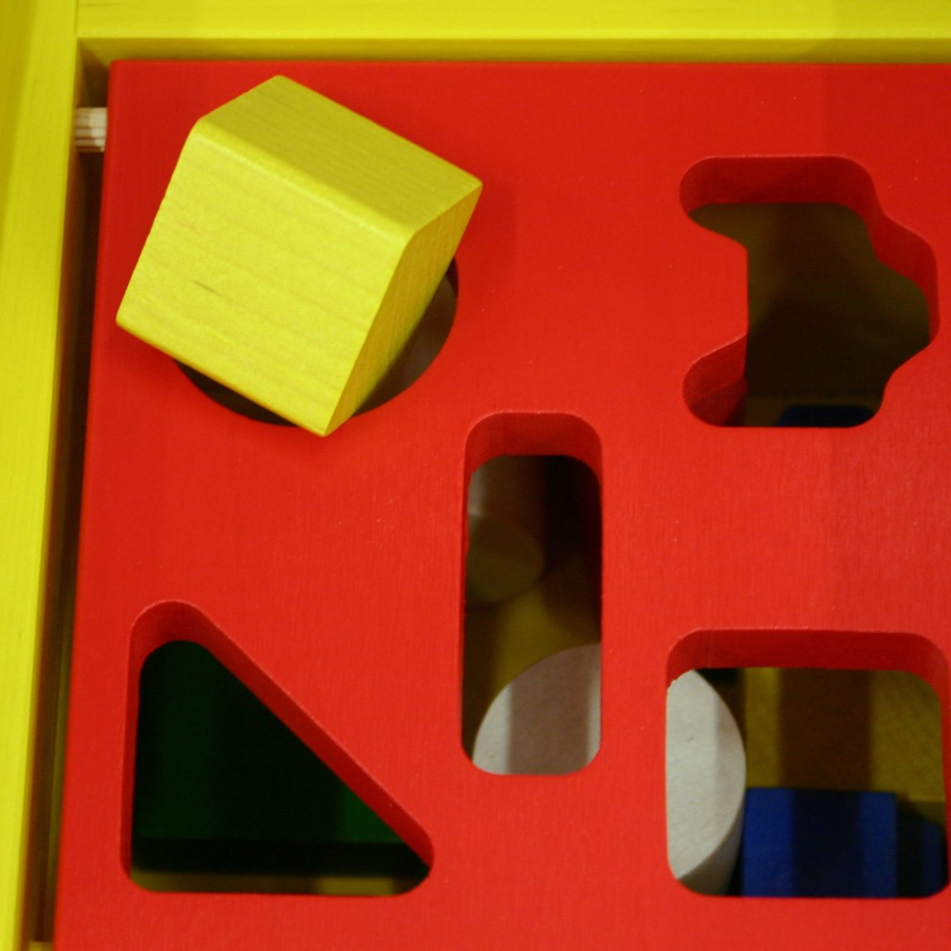
Square pegs, round holes: how do we make repositories work for arts research?
Dawn Pike
Nicola Siminson
The Glasgow School of Art
Notes:
Hello everyone, I’m Nicola and this is my colleague Dawn. As repository managers, we are aware of the need not only for open science, but also for open art and design!
This ‘rant’ addresses the needs of practice-based arts researchers, and their negative experiences of using repositories which were originally designed for researchers in science, technology, engineering and mathematics (or “STEM”) subjects. We think this rant will be of interest to repository developers, managers and users alike – whether you’re at a large institution, or a small specialist one – because everyone may be faced with the challenges of capturing and representing complex outputs effectively.

Slide 2
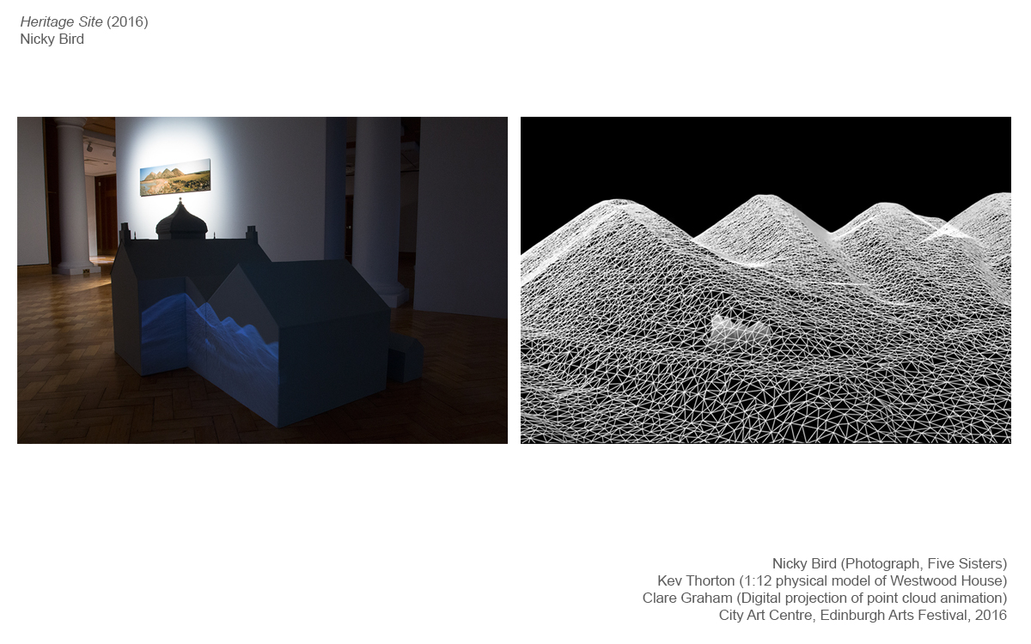
What do we mean by
“practice-based arts research”?
encompasses a range of disciplines, from fine and performing arts, to architecture and design; outputs tend to be in a non-text format
Example 1:
Nicky Bird et al: “Heritage Site, 2016”
Exhibition
http://radar.gsa.ac.uk/5088/
Notes:
We’re using the term “practice-based arts research” here, to encompass a range of disciplines, from fine art and performing arts, to architecture and design. Whilst some arts researchers do write journal articles, many outputs in these subjects tend to be in a non-text format.
Here are some examples from the Glasgow School of Art:
First we have Nicky Bird, a Fine Artist whose exhibition “Heritage Site” you can see here.

Slide 3
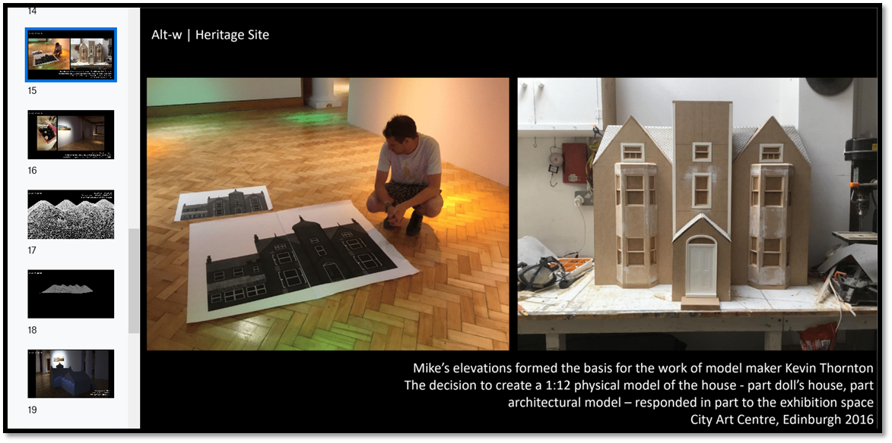
Nicky Bird: “Heritage Site, 2014 - 2016”
taken from Nicky’s website:
https://nickybird.com/projects/heritage-site-2014-2016/
Notes:
Here, you can see that this work was a collaboration between a range of different researchers and practitioners, from archaeology, to model making and visualisation.

Slide 4
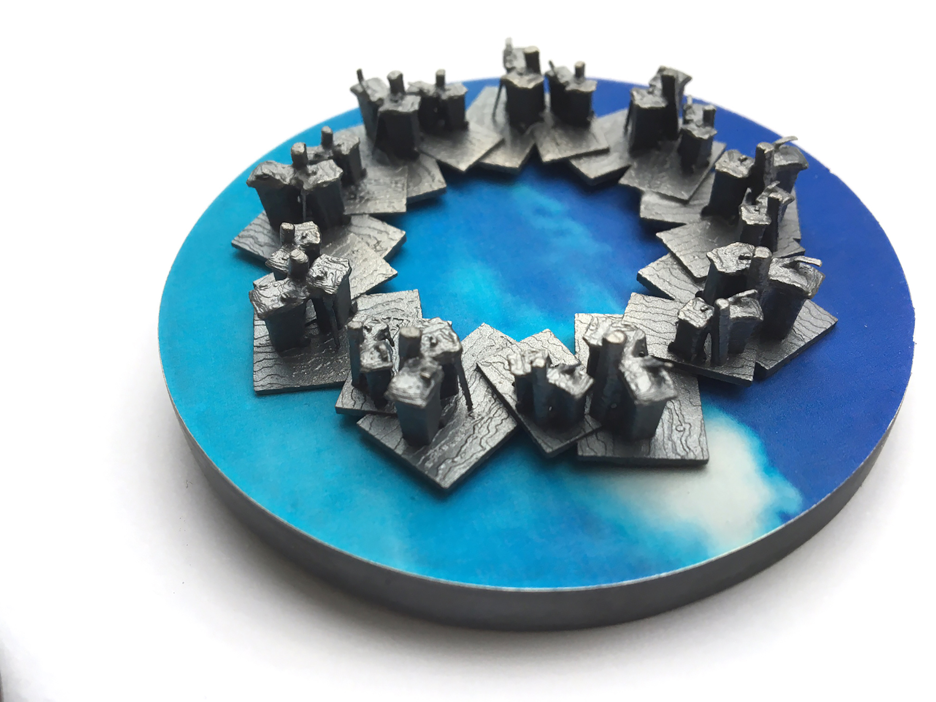
Jonathan Boyd: “Street Furniture”
Artefact
http://radar.gsa.ac.uk/5236/
Notes:
Our second example features Silversmith Jonathan Boyd, who uses 3D scanning to make sculptures from everyday objects from the streets of Glasgow.

Slide 5
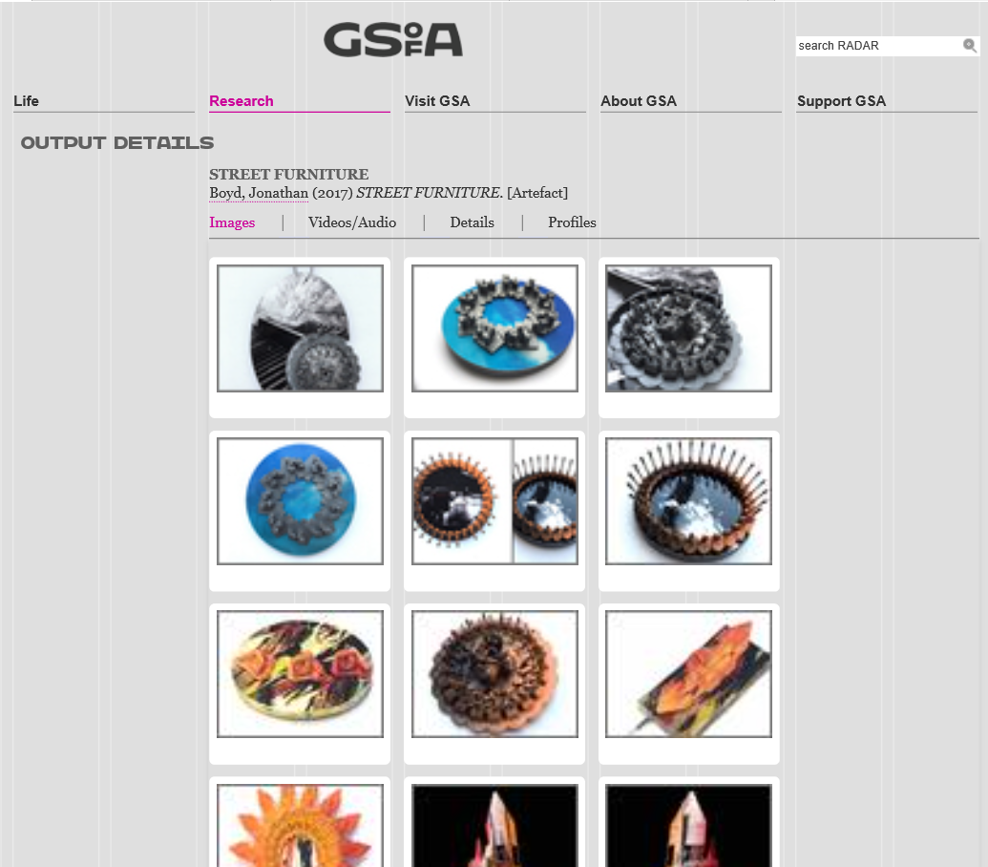
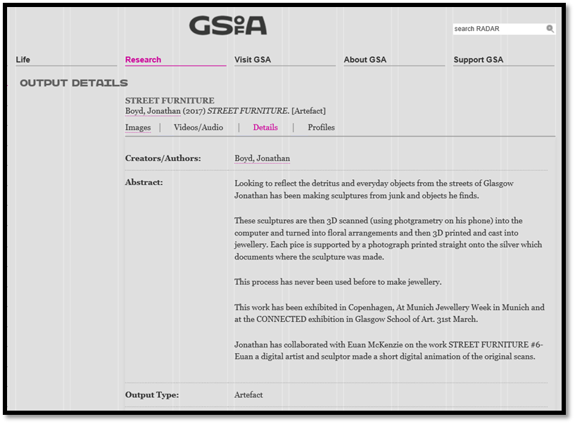
Notes:
This is how Jonathan’s work is currently represented in RADAR, the GSA’s research repository. Whilst we have these records in RADAR, they are only a snapshot of these outputs; the current repository infrastructure hampers users in experiencing these artefacts and exhibitions in the way the researchers intended.

Slide 6

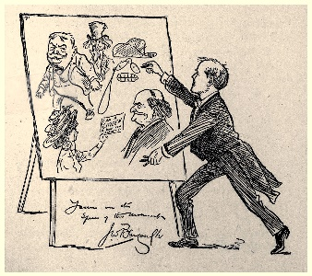
A strong bias towards the STEM perspective…
What does the term open science mean to you?
Lack of diversity in open access policies which tend to ignore the arts and humanities
Don’t forget the arts play an important role in building social cohesion and supporting wellbeing
The creative/cultural industries generate £250 billion
and create 29.5 million jobs a year!
Notes:
Where better to start this rant than with some alienating terminology! Just take a moment to consider what you think of when you hear ‘open science.’ Plan ‘S’ where the s can stand for Science (amongst other things) defines it as covering all research disciplines. But let’s be honest …researchers in art and design are unlikely to define their research as ‘science’ and ultimately this language will fail to resonate with them and leave them feeling alienated. In its response to Plan S DARIAH EU stated the plan showed a ‘strong bias towards the STEM perspective.’ However, this is not an isolated issue – there seems to be a real lack of diversity in open access policies which tend to forget about the arts. Yet we should remember that the arts play an important role in building social cohesion and supporting wellbeing. Given the figures on this slide – shouldn’t we be making more of an effort to make this research open access in repositories?

Slide 7
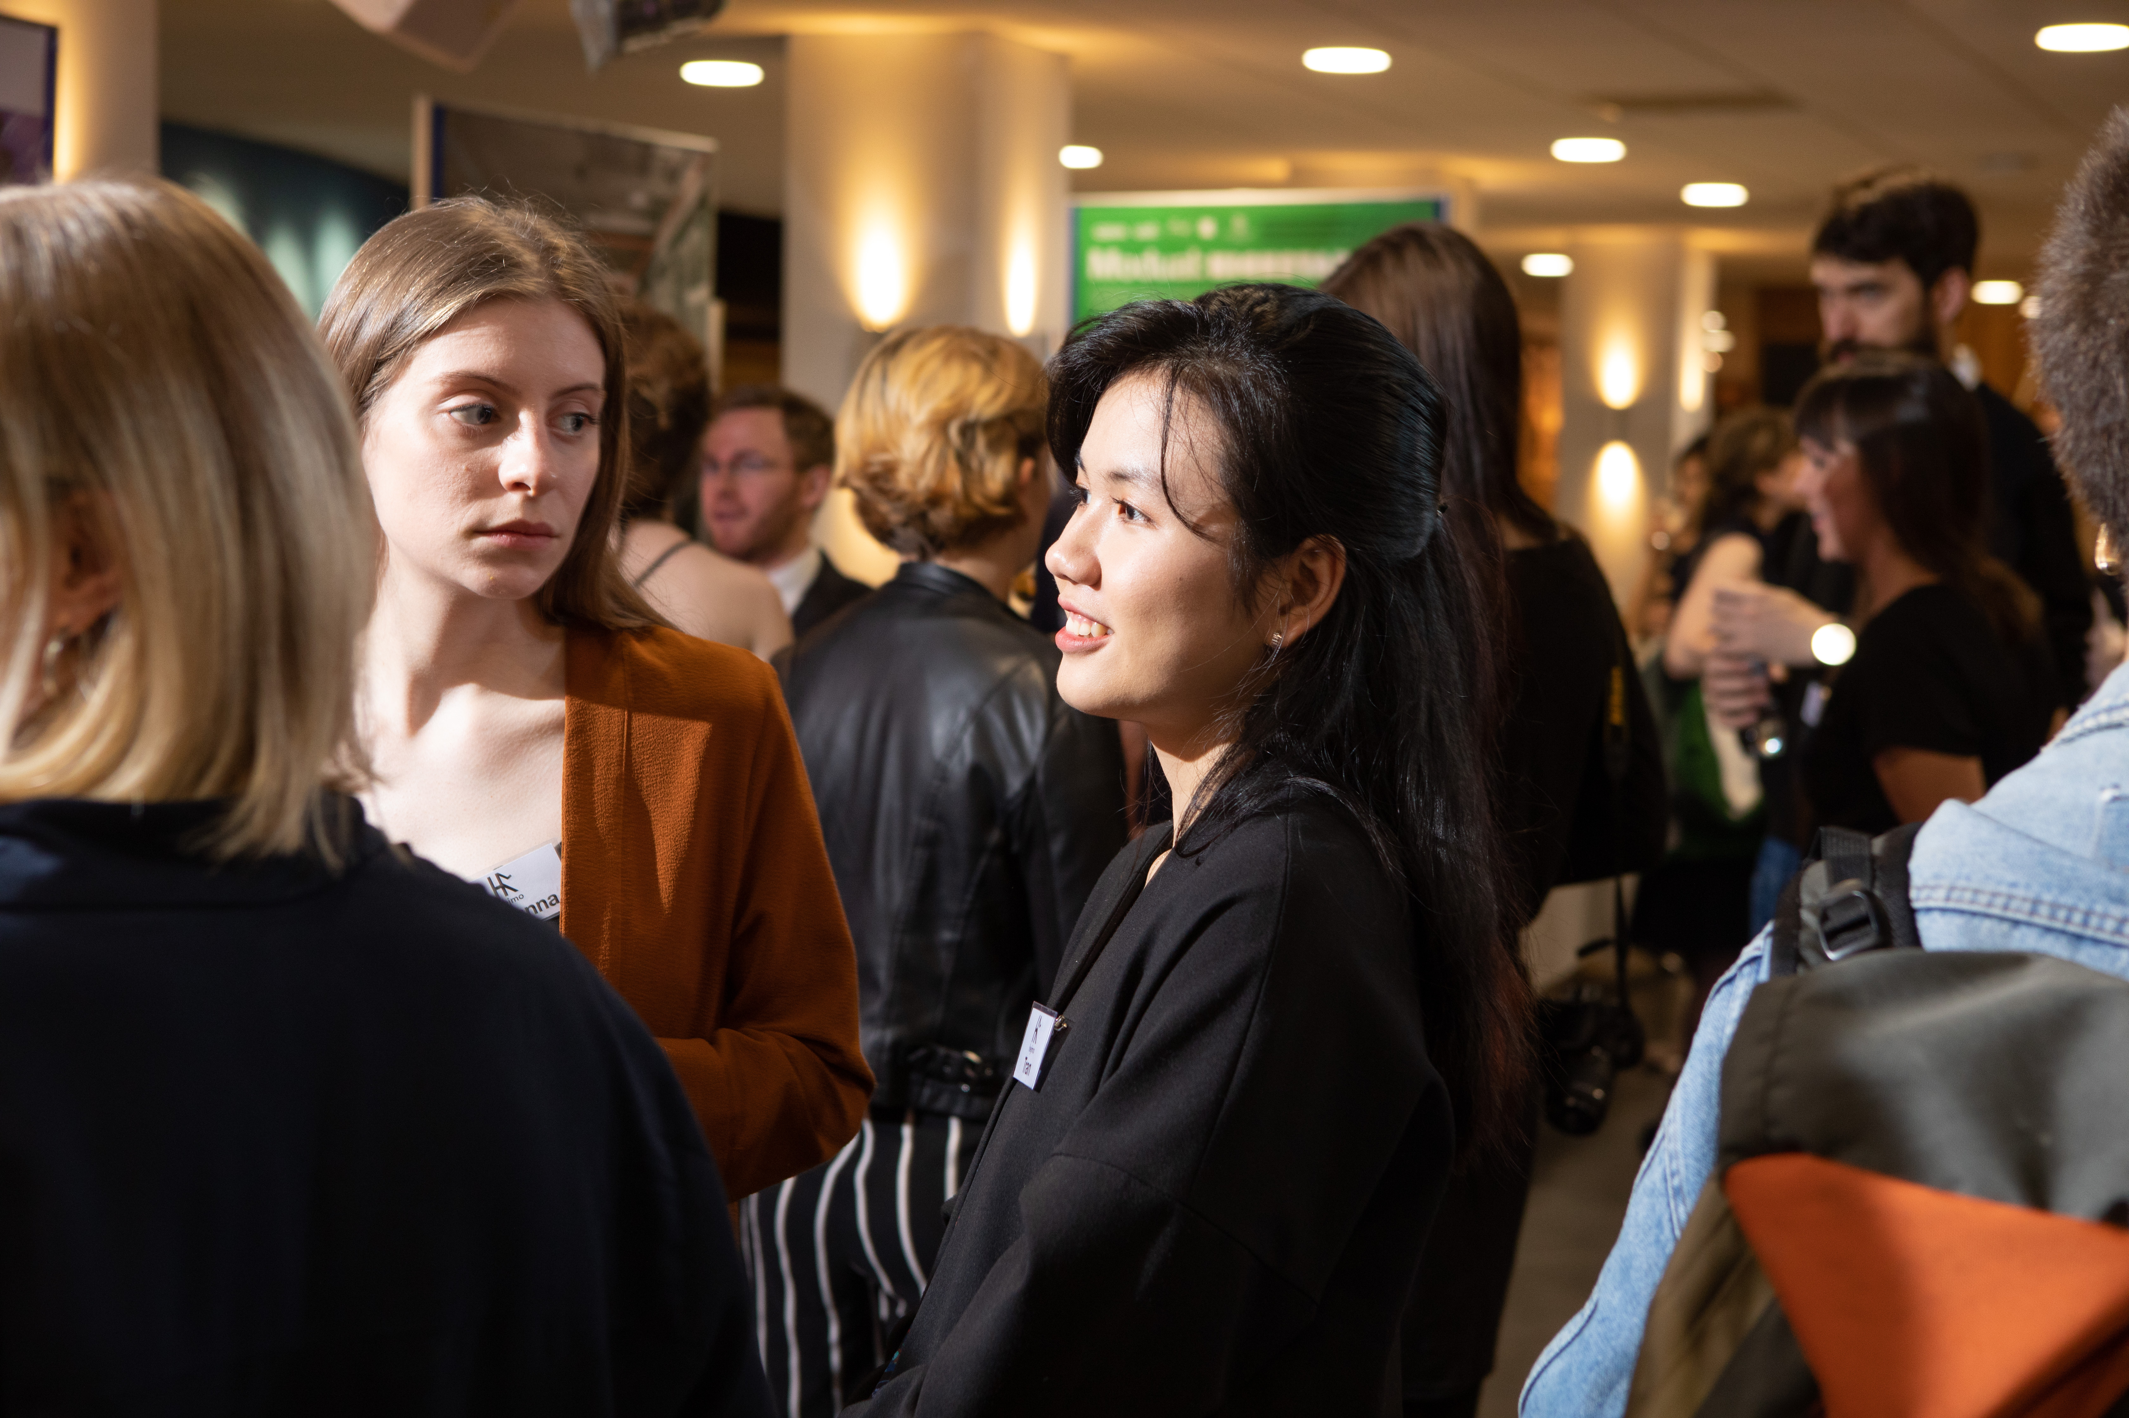
A problem shared is a problem… multiplied?
Notes:
Following discussions with colleagues at a Repository Fringe event in 2018, a range of barriers to capturing and representing arts outputs emerged. These issues were subsequently shared in a Google doc, which has continued to be updated by the repository community in the UK; this is clearly a topic of vital interest, and the same issues are consistently identified by a range of stakeholders across Higher Education. A follow-on event in March this year was attended by more than 80 arts researchers and repository managers – but we now need developers to be engaged, in order to move forward.

Slide 8
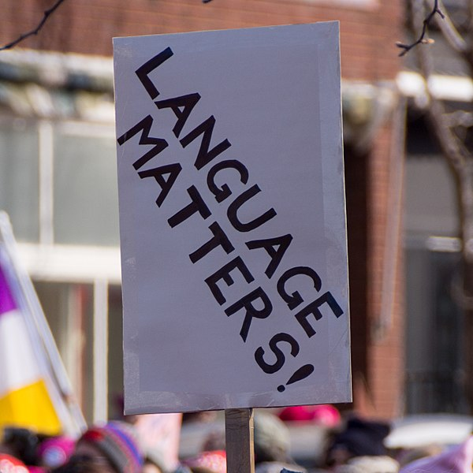
Metadata
Repositories are still not speaking the language of art and design
Describing complex non-text outputs in repositories can feel like putting a square peg in a round hole
Metadata fields cause significant barriers for practice based researchers. Previous projects that have worked on this area:
  KULTUR : http://kultur.eprints.org/
  Defiant Objects: https://defiantobjects.wordpress.com/
Notes:
So what are the issues?
Firstly, arts research is poorly served by existing metadata standards. When it comes to describing complex, non-text outputs in repositories, researchers can feel like they are trying to put a square peg in a round hole. The language used is tailored towards traditional publication routes, and so fields that ask a practice researcher when their artefact was ‘published’ or for its ‘abstract’ can lead to confusion. Trying to choose a suitable ‘output type’ for their work is another barrier and leads to an overuse of the ‘other’ item type. This can compound researchers’ feeling that the repository is not suited to their work and can result in a lack of engagement. Various UK projects such as Kultur and Defiant Objects have, in the past, tried to tackle the issue of metadata for arts outputs, but ultimately repositories are still not speaking the language of art and design. More is needed than workarounds to make these outputs ‘fit’ a metadata schema designed for STEM outputs.

Slide 9
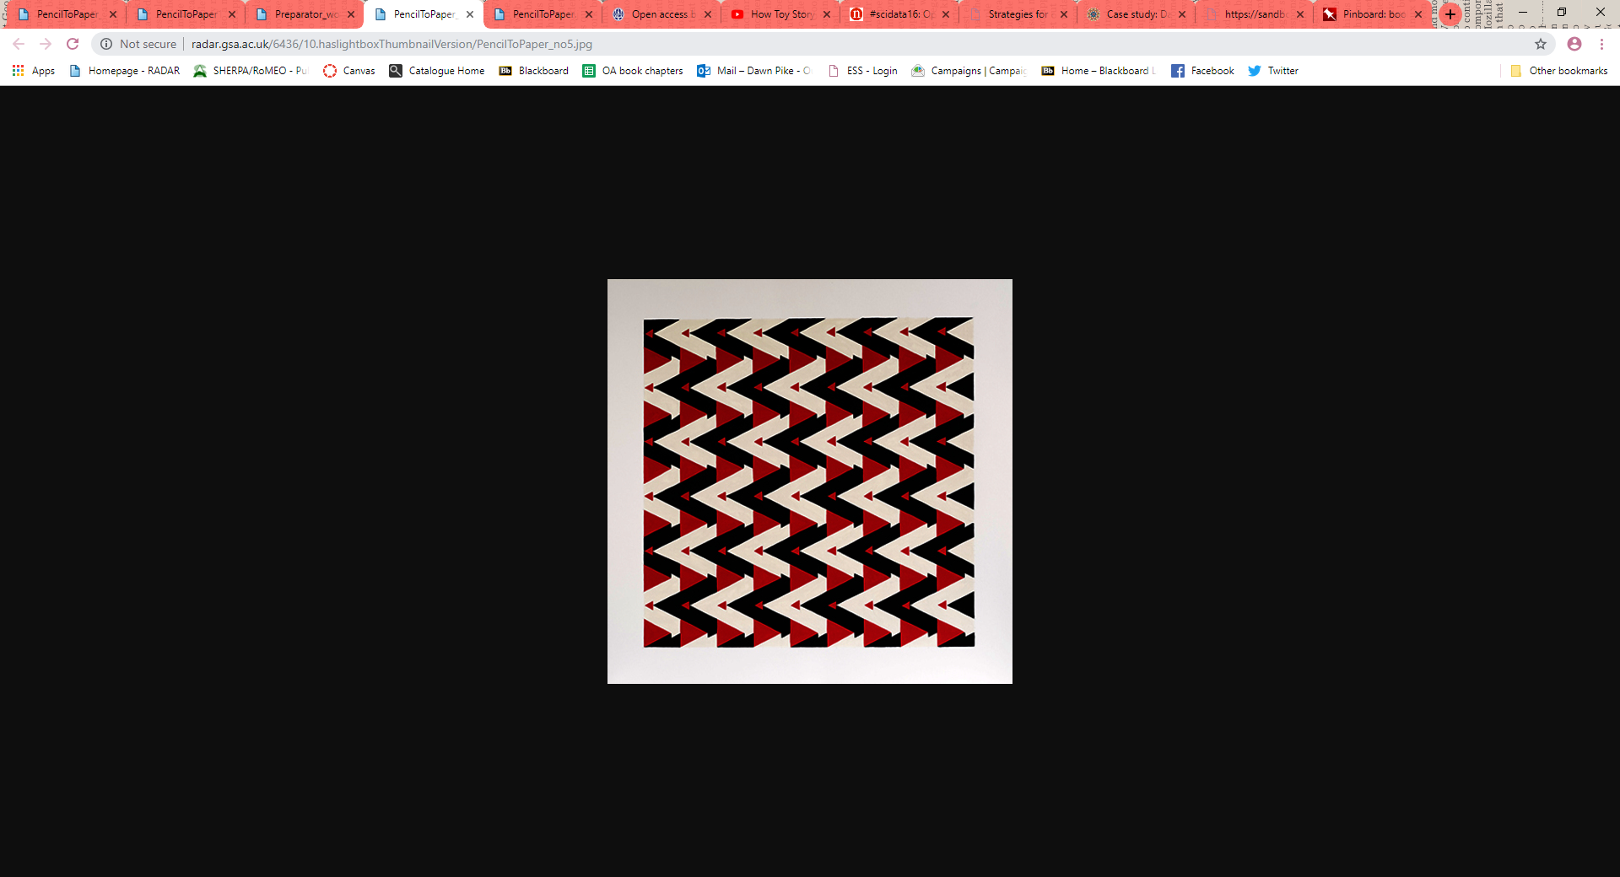
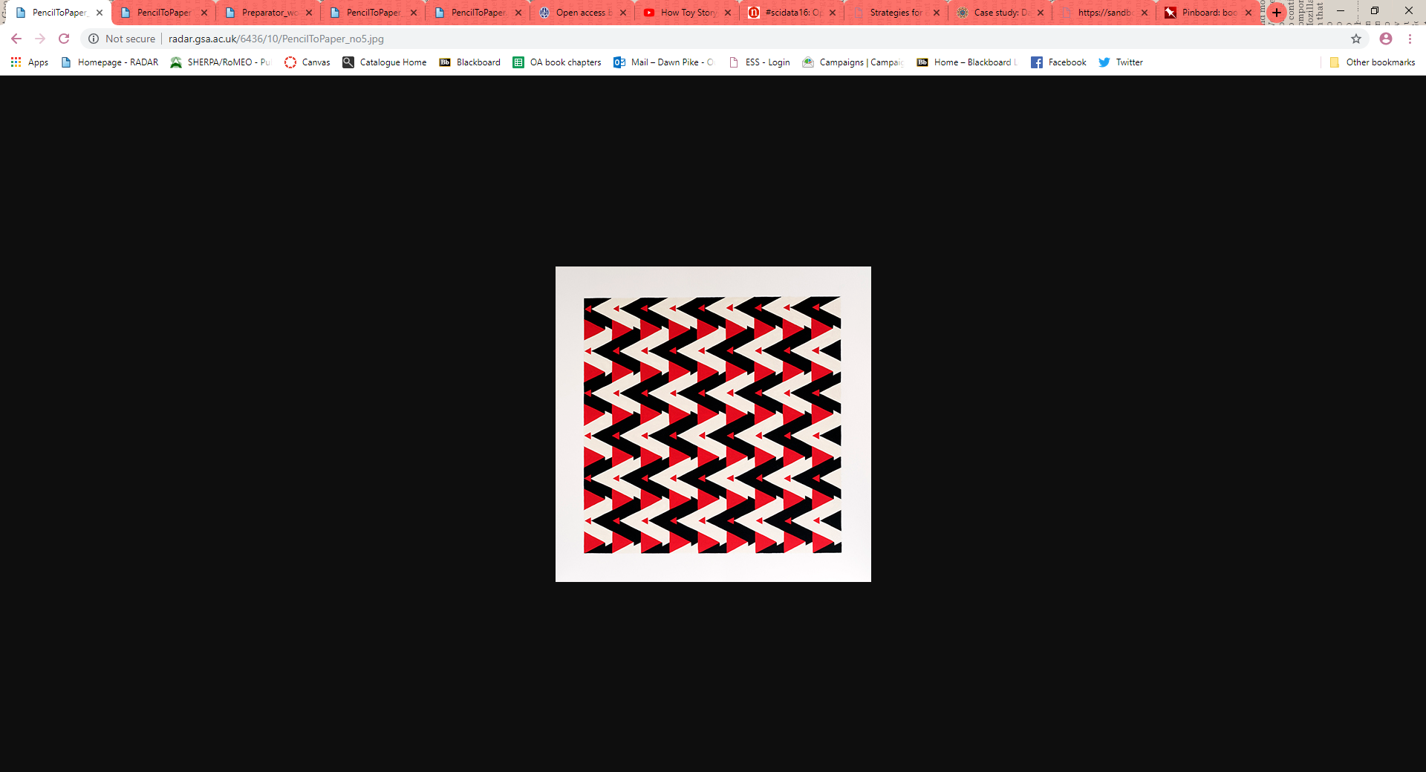
Does my output look good in this?
Poor representation of colour
How it should look
Notes:
Representation and storage of outputs in repositories is another significant barrier: large video files, for example, may need to be cut down in order to ‘fit’ in to the repository (whereas a STEM researcher would hardly be expected to shorten a long journal article due to a lack of repository capacity). Poor representation of an artist’s work can also occur. For example, colours in images and thumbnails can differ; or if an output requires sound to be played alongside visuals, this may not be possible within the repository. We therefore have to link to the artist’s website as a workaround, for users to access files we cannot host in the repository.
The images on this slide highlight issues experienced with accurately representing colour. The image on the left shows that the colours were far too dark and this researcher didn’t want it to be shown if we could not get it to display correctly. In this instance the developers were able to fix how the image was displayed, but this ultimately reduced the researcher’s confidence that the repository could represent their work as intended.

Slide 10
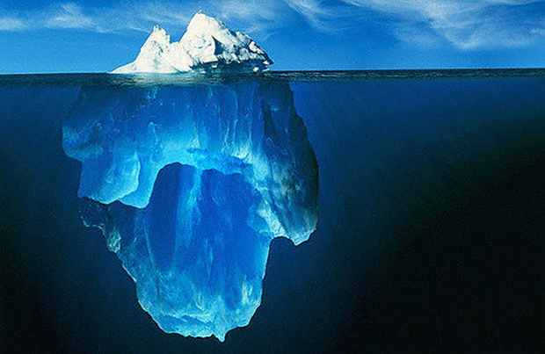

Bodies of work
Repositories only show the tip of the iceberg!
Output as represented in the repository
The journey that leads to the output – including various avenues of enquiry and form of output
Notes:
Furthermore, practice researchers often think of their work as series or ‘bodies of work’, rather than discrete outputs. They are usually part of a wider project with many linked records, but their representation in repositories can often be inadequate. Bruce Brown, a highly-respected Professor of Design in the UK, describes “bodies of work” as exploring “various avenues of enquiry and form of output”. Currently there is no satisfactory way to represent these nuanced, layered works within repositories. Researchers have told us it feels ‘odd’ and ‘disconnected’ adding separate isolated records to the repository that are in fact a wider body of work. One researcher we spoke to likened it to an iceberg – you can only see the tip in the repository record but not the process or the various other outputs that underpin it.

Slide 11
A vicious circle…
Lack of engagement
Invisibility of research
No funding
No arts research
STEM-biased repositories
Notes:
All of these limitations and barriers can compromise engagement by researchers with repositories; this risks the loss of access to, and discoverability of, this important research, and creates a vicious circle. Because if depositing their research is difficult, how can these researchers even begin to think about making their research OA?

Slide 12
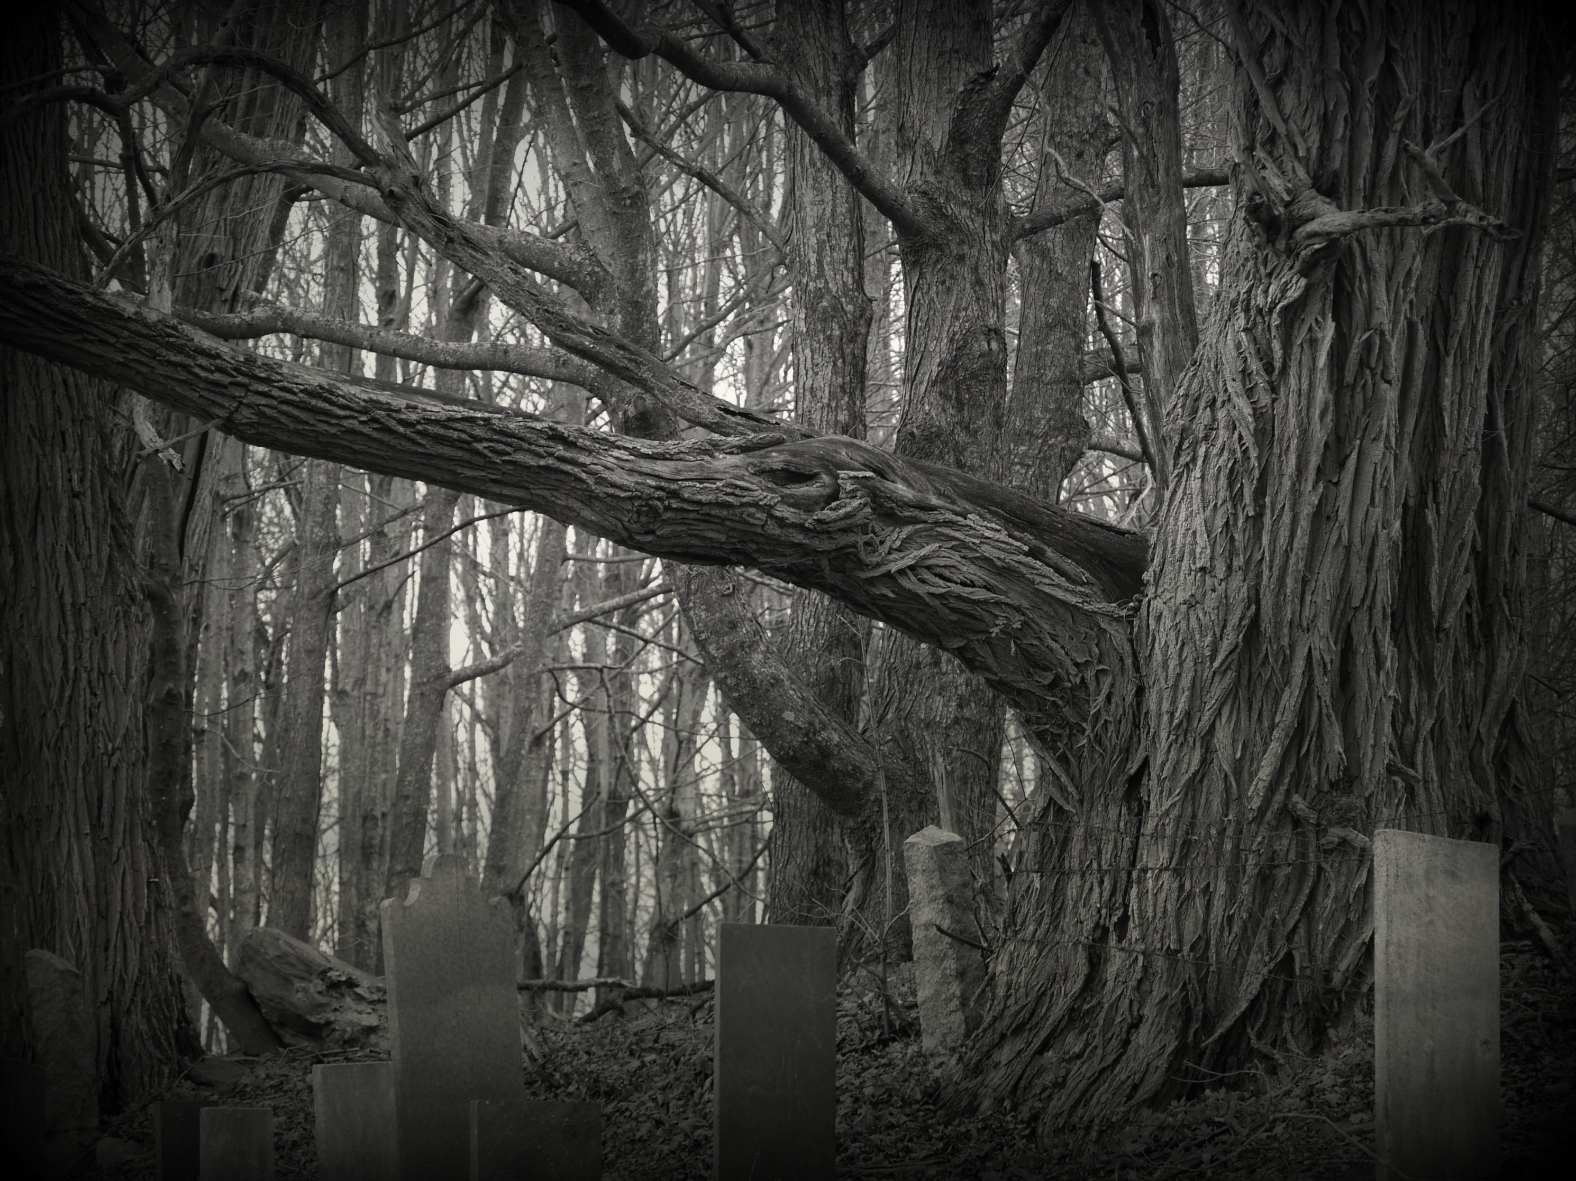
Conclusion – and a call to arms!
Plan S and current OA developments risk bypassing the open scholarship of arts researchers
How can we make repositories work better, to capture and represent this dynamic and valuable material?
How can we avoid a gaping hole in the OA landscape?
Notes:
PRAG-UK have expressed concerns about practice-based research ending up in a “graveyard”, due to lack of visibility and accessibility – but we cannot let this happen!
As we have discussed, Plan S and current OA developments are at risk of bypassing the open scholarship of arts researchers; but this discipline has much to offer society and the economy. As repositories evolve, the unique characteristics of arts outputs need to be addressed by developers – so this rant is a call to arms, so we can avoid the development of a gaping hole in the open access landscape!

Slide 13
Useful information
Contact details
  Dawn Pike, Research Information Co-ordinator:
  d.pike@gsa.ac.uk
  Nicola Siminson, Institutional Repository and Records Manager:
  n.siminson@gsa.ac.uk
Relevant links
  Google doc:
    https://docs.google.com/document/d/1O8DOnjwYvRePhnTWjpcjab29zsfnvHPzhKLKWbUI53M/edit?usp=sharing
  Jisc: https://www.jisc.ac.uk/
  PRAG-UK (Practice Research Advisory Group): https://prag-uk.org/
  blog post on “Capturing practice research: improving visibility and searchability ”:
    https://scholarlycommunications.jiscinvolve.org/wp/2019/03/29/practice-research-is-for-life-not-just-ref/

Slide 14
Image credits
Square Peg into a round Hole, RosiPaw, licensed under CC-BY-NC-SA 2.0: https://flic.kr/p/85i5yW
A scientist at the desk, DataBase Center for Life Science, licensed under CC-BY-4.0: https://commons.wikimedia.org/wiki/File:201705_Scientist_desk_F.svg
Chalk Talk, John Wilson Bengough, Public Domain: https://commons.wikimedia.org/wiki/File:John_Wilson_Bengough_-_chalk_talk.jpg
People Talking, Glasgow School of Art, licensed under CC-BY-NC-ND 2.0: https://flic.kr/p/293V8hy
Language Matters, Marc Nozell, licensed under CC-BY-2.0: https://commons.wikimedia.org/wiki/File:Language_Matters!_-WomensMarch_-WomensMarch2018_-SenecaFalls_-NY_(38908938455).jpg
Resting Place, Rebecca Siegel, licensed under CC-BY-2.0: https://flic.kr/p/dqE3Xy

Slide 15
References
DARIAH-EU, 2018. Towards a Plan(HS)S: DARIAH’s position on PlanS. [online]. DARIAH-EU. [viewed 15 January 19]. Available from: https://www.dariah.eu/wp-content/uploads/2018/10/Towards-a-PlanHSS-excerpt.pdf
Kampfner, J. (2017). Creative industries are key to UK economy. [online] The Guardian. Available from: https://www.theguardian.com/commentisfree/2017/jan/01/creative-industries-key-to-uk-economy
Meece, S., Robinson, A. and Gramstadt, M., 2017. Engaging Researchers With the World's First Scholarly Arts Repositories: Ten Years After the UK's Kultur Project. New Review of Academic Librarianship [online]. 23(2-3), pp.209-232. Available from: https://doi.org/10.1080/13614533.2017.1320767
Suber, P., 2018. Thoughts on Plan S. [online] Google+. 04 September. Available from: https://plus.google.com/+PeterSuber/posts/iGEFpdYY9dr
Snowball, J.. 2016. Why art and culture contribute more to an economy than growth and jobs. [online] The Conversation. https://theconversation.com/why-art-and-culture-contribute-more-to-an-economy-than-growth-and-jobs-52224

