Slide 1
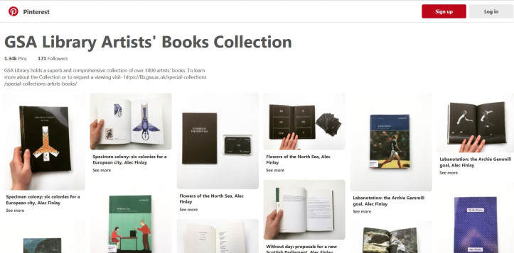
Widening Access to the Glasgow School of Art Library Artists’ Book Collection
Christine Baird

Slide 2
Thesis Statement
Aim: to increase accessibility of an underused Special Collection
By employing a process of ‘DIY’ digitisation to a Collection subject to access limitations, this project aimed to create a visual supplement which operated as a finding aid and a teaching and learning tool while encouraging engagement with the physical Collection

Slide 3
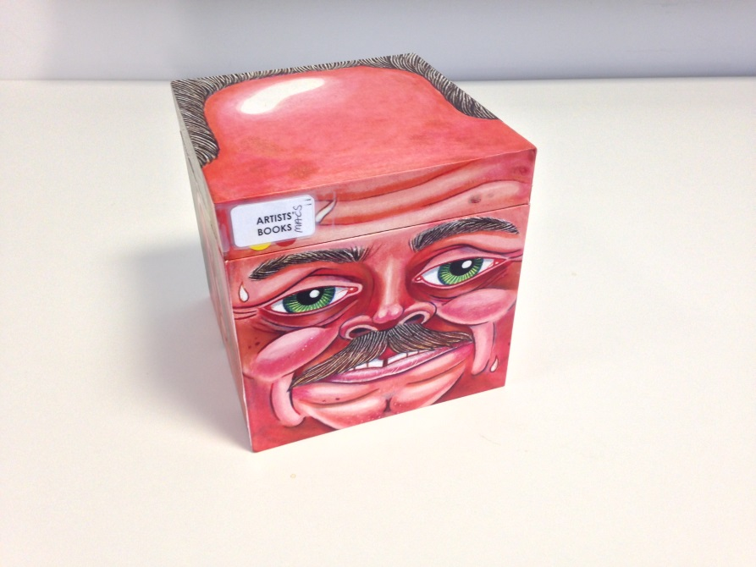
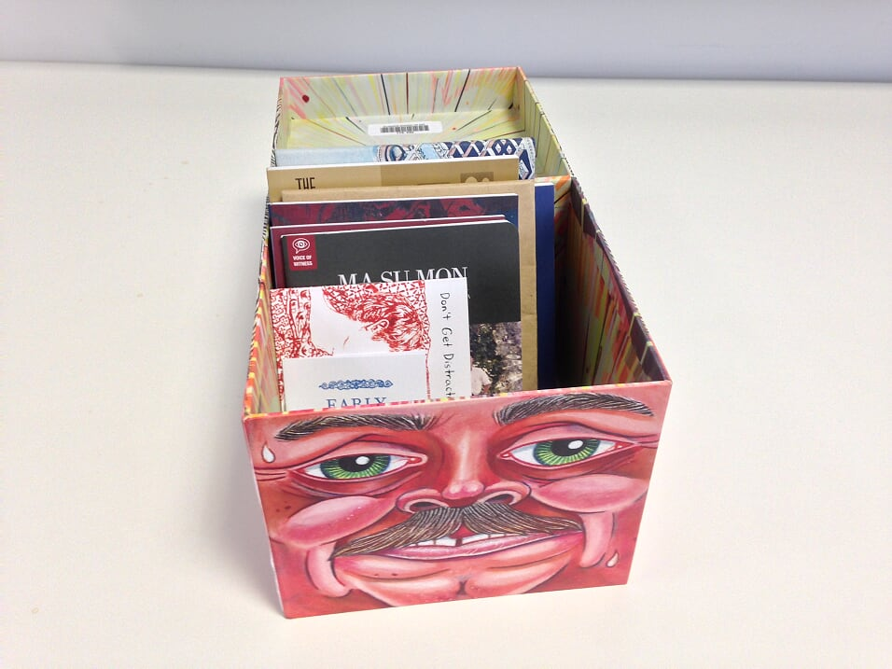
Glasgow School of Art Library Artists’ Book Collection
- Over 2,000 works
- A stylistically diverse Collection, encompassing illustration, photography, poetry, comics etc
- Many of these titles employ the form of the codex in subversive ways, or abandon it completely
- Primary works of art in their own right, as well as bibliographic entities

Slide 4
Student Survey
69% of respondents were already aware of the GSA Library Artists’ Book Collection
25% had accessed the Artists’ Book Collection
19% of respondents felt the Collection was easy to access
44% were unsure if the Collection was relevant to their practice
94% of respondents to the survey expressed an interest in learning more about the Collection

Slide 5
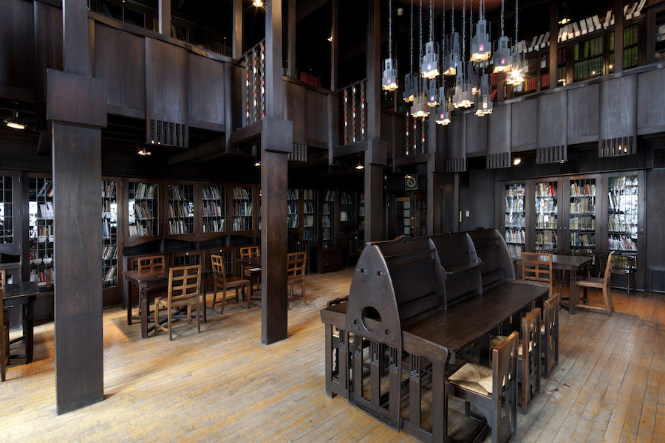
The Mackintosh Library
Photograph: Design Week

Slide 6
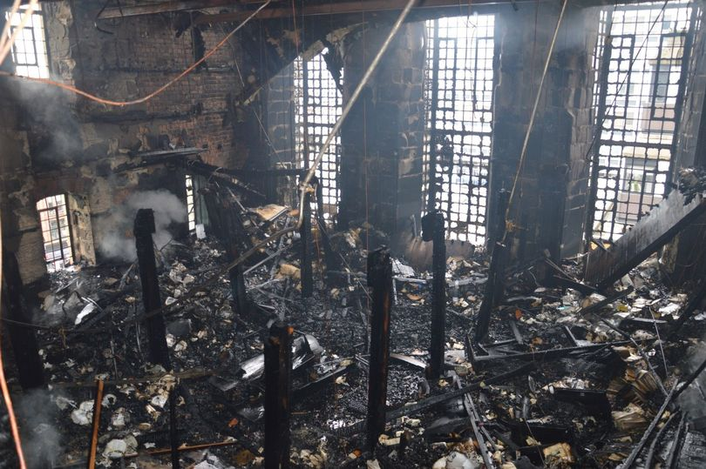
The Mackintosh Library following the fire
Photograph: Glasgow Live

Slide 7
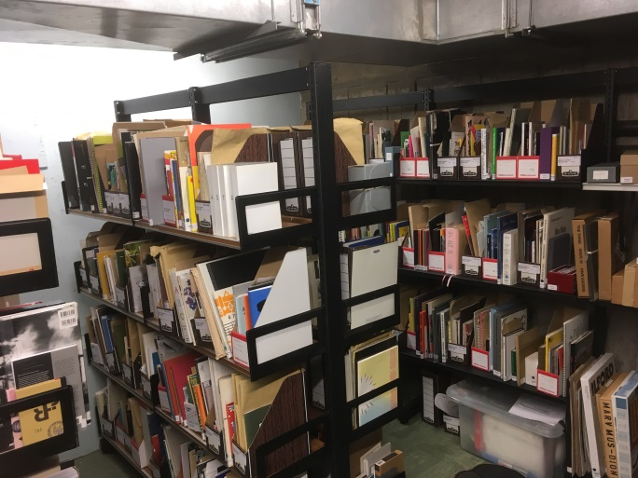
The Bourdon Building bookstore

Slide 8
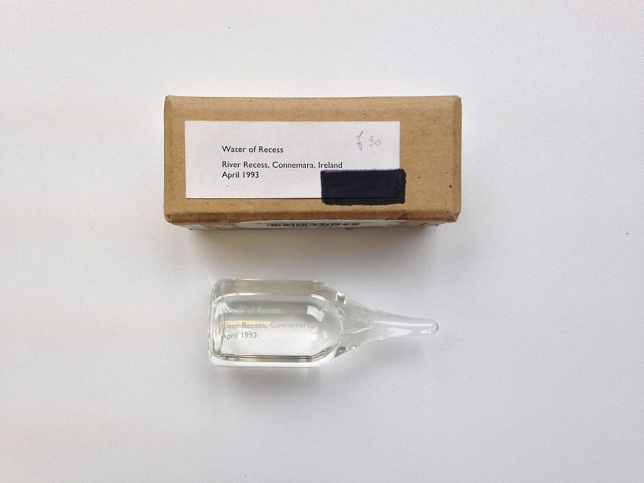
Erica Van Horn & Simon Cutts, River Recess, Connemera, Ireland, April, 1993

Slide 9
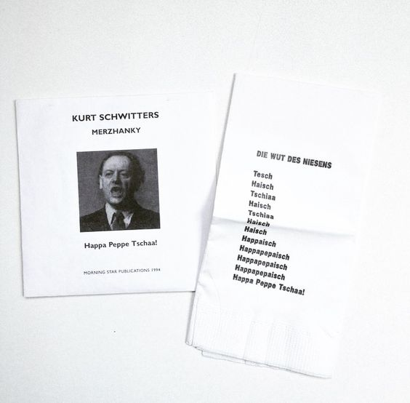
Kurt Scwitters, Merzhanky

Slide 10
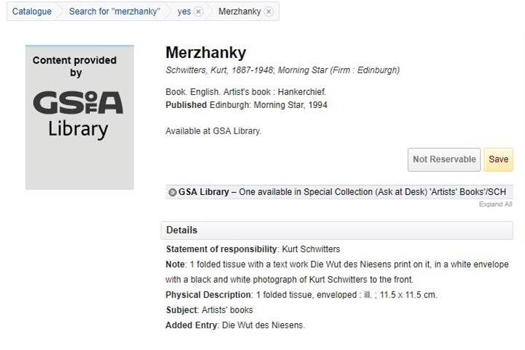
Merzhanky’s catalogue record

Slide 11
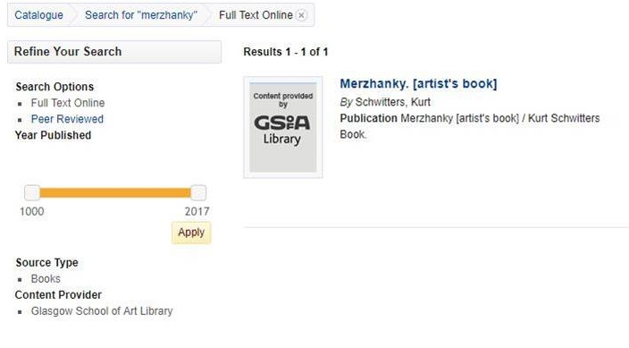
Merzhanky as it appears on the catalogue

Slide 12
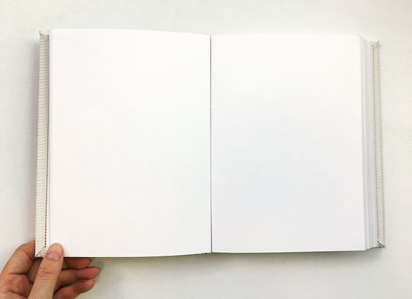
Carla Novi, White book

Slide 13
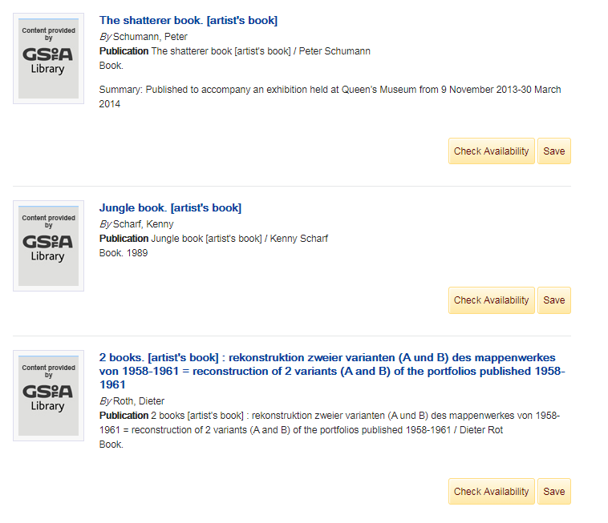
Image of artists’ books as they appear in the catalogue

Slide 14
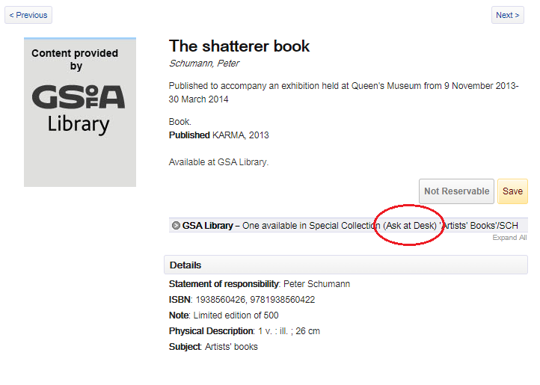
Access provision procedures as outlined in catalogue records

Slide 15
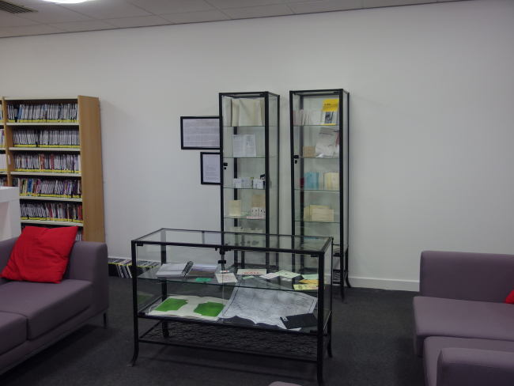
GSA Library display, Travel and the Journey

Slide 16
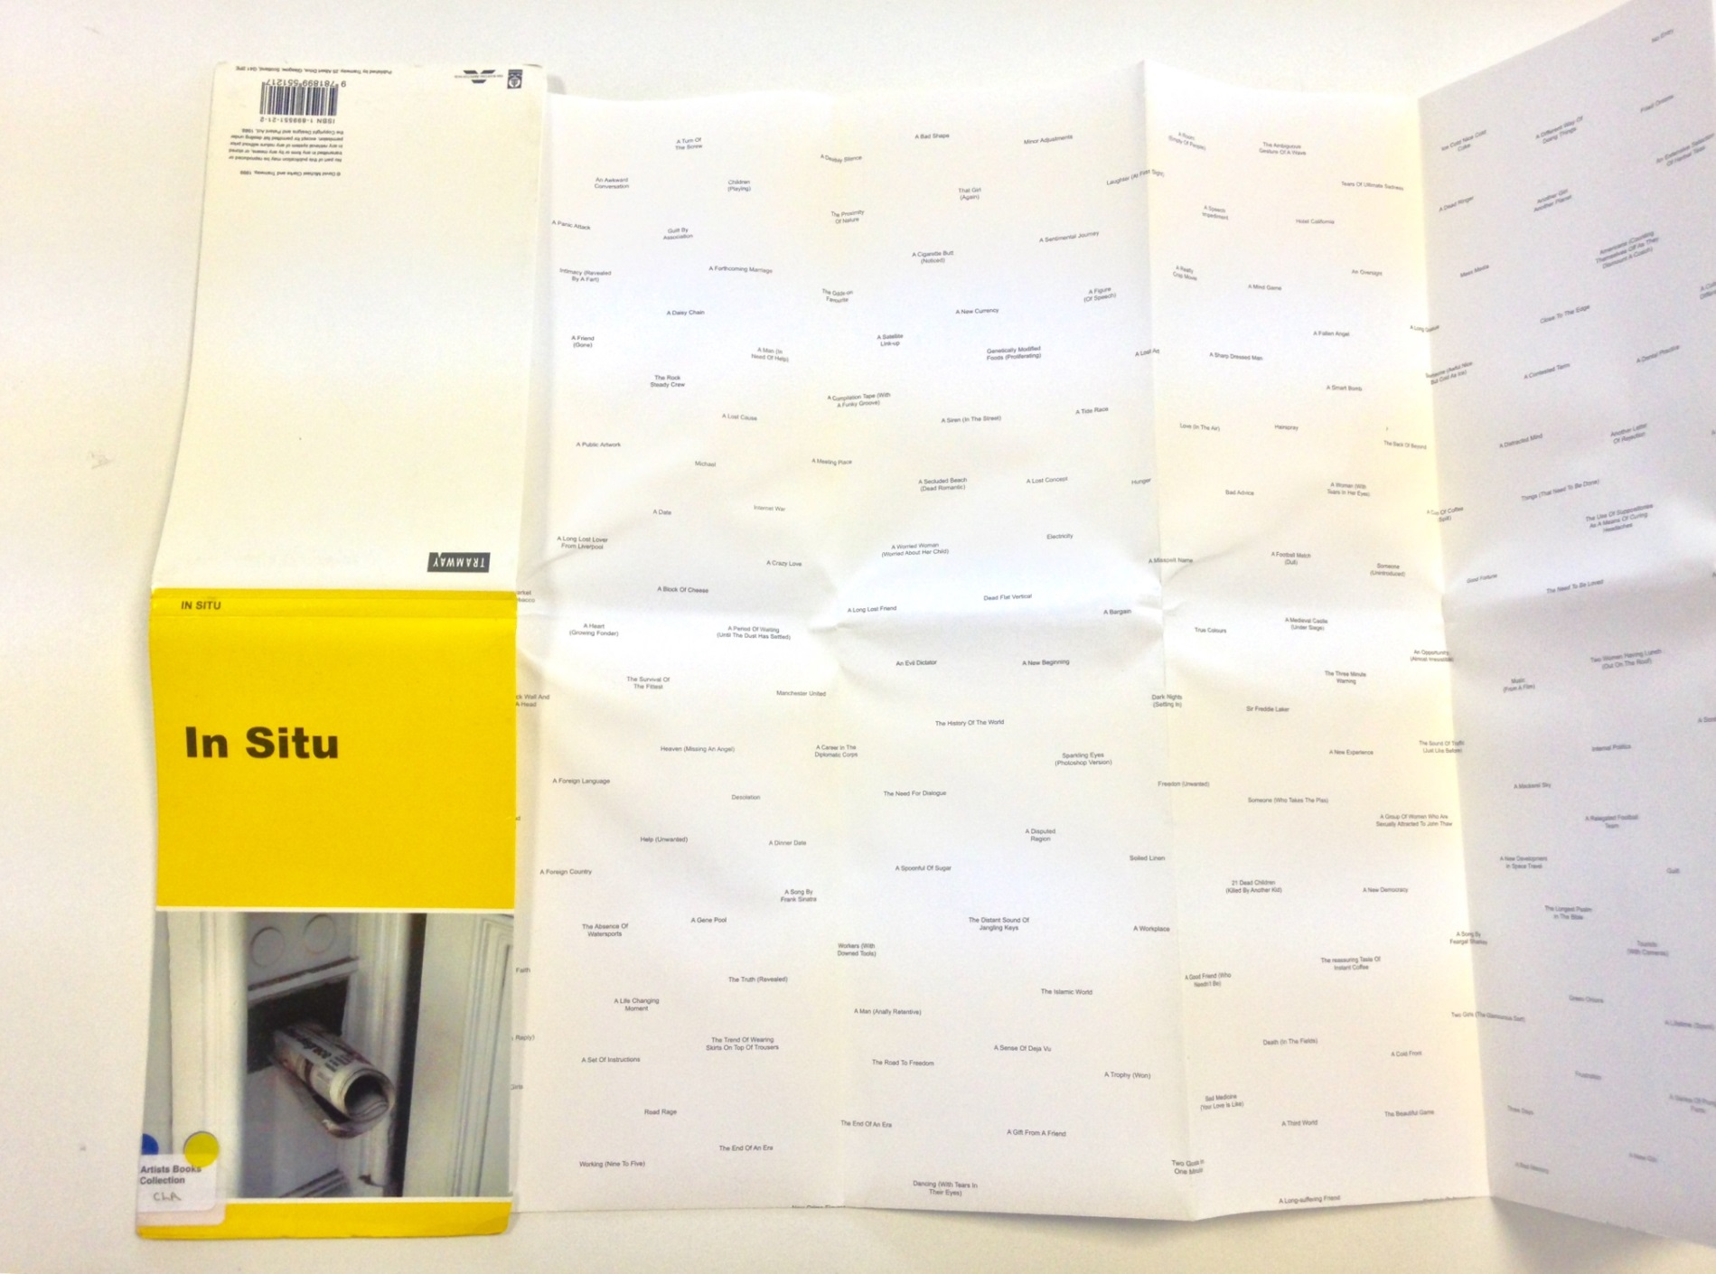
David Michael Clarke, In situ

Slide 17
Digital exhibition: project rationale
50 books, showcasing breadth of Collection
Utilising free or already available resources – iPhone, Pinterest, Instagram
Aiming respond to issues identified as limiting the effectiveness of exhibitions and digitisation by providing ‘digital hands-on experience’, emphasising materiality of the works and de-mystifying Special Collections resources

Slide 18
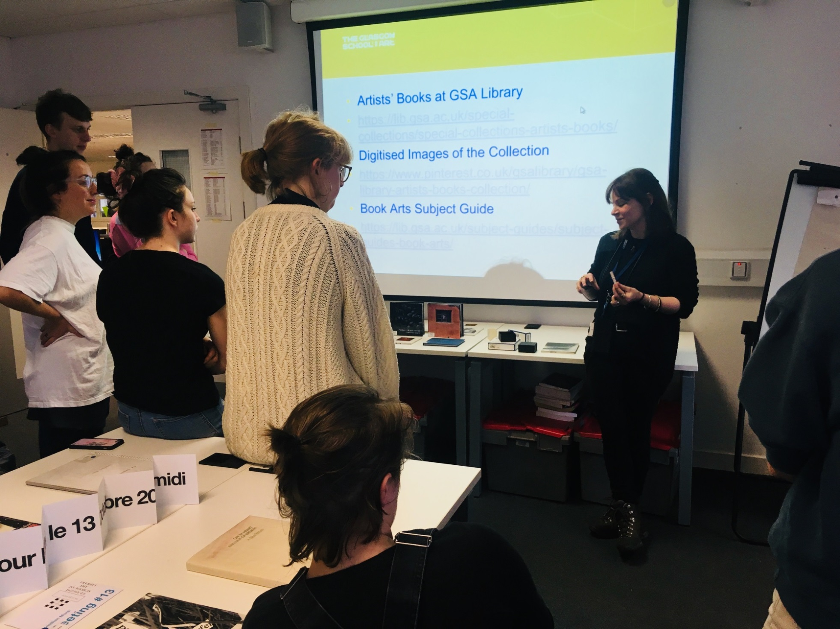
Artists’ book workshop
Photograph: @GSALibrary

Slide 19
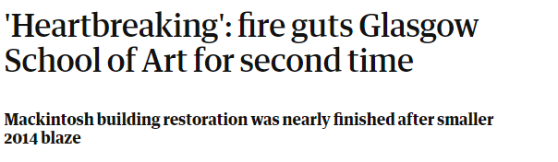
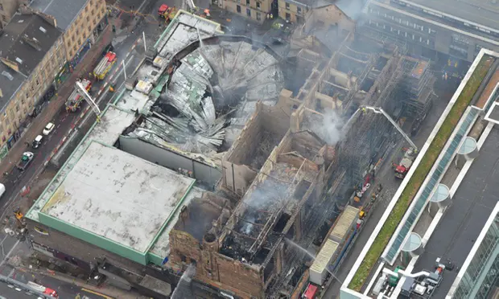
The Mackintosh building fire 2018
Photograph: The Guardian & Police Scotland Air/PA

Slide 20
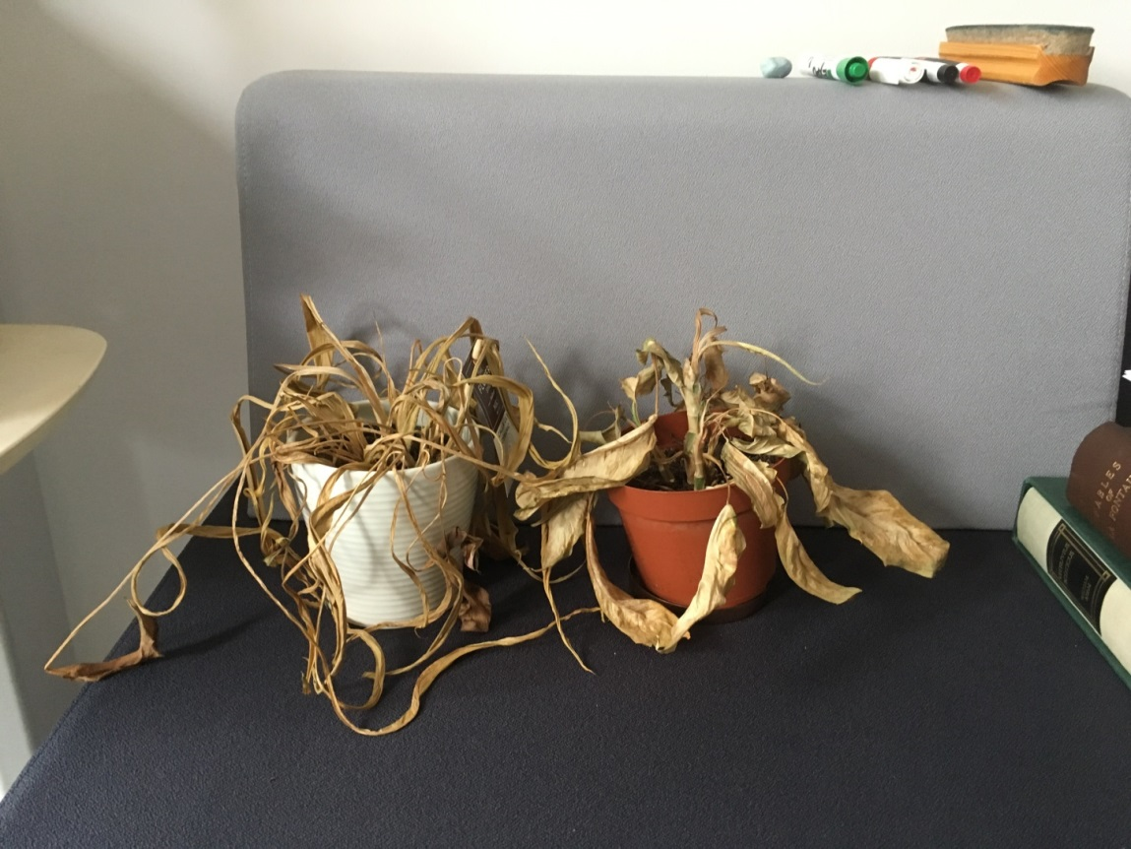
My extremely dead office plants

Slide 21
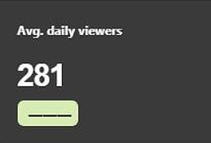
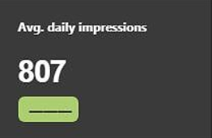


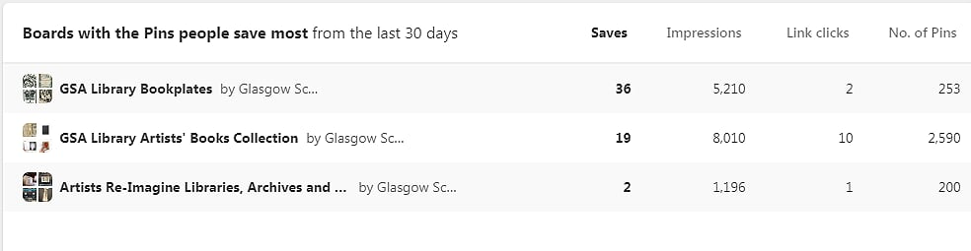
Pinterest Analytics
January – December 2018 average figures (across all Pinterest boards)
Project-specific results for July 2019

Slide 22
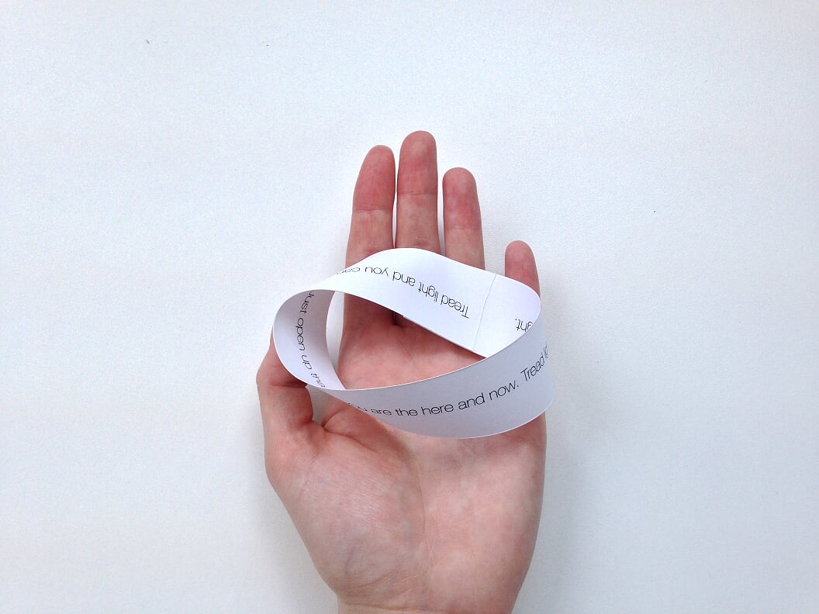
Collection monitoring
Academic year 2017-2018 -
97 Special Collections requests
Academic year 2018-2019 –
409 Special Collections requests
321.6% increase

Slide 23
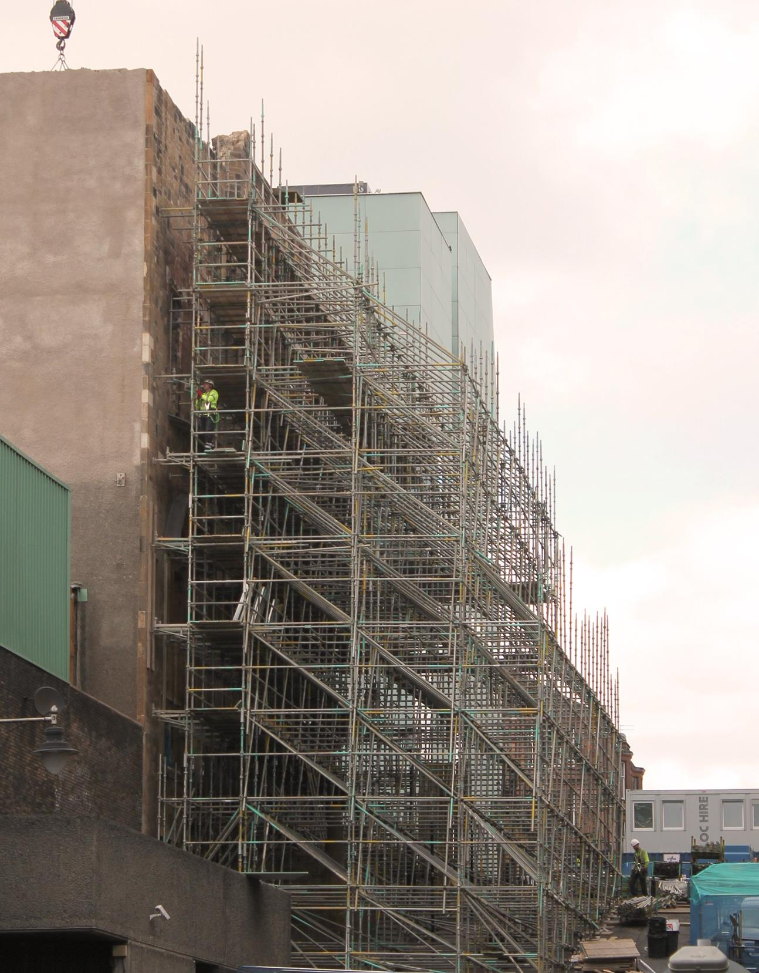
Reflection & next steps

Slide 24
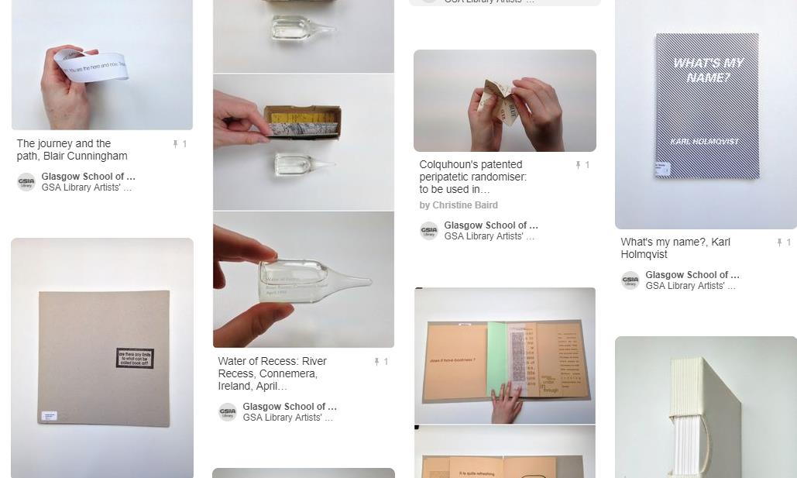
https://www.pinterest.co.uk/gsalibrary/gsa-library-artists-books-collection/

