Slide 1



Essential Ethics for Immersive Learning Practitioners
Daniel Livingstone
School of Simulation & Visualisation
The Glasgow School of Art, UK
CW: Includes discussion of abuse & harassment
CC-BY-NC Daniel Livingstone,
The Glasgow School of Art, 2021
https://creativecommons.org/licenses/by-nc/4.0/legalcode

Slide 2
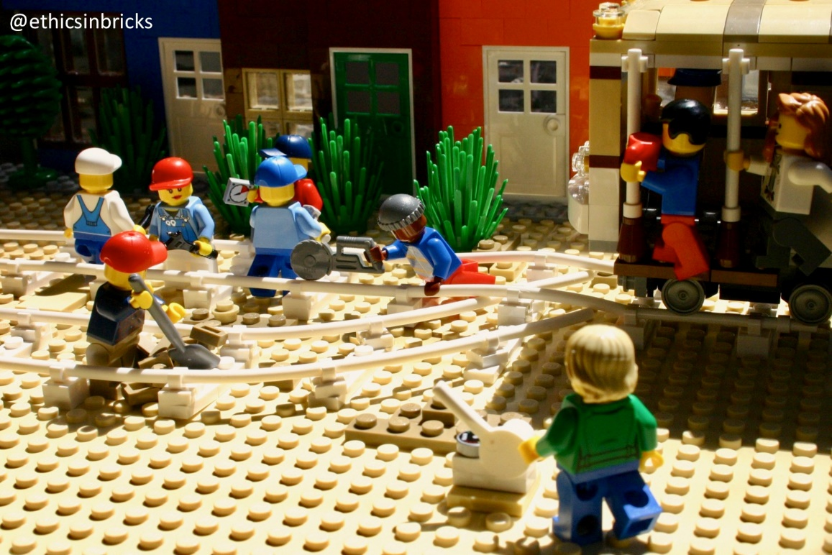
“Essential” Ethics?
A pragmatic view of ethics
Examples of ethical failures… and consequences
  Short presentation – plenty of discussion time!
Understanding the importance of considering ethics
    Why you should consider ethical issues in your own practice
Pragmatic guidelines for Immersive Learning
Practitioners
Links for further information
  Including professional codes
Image © EthicsInBricks, 2021

Slide 3
Is Immersive Ethics different?
Ethical issues relating to Information Technology in specialist journals and conferences for decades now… with many recent books on topics such as algorithmic bias
Many issues here also relate to ethics for VR
Privacy & Surveillance capitalism (the user as product)
Online safety & harassment
More recent work has explored ethical issues in computer games and in VR
Some issues may be of greater concern in VR – but the ethical issues themselves are not necessarily new
Online multi-user experiences are more than just the application – they are also the communities, and this brings many additional concerns and issues

Slide 4
VR and Big Data
VR Headsets with controller tracking can potentially track significant amounts of user data simply from body & hand motions
  With Big Data profiling methods there is potential to make inferences about a range of health conditions from nothing more than motion data, and this could be collected from VR devices
    c.f. Motion data as biometric, by gait analysis (Giles, 2012)
  Outlaw & Persky (2019) hypothesise a situation where a user is refused health insurance as a result of data from a VR game being sold on
  More simply, preferences from usage data could be used for more general advertising/targeting (similar to e.g. search data)
Notes:
Outlaw, J., Persky, S., 2019. Industry review boards are needed to protect VR user privacy [WWW Document]. World Economic Forum. URL https://www.weforum.org/agenda/2019/08/the-hidden-risk-of-virtual-reality-and-what-to-do-about-it/ (accessed 5.15.21).
Giles, J. 2012. Cameras know you by your walk. New Scientist 19 September. Available at: https://www.newscientist.com/article/mg21528835-600-cameras-know-you-by-your-walk/ [Accessed: 9 February 2021].

Slide 5
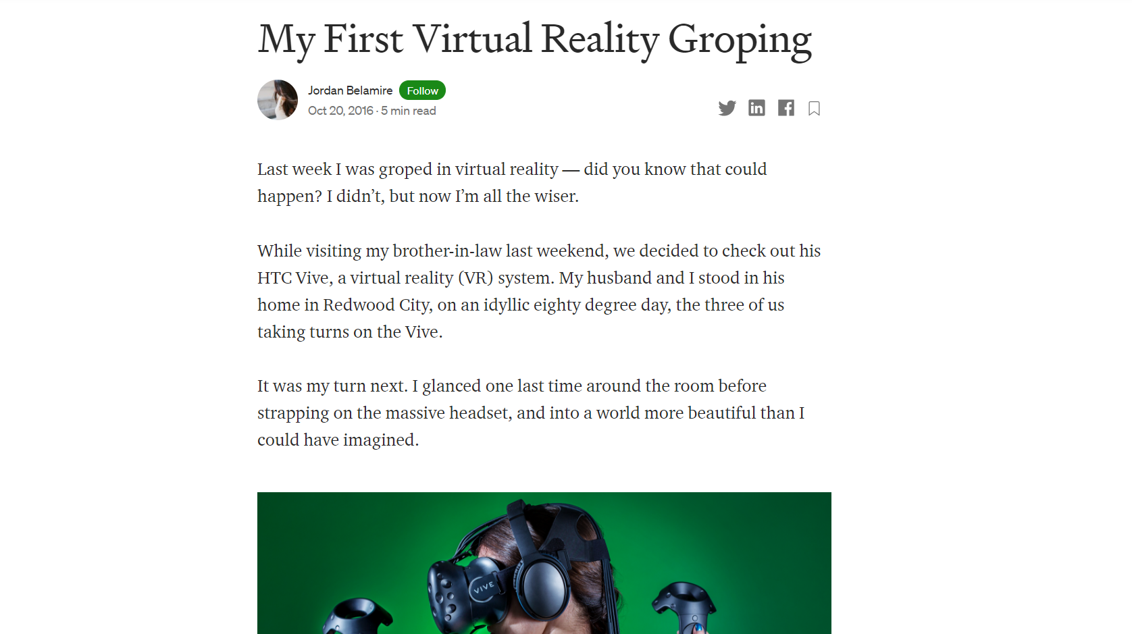

Slide 6
Moral Disengagement
Convincing yourself that normal ethical standards or moral rules do not apply in a particular context is referred to as moral disengagement
e.g. Games are not the external reality, and the actions inside do not affect real people, so you may feel that the normal moral rules do not apply when playing a computer game
For some users, the moral disengagement allows them to treat interactions with other users in games/VR as if the interaction is somehow ‘not real’
(Outside of games moral disengagement is studied as it affects criminal and violent behaviour, and helps understand situations where normal people may act with inhumanity towards others in specific contexts or situations)

Slide 7

Eve Online
A safe space for bad behaviour?
A space sim with control of resources and planetary
systems fought over by player factions
Interesting example as many ways in which players
could cheat other players that would be against the rules in other MMO are part of the game in Eve
  Swindling other players out of in-game currency (Ponzi scheme)
  Scams: a short list of forbidden and LONG list of permitted scams in Eve Online
The game of Eve Online is that of a ruthless war between factions and lone-operatives for money and power
  The game fiction deliberately tries to set boundaries for moral disengagement
  Scams that affect real life are outside scope of game and are forbidden

Slide 8
Student Safety in Immersive Learning
Learning from Online Games:
Many MMO games limit PvP play to specific zones or require players to enable it
Ability to block players in chat
  More safety controls needed in multi-user VR
Designated ‘safe’ zones for new players
Rule enforcement with bans for players for ‘griefing’ or bad behaviour
Emphasise the game nature of the world to emphasise that what might be considered rule-breaking in other games (Ponzi scheme fraud, deception) is explicitly part of the game (c.f. Eve Online)
In any multi-user space you should expect some users to attempt to intimidate, harass, and set out to upset other players
  Designing to prevent problems before they happen and considering what could happen is the responsibility of the creators of any VW

Slide 9
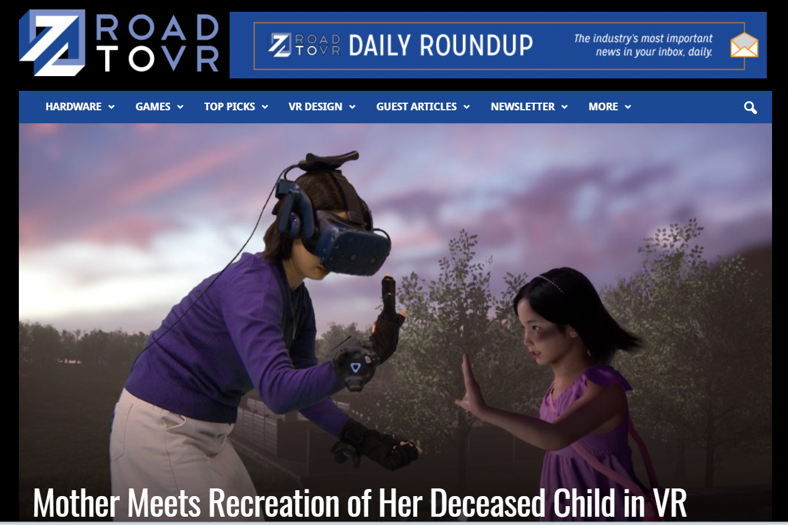
Bringing Back the Dead
South Korean TV documentary recreated a deceased
child in VR for the mother to meet and say a final
goodbye (Hayden, 2020)
Many ethical questions about the close invasion of family
privacy for entertainment in the TV programme!
Ethical?
  We have photos, videos, memories of those we have loved – why not simulations?
  What if this is enhanced with AI to allow us to have conversations with deceased family members?
  Is this something that can provide comfort to survivors? Should applications like these be controlled or licensed?
  What are the implications for immersive recreations of recent history?
Notes:
Hayden, S. 2020. Mother Meets Recreation of Her Deceased Child in VR. Road to VR 7 February. Available at: https://www.roadtovr.com/mother-meets-recreation-of-deceased-child-in-vr/ [Accessed: 5 February 2021].

Slide 10
“They’re fake people, but their pain is real”
Michael, The Good Place
People form real & authentic emotional attachments to virtual characters
  “virtual characters evoke strong feelings” (Coulson, et al. 2012)
This may give an intrinsic motivation to take actions that are protective of, or pleasing to, other characters in a game
  There may be limited agency, as the game itself may have story elements to defeat player attempts to protect others
Additionally, it is possible to set up extrinsic systems to reward or punish certain player behaviours
  Alignment systems, points, trophies or awards for certain behaviours
Can Immersive Learning support the teaching of ethics?
Notes:
Coulson, M., Barnett, J., Ferguson, C.J., Gould, R.L., 2012. Real feelings for virtual people: Emotional attachments and interpersonal attraction in video games. Psychology of Popular Media Culture 1, 176–184. https://doi.org/10.1037/a0028192
Bopp, J.A., Müller, L.J., Aeschbach, L.F., Opwis, K., Mekler, E.D., 2019. Exploring Emotional Attachment to Game Characters, in: Proceedings of the Annual Symposium on Computer-Human Interaction in Play, CHI PLAY ’19. Association for Computing Machinery, New York, NY, USA, pp. 313–324. https://doi.org/10.1145/3311350.3347169

Slide 11
VR Research Ethics
Research with VR does not change fundamental issues, but there are some specific concerns and issues
Physical & Sensory
  Cause harm through use of equipment, motion sickness, light-sensitivity, dizziness
  Users’ lack of spatial awareness, trip hazards, cables
  Risks need minimised & plan for support in case of e.g. motion sickness
Behavioural Responses
  Possible to use approaches that promote user ‘embodiment’ in VR, which increases feeling of being in the VR simulation (c.f. Petkova & Ehrsson, 2008)
  Can react to things happening to virtual body as if own
  Implications?
Notes:
Petkova, V.I. and Ehrsson, H.H. 2008. If I Were You: Perceptual Illusion of Body Swapping. PLOS ONE 3(12), p. e3832. doi: 10.1371/journal.pone.0003832.

Slide 12
VR: Equity and Accessibility
Some users are prone to motion sickness in VR (women more than men)
  Should all VR apps include a non-VR mode, for accessibility?
  How liable should VR developers be for taking steps to minimise motion sickness?
Sensory stimulus from VR can be quite high and tiring
  Weight of headsets, and screens close to eyes
  Do apps need to be designed to ensure regular breaks?
Inversion of stimulus
  Mismatching proprioception (body sensing own movements) can be very disorienting and very likely to cause motion sickness.
Accessibility and digital divide
  Are developers focussing on VR exacerbating issues around digital access?

Slide 13
Benefits of VR
There is a wide range of evidence from different contexts of the possible beneficial uses and applications of VR (c.f. Slater & Sanchez-Vives, 2016)
Improved understanding of the most effective & least harmful ways of exploiting these benefits is of clear potential benefit to society
As such, there is a good reason and justification for continuing VR research or using it in your teaching practice
However, each experiment and intervention still needs consideration
E.g. In some contexts the experiments/intervention may have few or no potential benefits – is this worth the potential harm?
Notes:
Slater, M. and Sanchez-Vives, M.V. 2016. Enhancing Our Lives with Immersive Virtual Reality. Frontiers in Robotics and AI 3. Available at: https://www.frontiersin.org/articles/10.3389/frobt.2016.00074/full [Accessed: 14 February 2021].

Slide 14
VR, Embodiment & Experience
The body we have in VR may influence our behaviour, and the experiences in VR may impact on user behaviour after finishing a game/session
  See (Madary & Metzinger, 2016), (Yee & Bailenson, 2007)
To some extent, Virtual Reality with high degrees of realism is experienced almost as if real (Slater et al., 2020, Grisjeels, D. 2021)
  Are some experiences that might be OK in a computer game problematic when experienced in VR? Where is a line drawn?
However, we can also use VR to give experiences otherwise impossible – such as putting a user into a different body
  Banakou, D. et al. (2016) put white participants into a black body in a simple VR test
  Post test demonstrated a sustained reduction in implicit racial bias
Notes:
Yee, N. and Bailenson, J. 2007. The Proteus Effect: The Effect of Transformed Self-Representation on Behavior. Human Communication Research 33(3), pp. 271–290.
Madary, M. and Metzinger, T.K. 2016. Real Virtuality: A Code of Ethical Conduct. Recommendations for Good Scientific Practice and the Consumers of VR-Technology. Frontiers in Robotics and AI 3. Available at: https://www.frontiersin.org/articles/10.3389/frobt.2016.00003/full [Accessed: 9 February 2021].
Grijseels, D. 2021. Your brain isn’t the same in virtual reality as it is in the real world. Available at: https://massivesci.com/articles/virtual-reality-vr-real-world-limitations-touch-smell-visual/ [Accessed: 11 February 2021].
Slater, M. et al. 2020. The Ethics of Realism in Virtual and Augmented Reality. Frontiers in Virtual Reality 1. Available at: https://www.frontiersin.org/articles/10.3389/frvir.2020.00001/full [Accessed: 16 June 2020].
Banakou, D. et al. 2016. Virtual Embodiment of White People in a Black Virtual Body Leads to a Sustained Reduction in Their Implicit Racial Bias. Frontiers in Human Neuroscience 10. Available at: https://www.frontiersin.org/articles/10.3389/fnhum.2016.00601/full [Accessed: 12 February 2021].

Slide 15
Codes of Conduct for Researchers & Practitioners
IEEE is currently engaged in an exercise to develop a white paper on ethics for XR (eXtended Reality, AR & VR)
  Report due to be completed mid 2021
Professional and Trade Bodies in VR/Games/EdTech space have range of codes of conduct (c.f. ACM, IGDA, TIGA, …)
Madary and Metzinger (2016) present a code of conduct for both consumer and research use of VR
Notes:
https://voicesofvr.com/976-xr-ethics-white-paper-invitation-from-launch-of-the-ieee-global-initiative-of-the-ethics-of-extended-reality/
Madary, M. and Metzinger, T.K. 2016. Real Virtuality: A Code of Ethical Conduct. Recommendations for Good Scientific Practice and the Consumers of VR-Technology. Frontiers in Robotics and AI 3. Available at: https://www.frontiersin.org/articles/10.3389/frobt.2016.00003/full [Accessed: 9 February 2021].

Slide 16
Discussion…
There is a large body of work on potential benefits of immersive learning
There are also a wide range of potential issues
  accessibility
  physical safety
  safety in online environments
  data protection
What are issues you face?
How do you address these issues in your own work?
What support is needed for practitioners grappling with practical ethical issues?

Slide 17
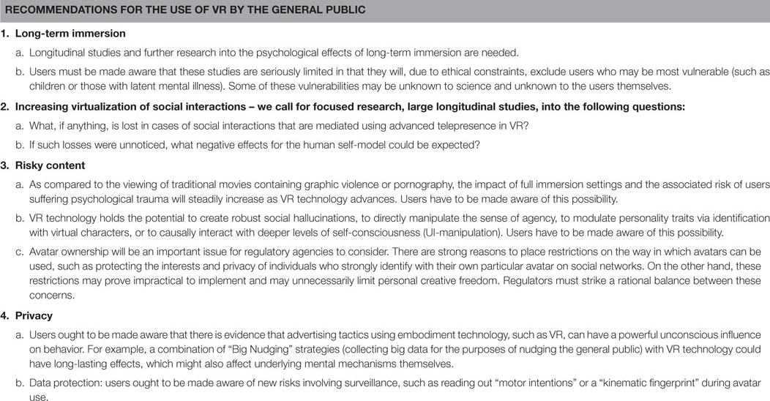
© Madary & Metzinger 2016
CC-BY (Creative Commons Attribution) 2016
https://www.frontiersin.org/articles/10.3389/frobt.2016.00003/full

