Slide 1
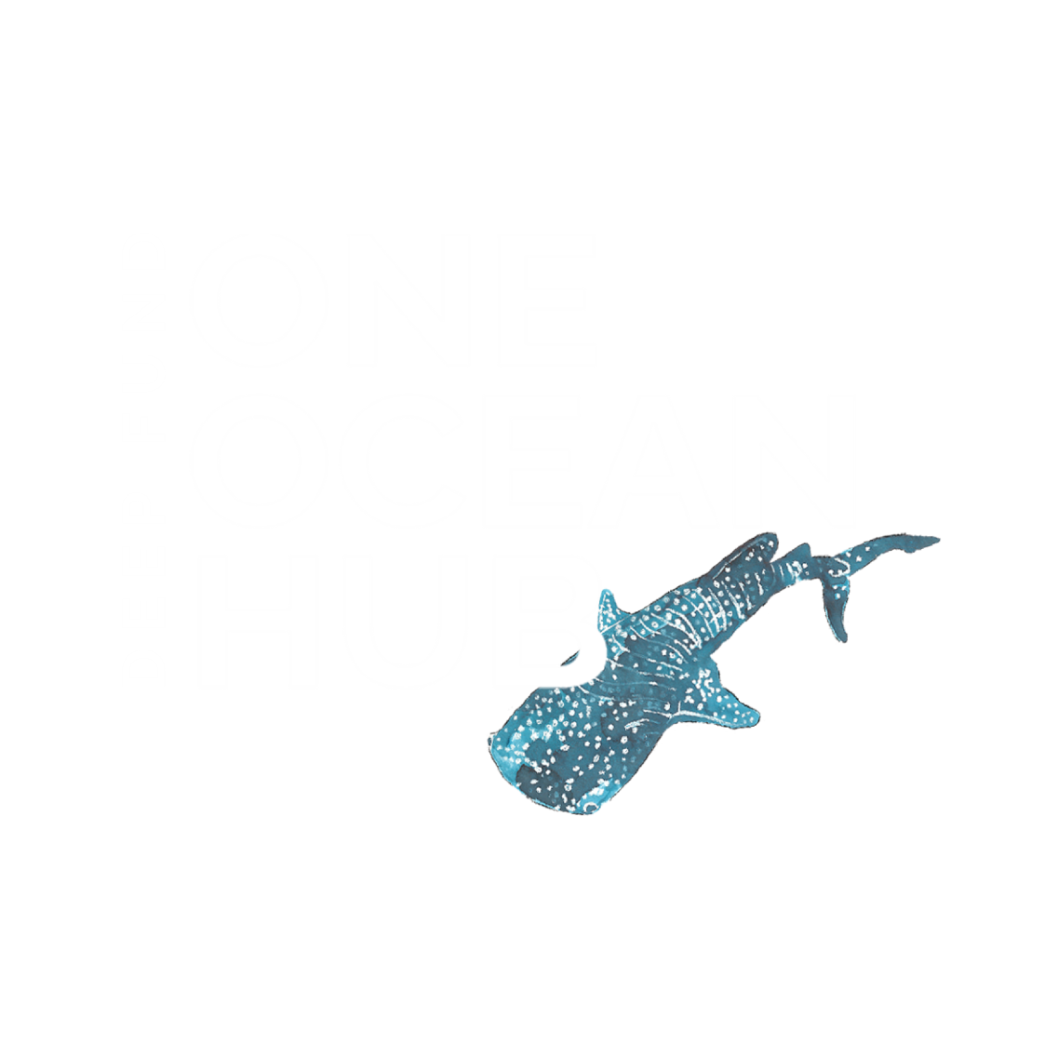

Intangible Cultural Heritage and Ocean Governance in Africa and the Pacific
Prof Stuart Jeffrey & Dr Lisa McDonald
ACHS, Santiago, 5th December 2022

Slide 2


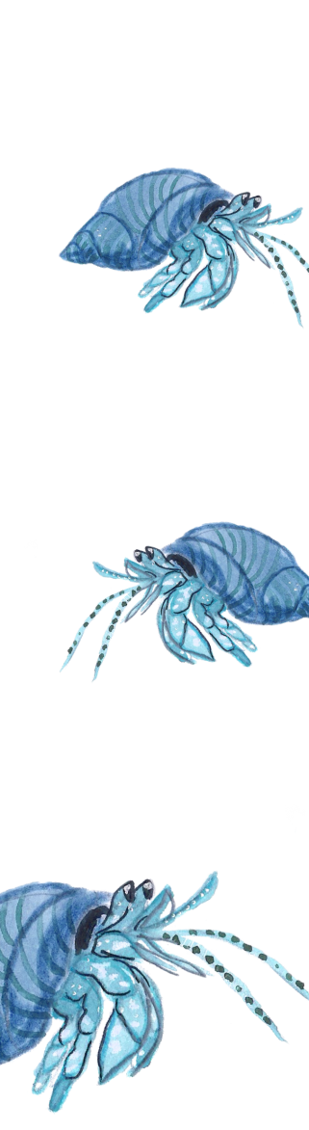

“Very often, the meaning of culture for sustainable development is difficult to narrow down to individual targets – it should rather be understood as enabling forms of participation and meaning-making, generating a setting in which communities can achieve their goals”
“culture can play a powerful role in working towards the SDGs, directly and indirectly, with a focus on contributing to positive social and economic outcomes via education, protecting and promoting tangible and intangible heritage, as well as digital engagement and technologies”
“Within the context of the development sector, the arts contribute to addressing divisive narratives, fostering human experiences, supporting skills development and building empowerment”
British Council (2020) “The Missing Pillar: Culture’s Contribution to the UN Sustainable Development Goals”
3/14/2023
2

Slide 3
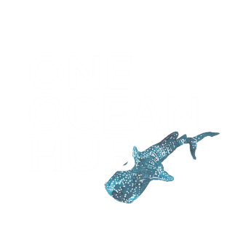
“Even though we have facts about climate change, the climate debate - or perhaps climate confusion - is far from over. Climate action therefore requires changing mindsets and pursuing systematic, multidimensional approaches to policy”
“‘Artistic endeavours communicate in ways policy speeches may fail to deliver.”
Patrick Kabanda, ‘The Creative Wealth of Nations: Can the Arts Advance Development?’ (2018:70;73)
3/14/2023
3

Slide 4
A RANGE OF HUMAN RIGHTS ISSUES TO BE EXPLORED
Procedural rights in the context of marine spatial planning (including marine protected areas) and the blue economy (including COVID-19 challenges & well-known issues re EIAs, consultations, benefit-sharing)
Everyone’s human right to health, food, water, culture
Human rights of indigenous peoples, local knowledge holders and small-scale fishers to marine resources and areas (including women)
Business and human rights
Large-scale fisheries & new foreign investors in the blue economy
Responsibility of civil society (including conservation NGOs and researchers)
3/14/2023
4

Slide 5
OVERVIEW
Fundamental to the prospectus of One Ocean Hub is sharing the emotional connections to the ocean of those most directly impacted by its health and governance.
One Ocean Hub has developed innovative modes of engaging directly with communities and cultural practitioners already affected by climate change
We work in collaboration artists, knowledge holders, communities and academics in five ODA list countries on the frontline of ocean and climate change nexus.
We have implemented a new funding model that directly supports projects led by 3rd Sector parties to promote creative autonomy
Fostering creative economies with a special focus on women and young people
3/14/2023
5

Slide 6
OVERVIEW
Methods: Law in support of art and art in support of implementing law
Our methodology avoids modes of investigating community relations where values and priorities are defined by academics, professionals or practitioners. Instead, artists and communities are supported in the co-design of creative content from which expressions of their values, priorities and relationships emerge
Foregrounding traditional knowledge and indigenous protocols in knowledge recording and sharing
So far we have funded 8 active projects: 3 in the Pacific, 2 in Ghana and 3 in South Africa.
Outputs from these projects include murals, tapestry, documentary film, song and video, illustrated children’s book, wearable art and digital content.
3/14/2023
6

Slide 7
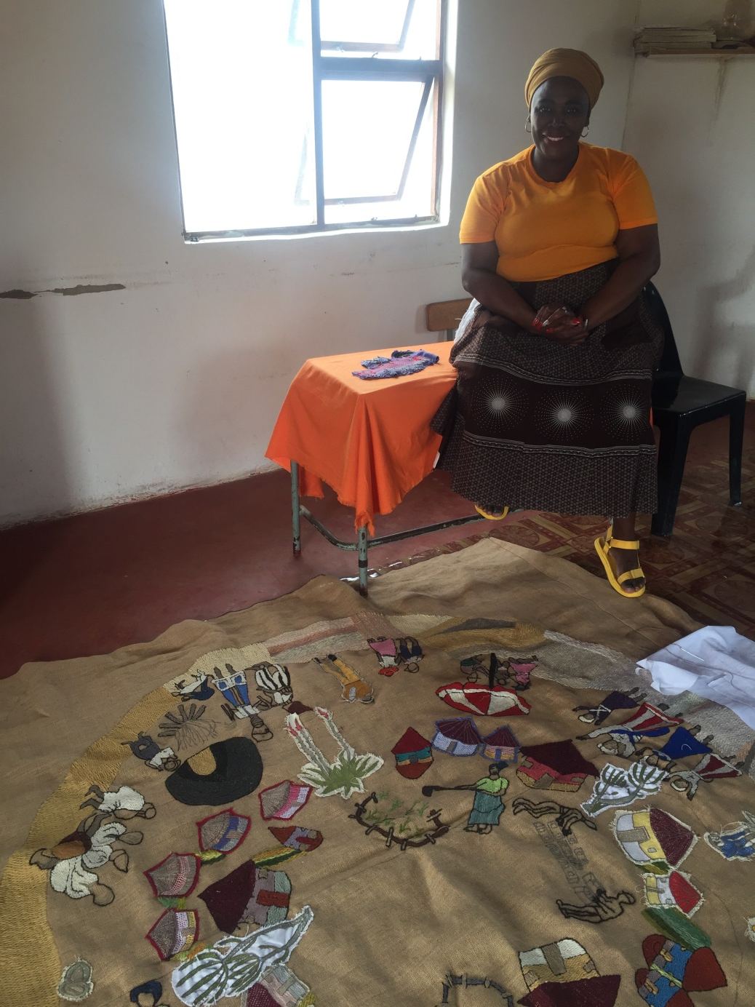
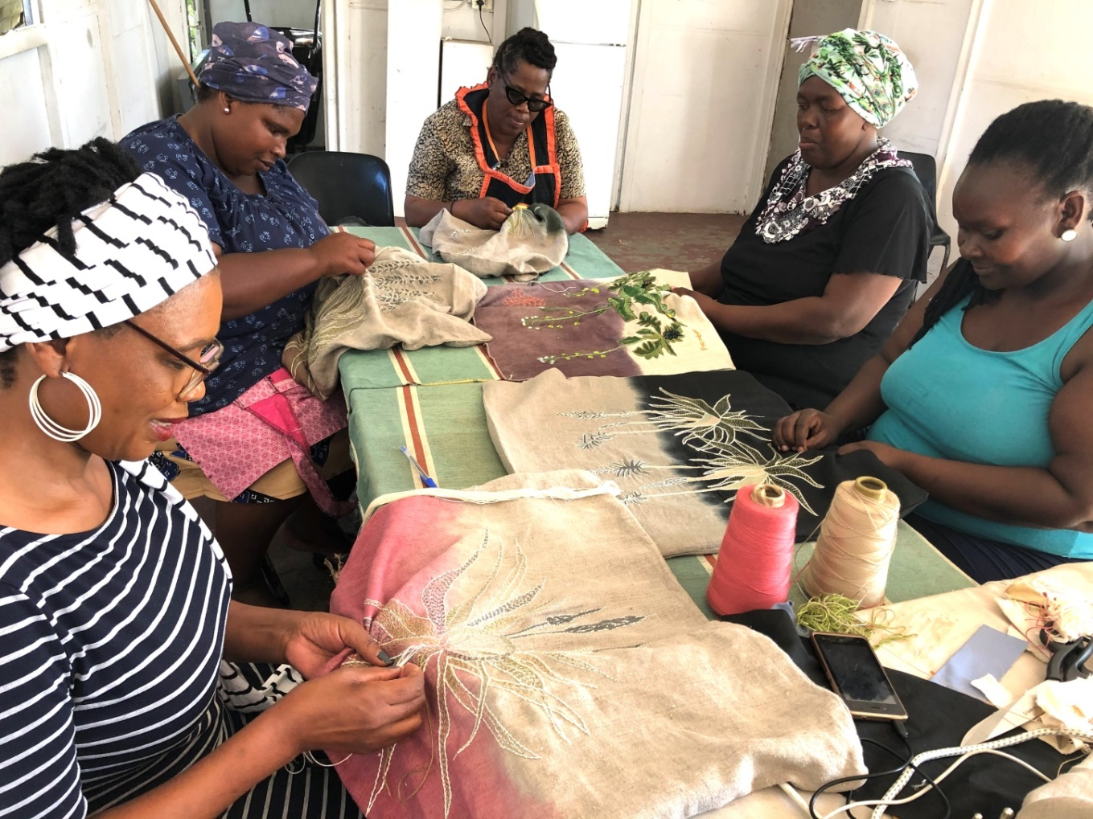
OUR SACRED OCEAN
Keiskamma Art Project,
Hamburg, South Africa: community tapestry
3/14/2023
7
© Pippa Hetherington & Keiskamma Trust

Slide 8
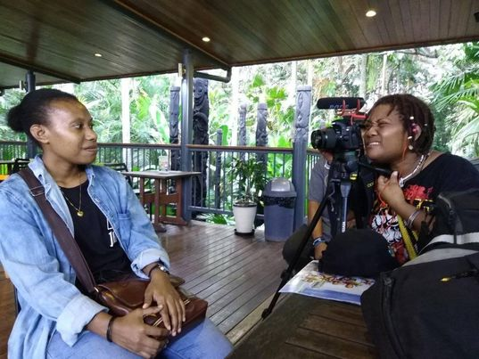
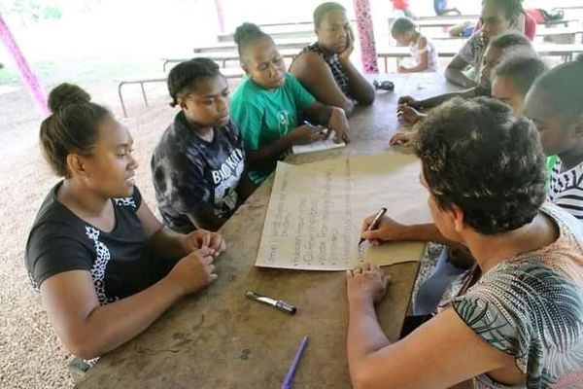
OUR OCEAN OUR IDENTITY
Lloyd Newton, Pax Jakupa &
Alvaro Kiki Kuautonga
Papua New Guinea/Vanuatu: Ocean inspired, community co-produced mural
© Pax Jakupa
© Alvaro Kiki Kuautonga
3/14/2023
8

Slide 9
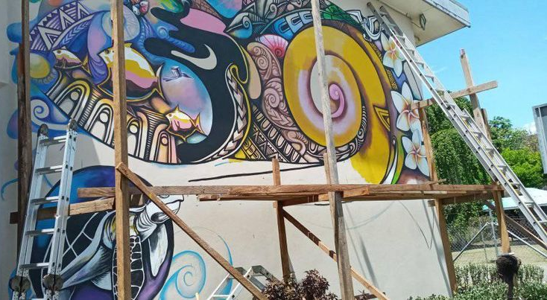
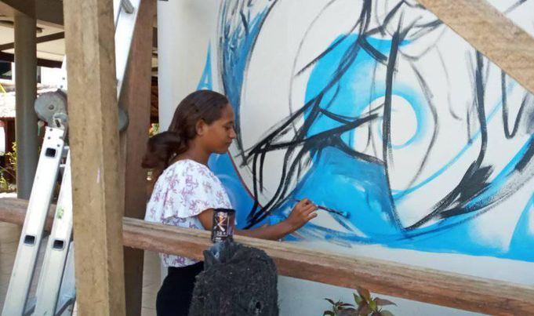
OUR OCEAN OUR IDENTITY
Lloyd Newton, Pax Jakupa and Alvaro Kiki Kuautonga
Solomon Islands: Ocean inspired, community co-produced mural
© Lloyd Newton
3/14/2023
9

Slide 10
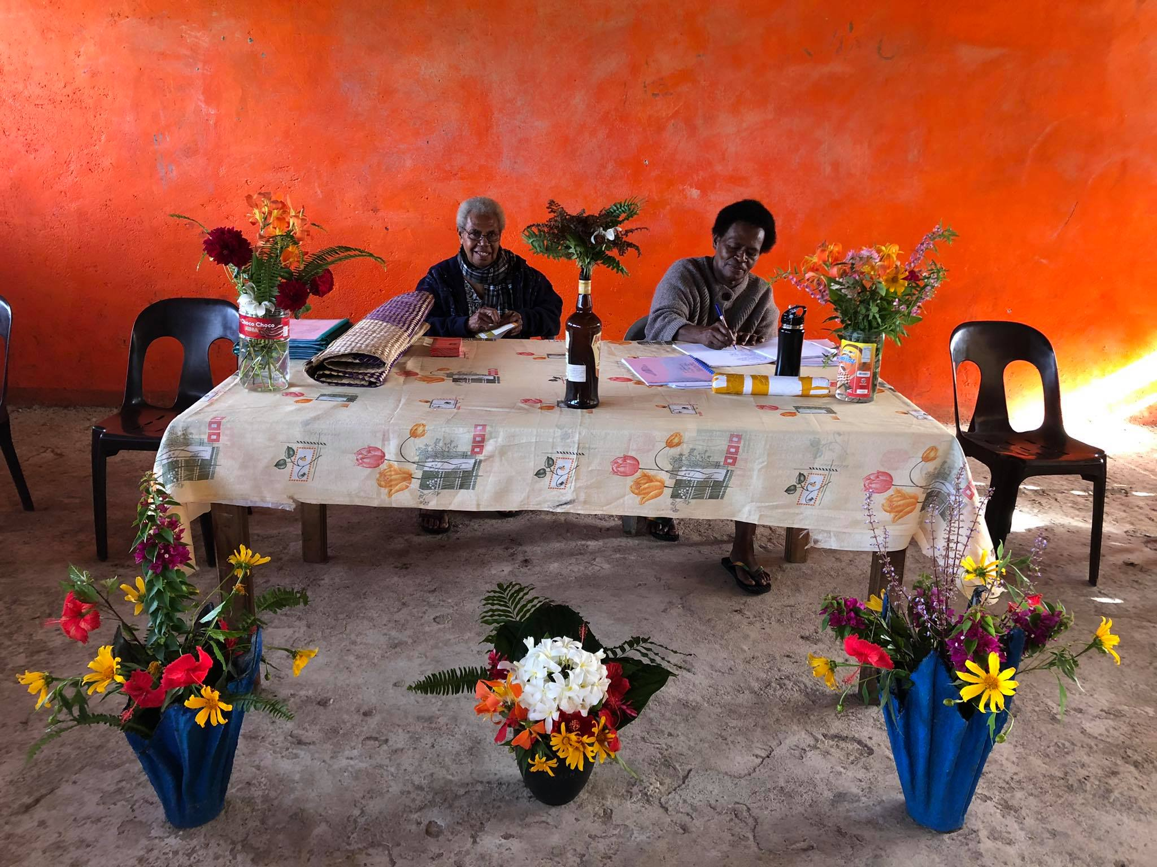
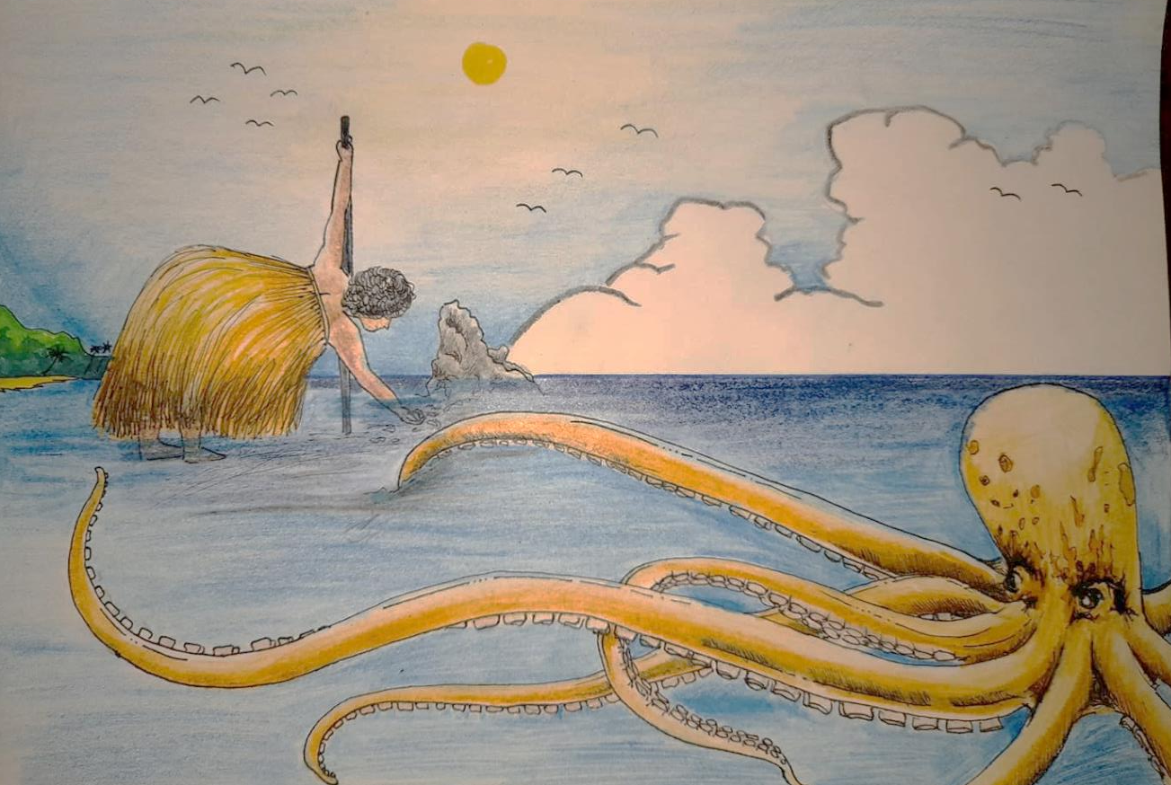
NETAI EN NAMOU TOC
Erromango Cultural Association, Vanuatu, Illustrated children’s book
“Netai en Namou Toc (Stories of Mother Ocean)”
© Erromango Cultural Association
(Simeon and Jarvis Tovovor)
3/14/2023
10

Slide 11
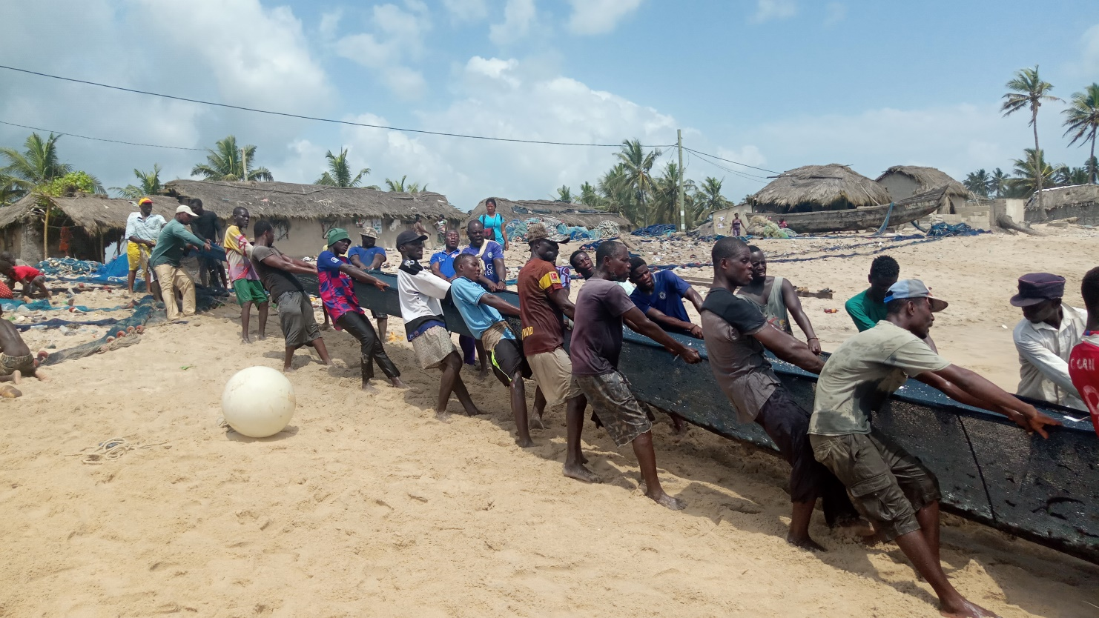
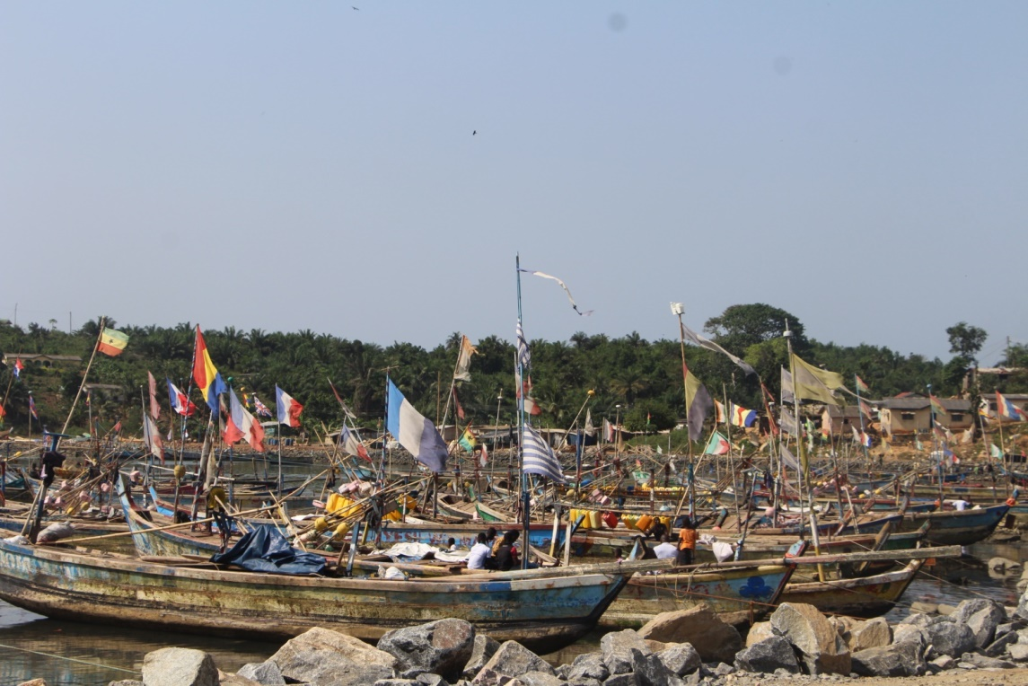
COCCOONED IN HARMONY
Eric Otchere, University of Cape Coast, Ghana: Traditional Ghanaian fishers songs and video documentary
© Eric Otchere
3/14/2023
11

