Slide 1
GIVE THEM AN INCH
Nicholas Oddy
n.oddy@gsa.ac.uk

Slide 2
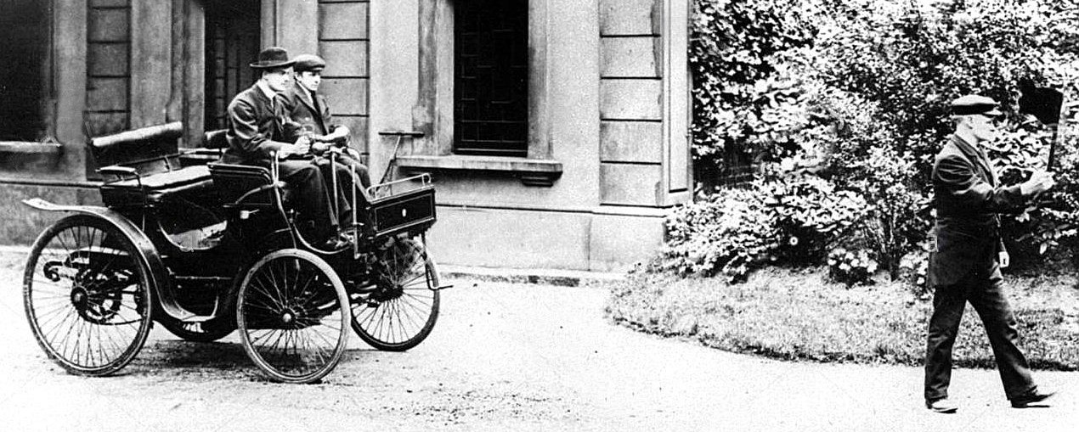
‘150 years ago tomorrow, Lord Palmerston's Liberal government passed a law that, according to one writer, "effectively stopped innovation in powered road transport in Britain for over a quarter of a century". The Locomotive Act 1865 became known as the Red Flag Act, thanks to its extraordinary stipulation that any self-propelled road vehicle had to be preceded by a person walking at least 60 yards ahead, carrying a red flag.’ From ‘Rhodri Marsden's Interesting Objects: Lord Winchelsea's red flag’ The Independent 3 July 2015
CS Rolls in a posed photograph created to ridicule the locomotive act. In fact there was no requirement for a flag bearer, merely someone to precede the locomotive by foot at a distance of 20 feet

Slide 3
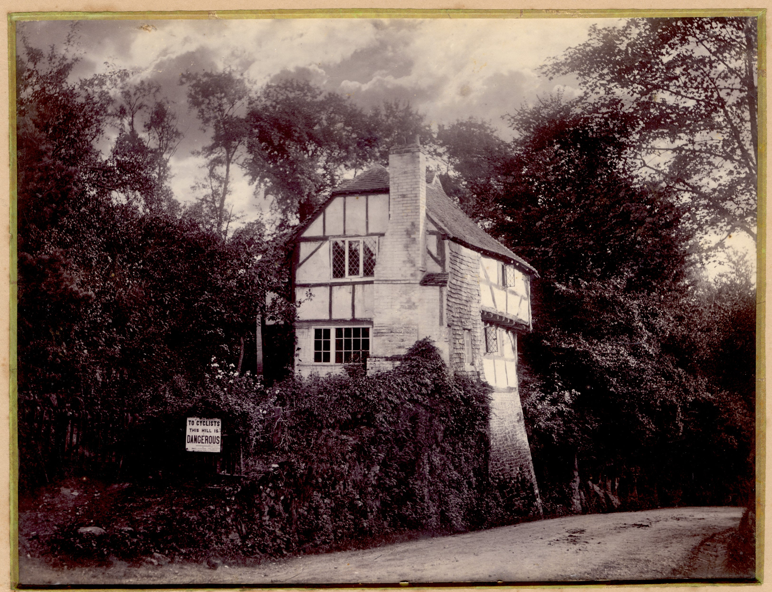
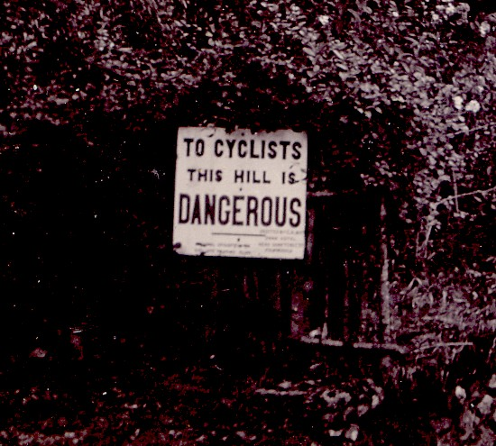
The road equipped for cyclists Photograph of quaint property c1890

Slide 4
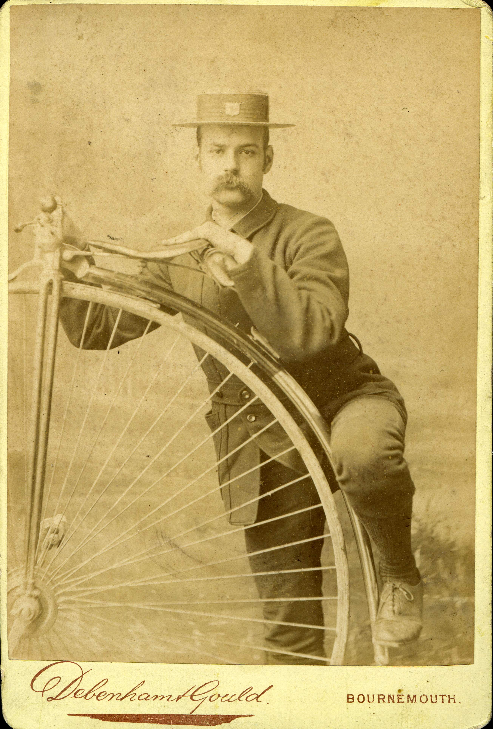
Cabinet photograph verso inscribed ‘Mr F Duarty Off for a spin, 1879’

Slide 5
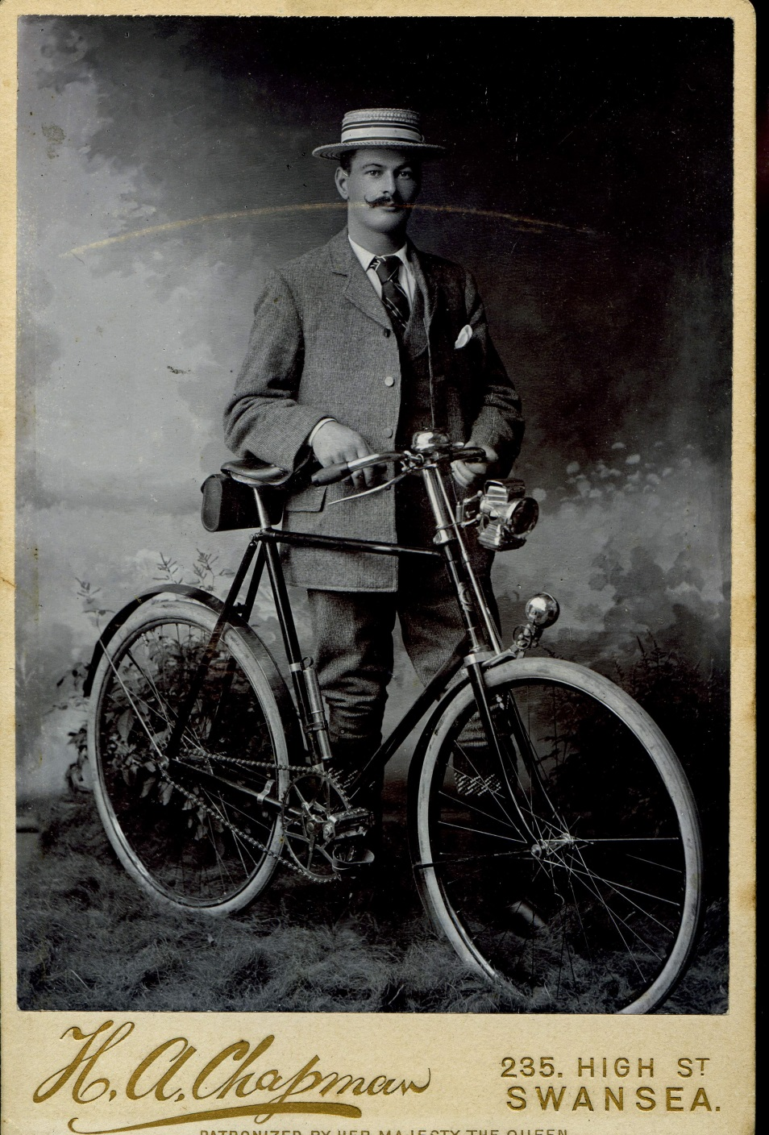
Diamond frame safety bicycle,
c 1899

Slide 6
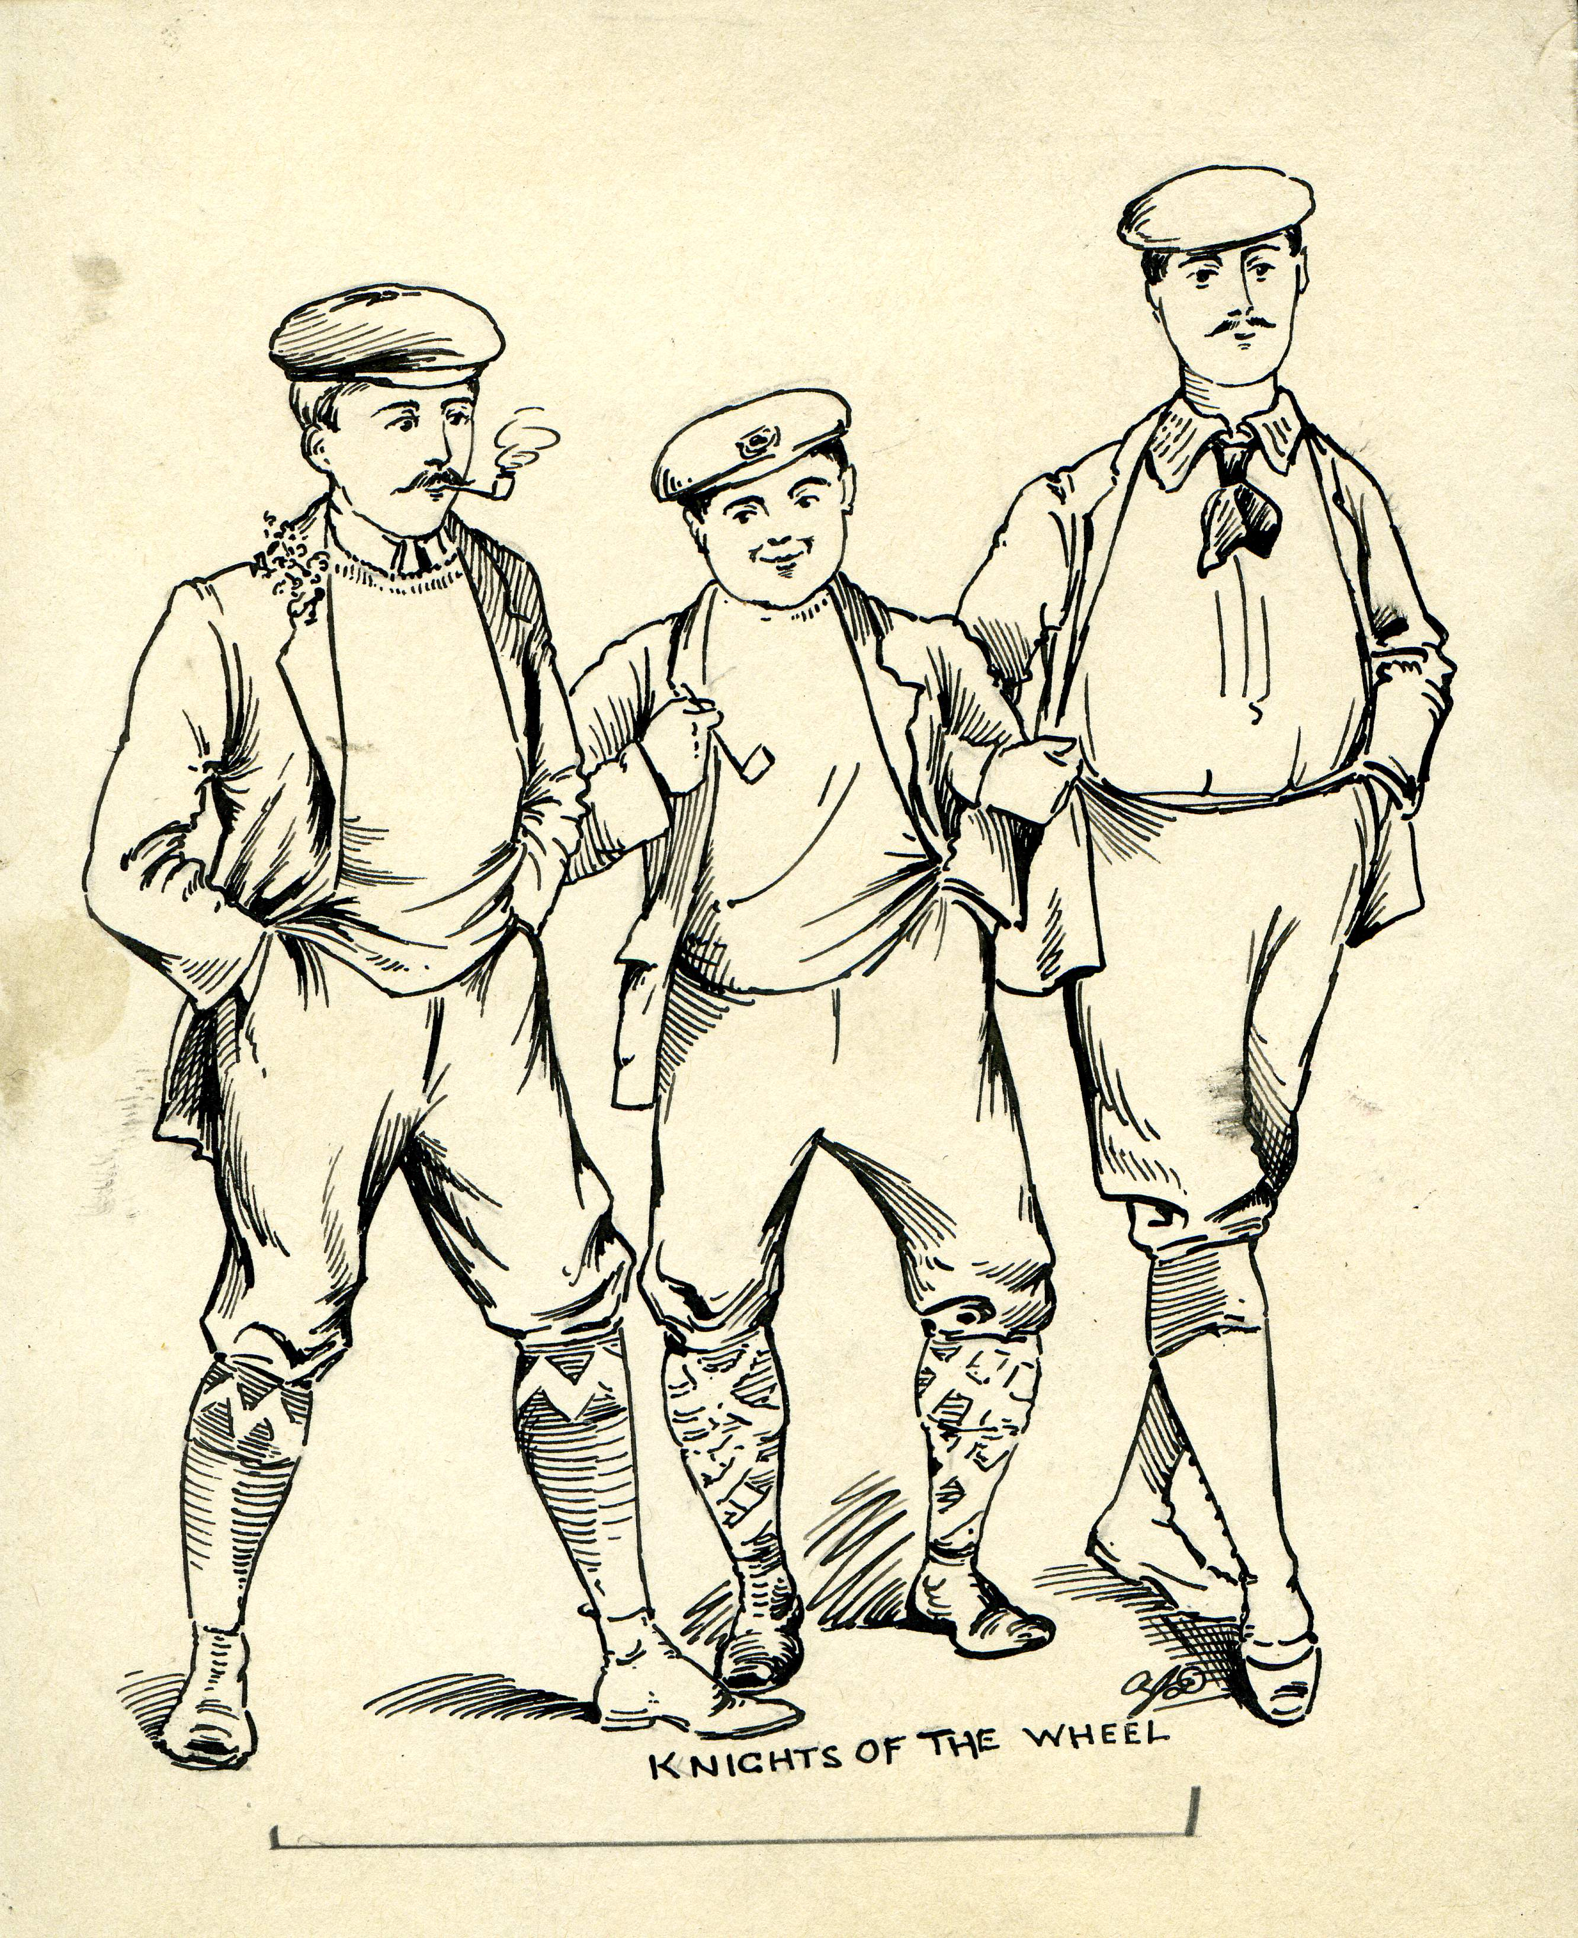
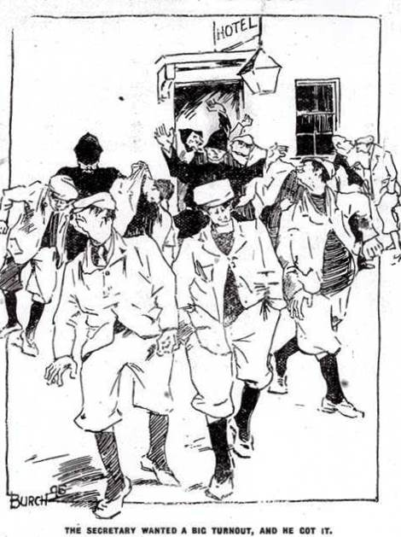
Satirical artwork ‘Knights of the Wheel’ c1896 Burch cartoon from The Scottish Cyclist ‘The Secretary wanted a big turnout, and he got it’ 1896

Slide 7
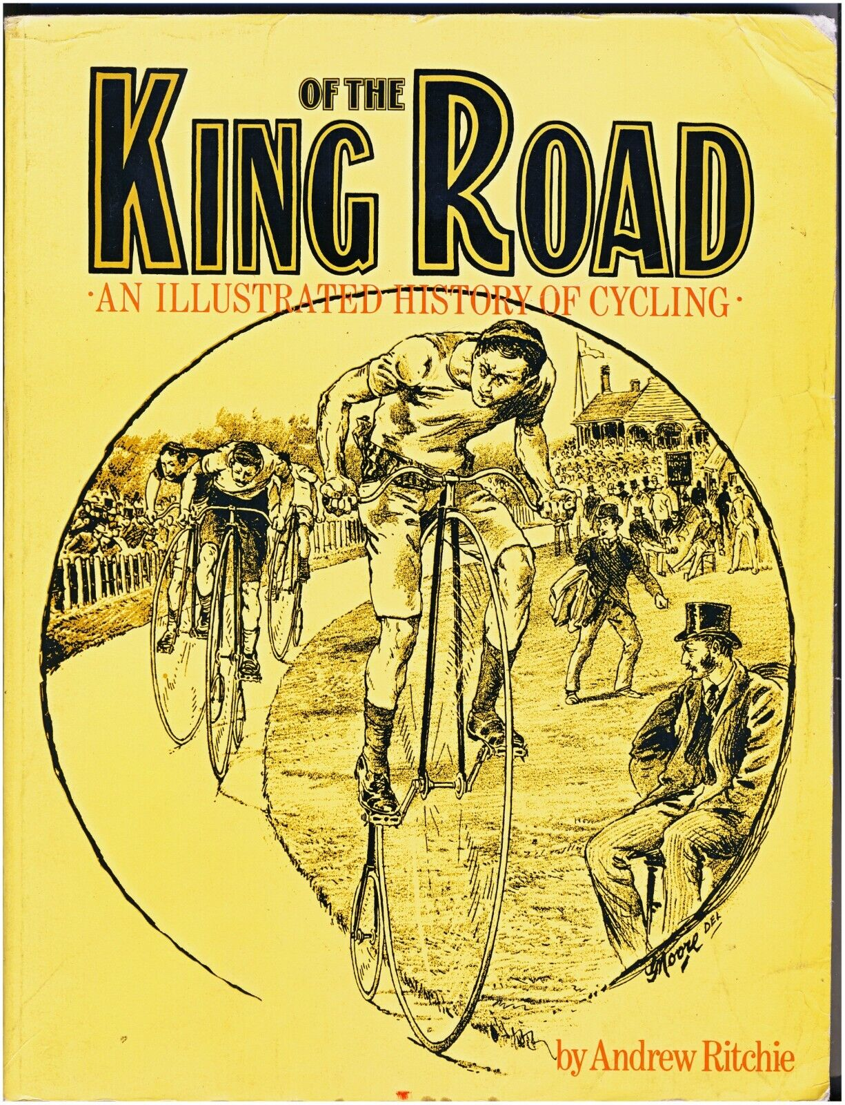
Andrew Ritchie’s King of the Road (1975) was a seminal history of cycling. The choice of cover artwork is indicative of the problematic conflation of sport and competition with travel and transport that dates from the period of the high bicycle and remains strong today

Slide 8
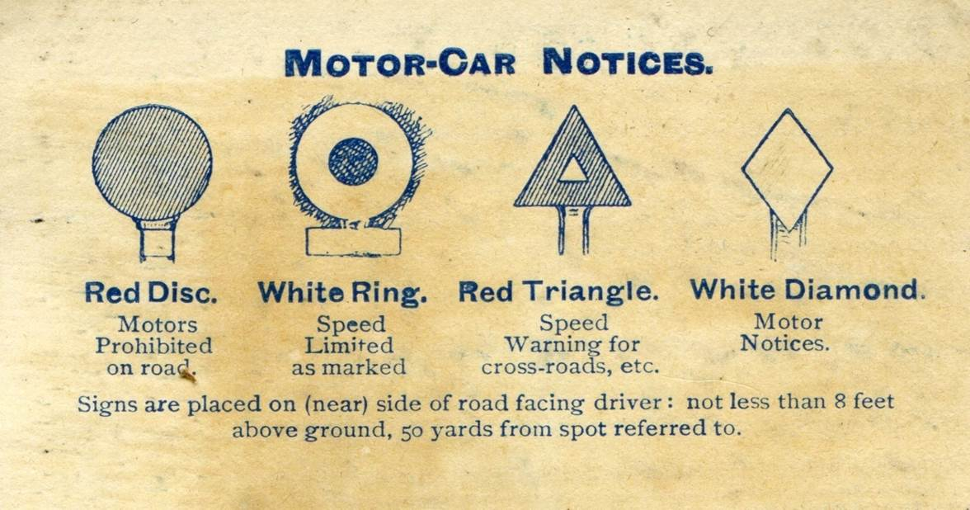
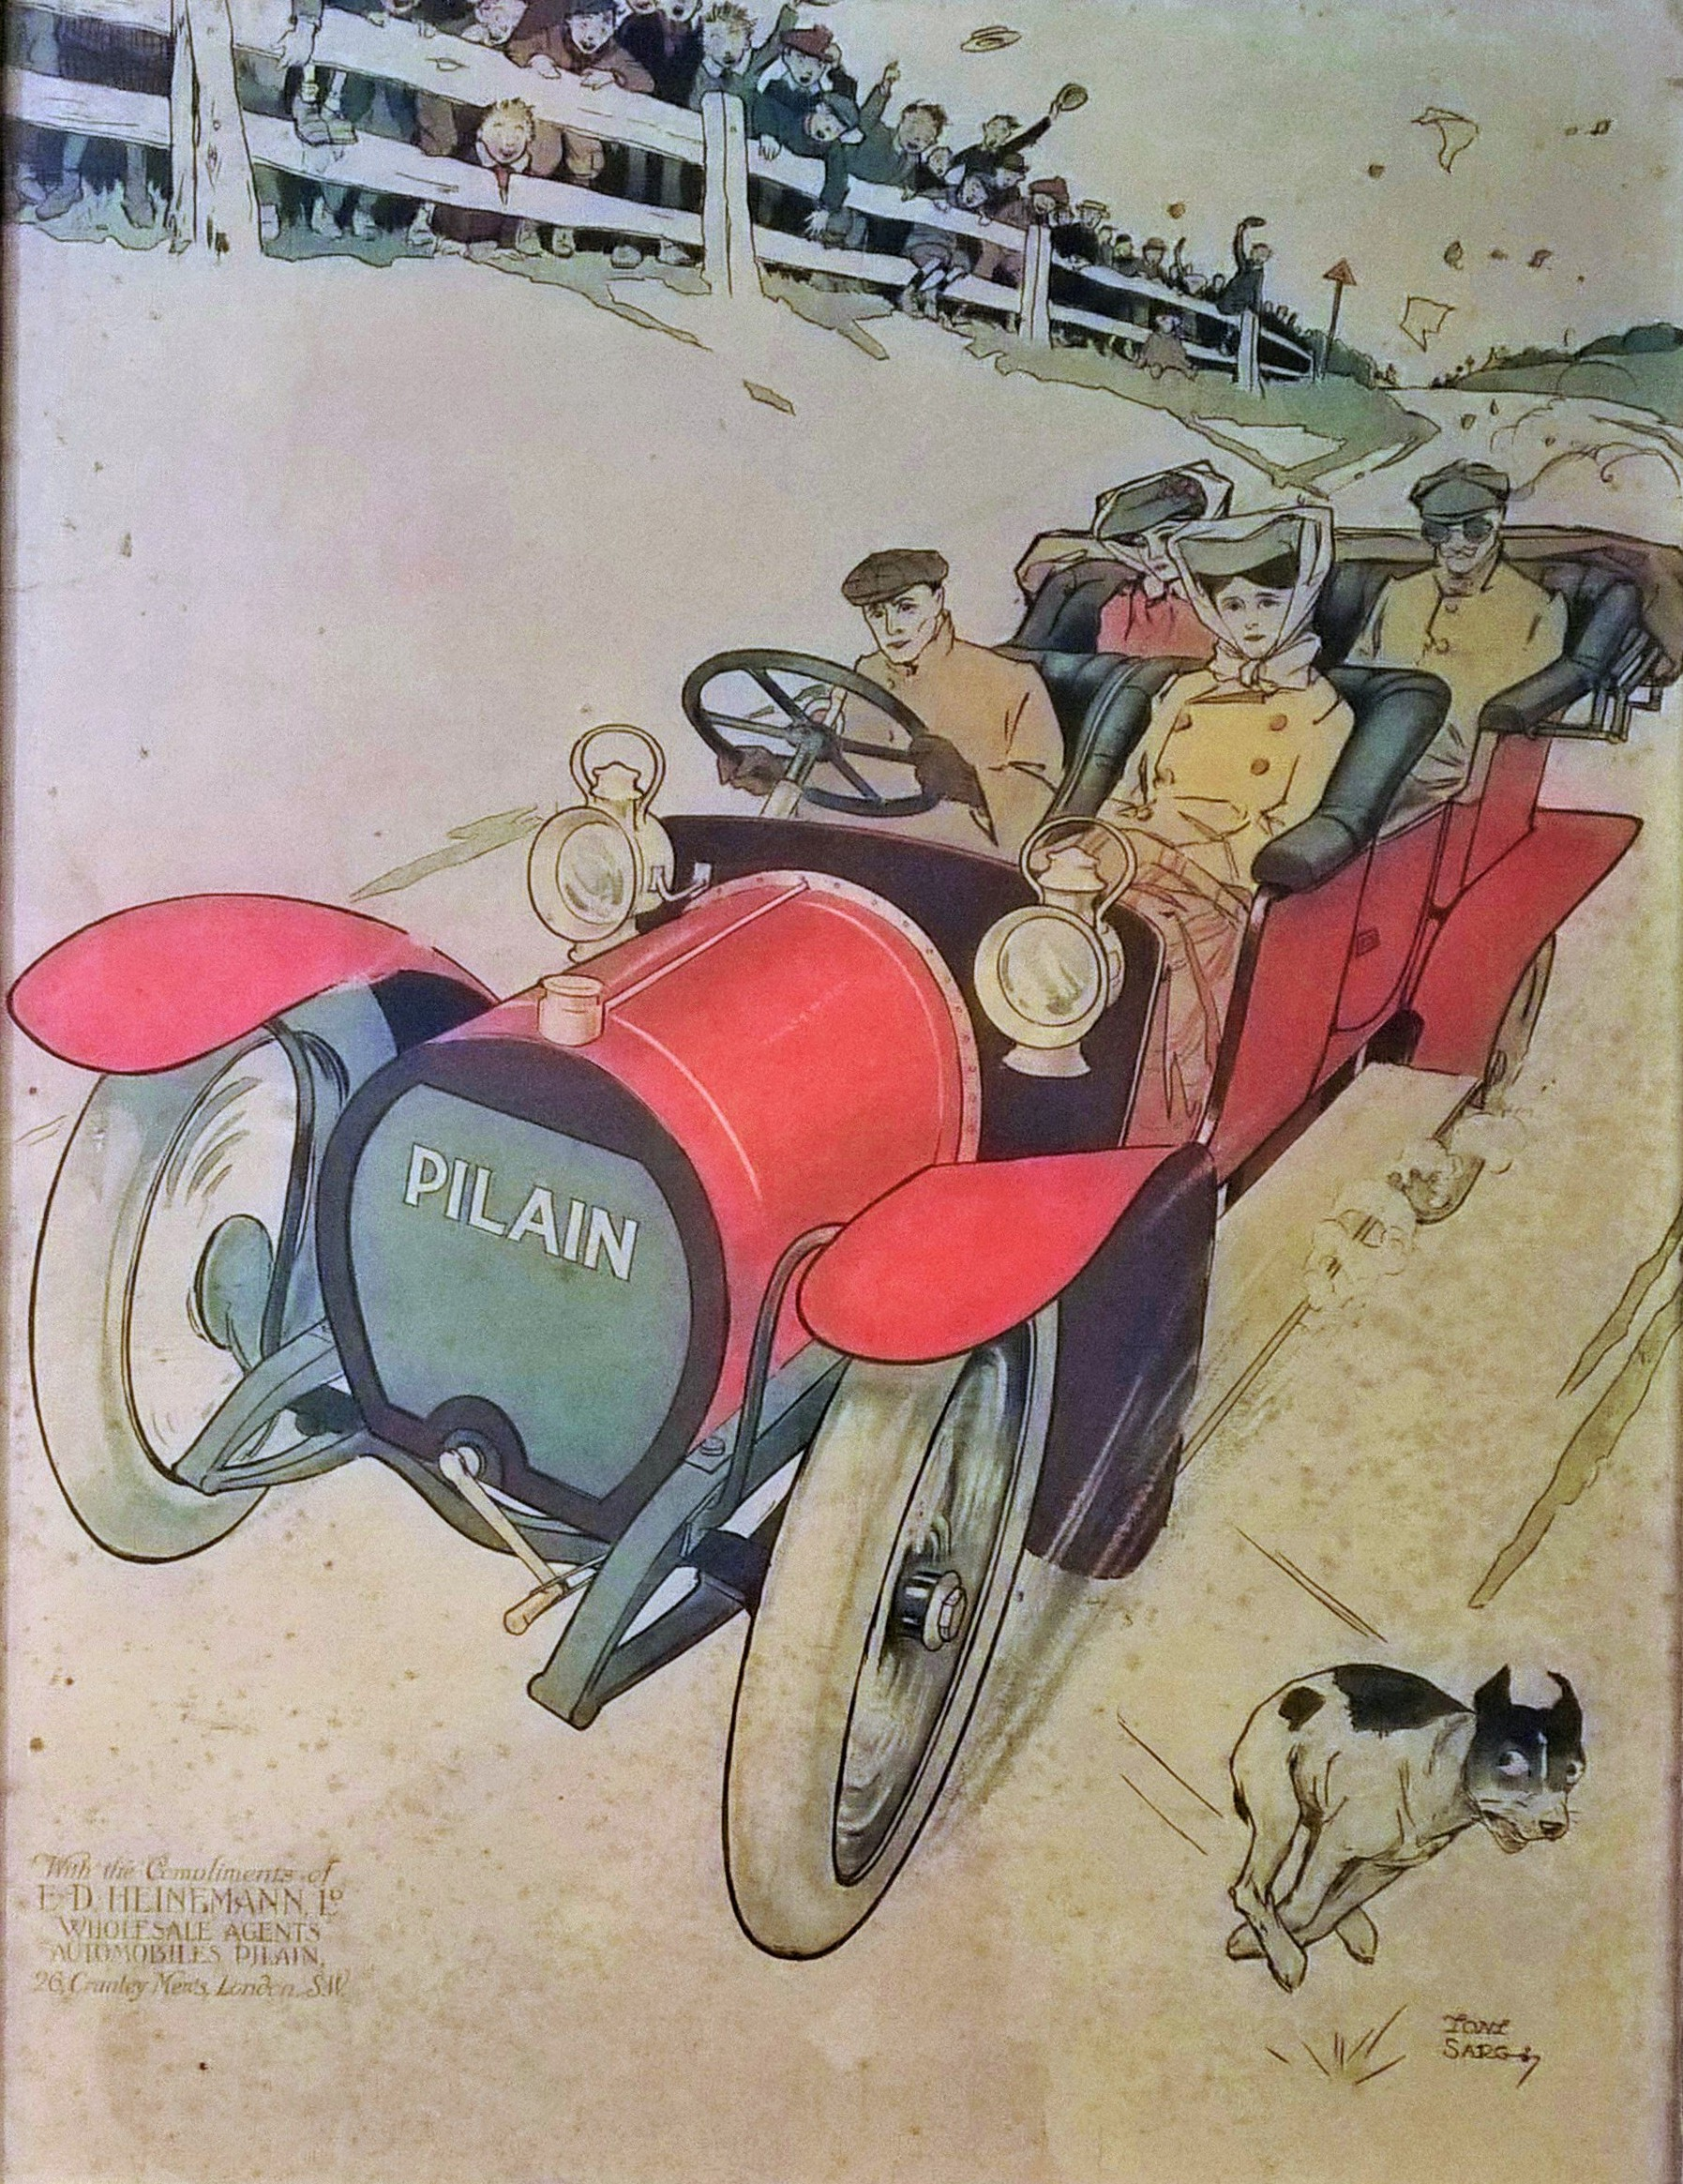
State signage for the ultra-privileged
1904 Motor Car Notices from The Contour Road Book of Scotland (1906)
and in a Pilain showcard by Tony Sarg (1907)

Slide 9
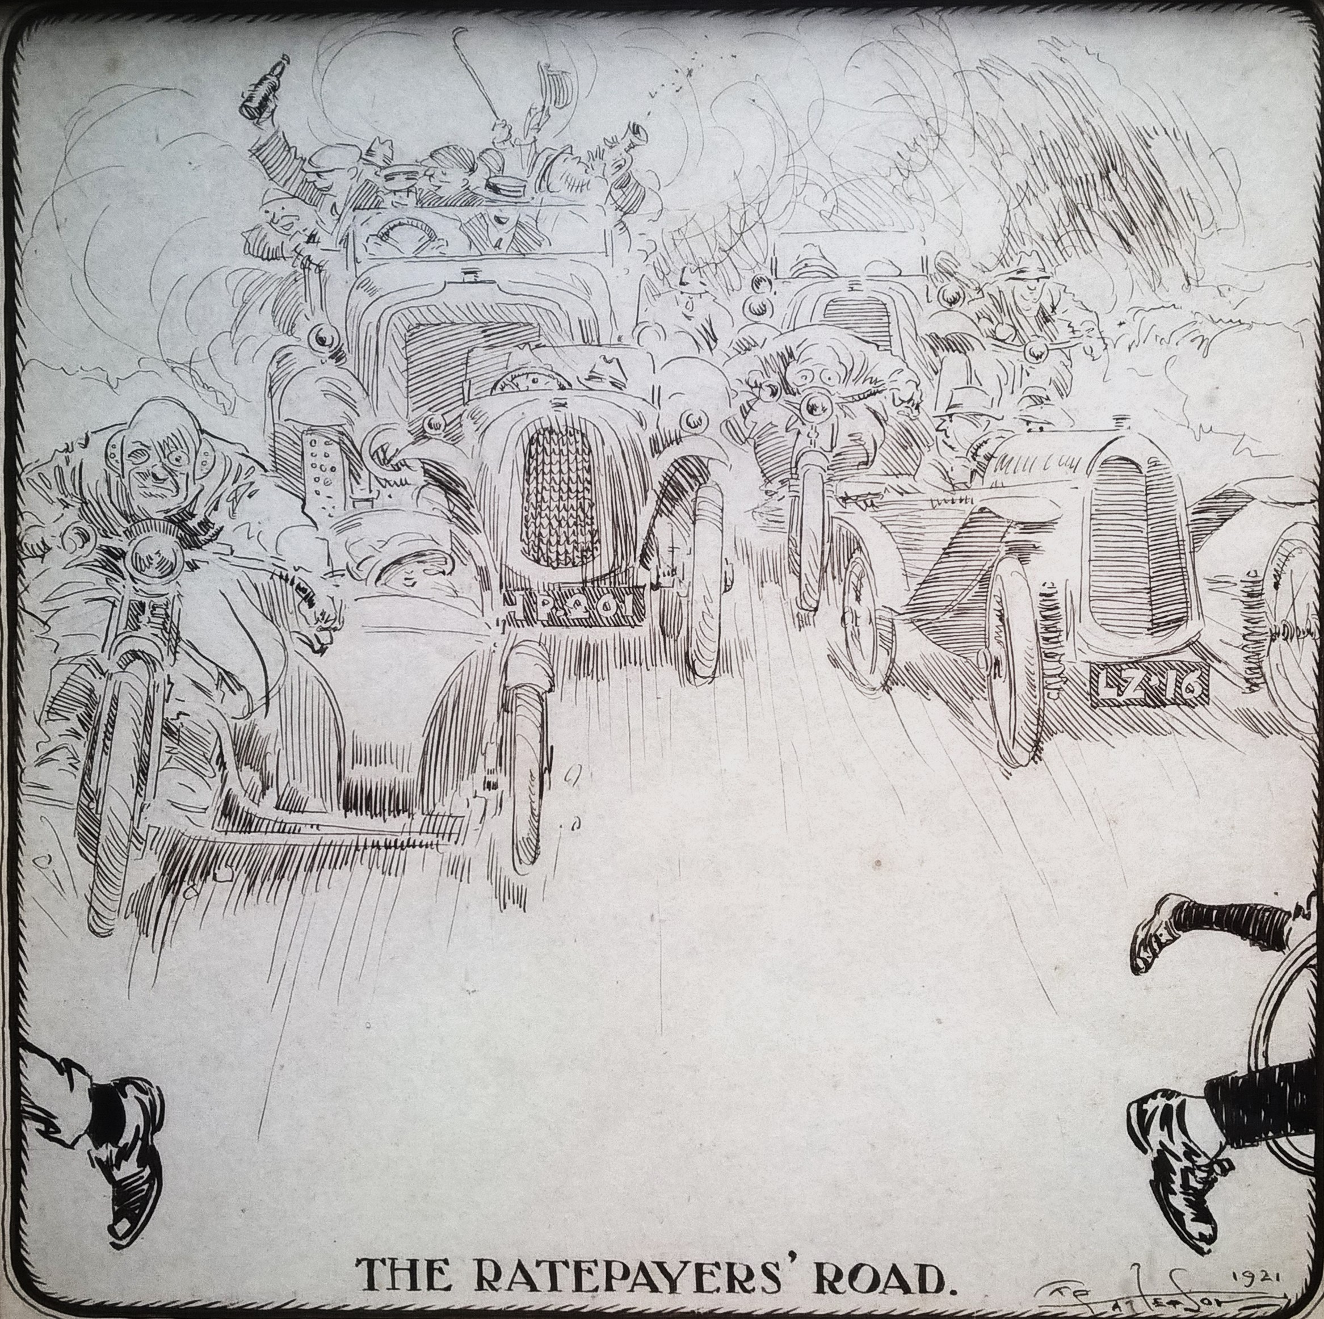
Frank Paterson artwork ‘The Ratepayers’ Road, 1921.

Slide 10
END OF PRESENTATION
Nicholas Oddy
n.oddy@gsa.ac.uk

