Slide 1

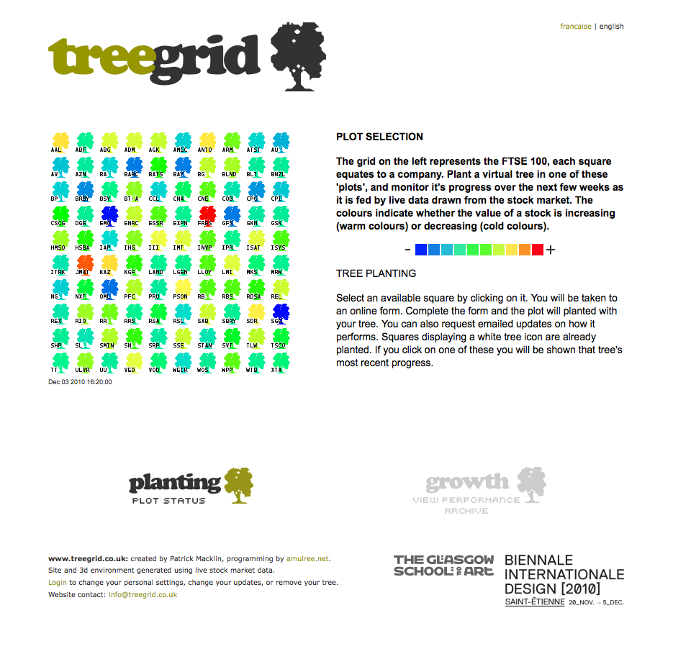
Treegrid
Treegrid is an interactive website with an accompanying, site-specific digitally produced ‘environment’. Both elements are simultaneously active and durational. It was first shown in May 2009 at CCA Glasgow and subsequently in Belfast and St Étienne.
Submitted by Patrick Macklin
Output No. 983

Slide 2

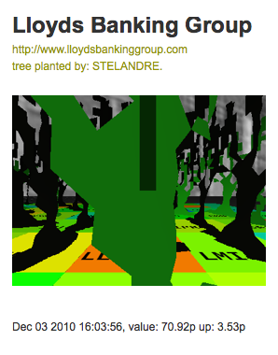
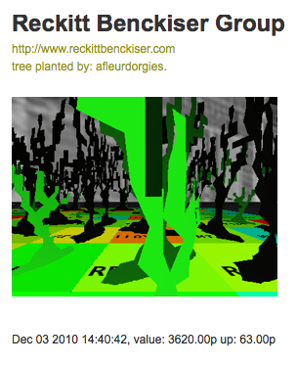
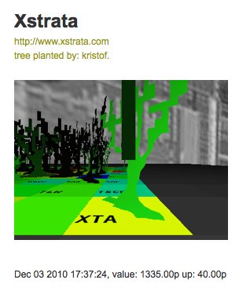
Treegrid
Treegrid (www.treegrid.co.uk) is an online website which uses live data from the FTSE 100 to generate a user interactive three-dimensional rendered environment.
The site presents a grid of plots available for gallery visitors to plant. These seeds are nourished by live data sourced from the FTSE 100, and begin to grow, creating a forest of digital trees. Individual trees wither or ﬂourish depending on the performance of their host stock on the ﬁnancial markets. A screenshot focusing on each of the 100 squares is emailed to participants over the duration of each iteration of the site. The audience for the work is both immediate – site visitors, and remote – online participants.
983
Patrick Macklin
Screen-grabs from St Étienne International Design Biennial 2010 auto-emailed to participants

Slide 3
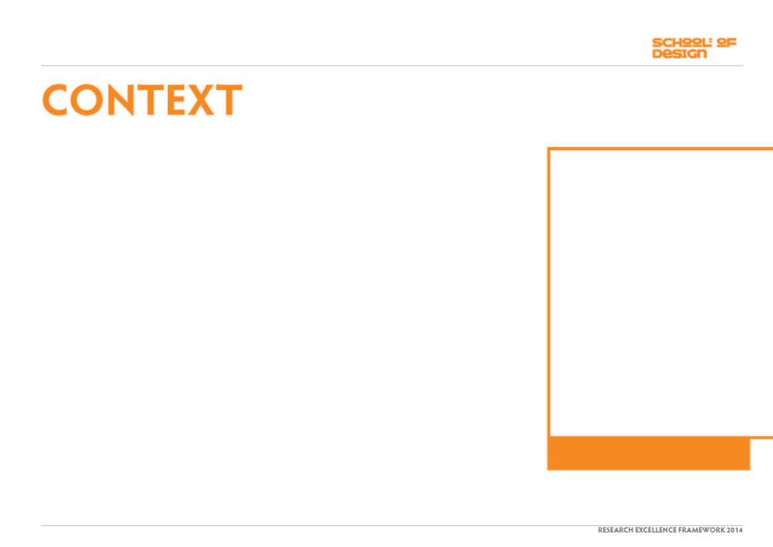
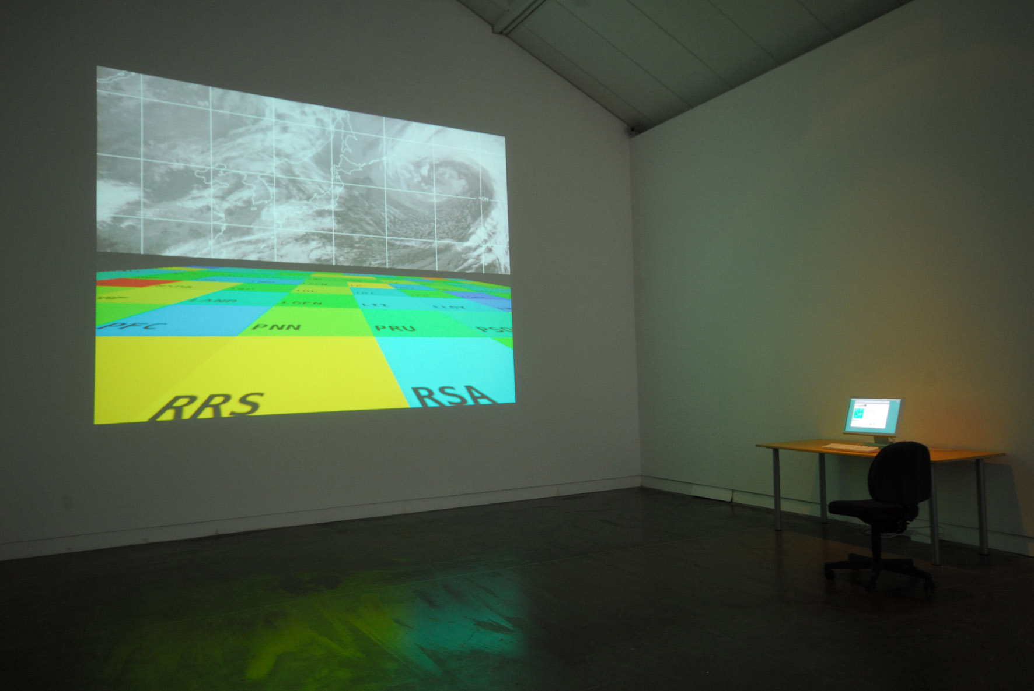
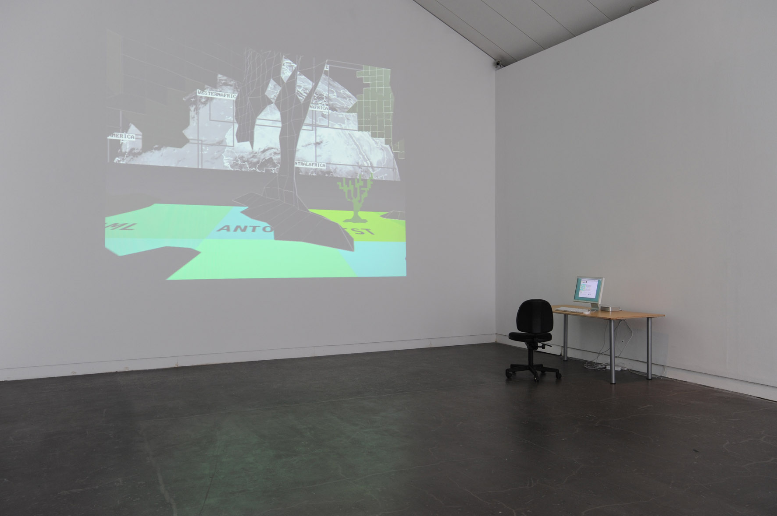
The project emerged from the brief for Stage Fright, an invited show at CCA in Glasgow by the theatre company Suspect Culture. Stage Fright was intended as an exploration into how in this case, theatre and visual art interact.
Treegrid sought to employ a rudimentary visual language to locate complex financial data harvesting, against a backdrop of economic uncertainty, and transform data into decoration. While some of the issues explored, multi-user online participation, customisation and personalisation, have been covered in early web-based works such as TechnoSphere (Prophet and Selley, 1995), and the exploration of Hertzian space is well documented eg in Placebo Project, GPS Table (Dunne and Raby, 2001). Treegrids’ attempts to blend and blur the web based and real-time site specific occur within an emerging field. A recent example of which might include the collaboration between Google Creative Lab and the RSC on Midsummer Night’s Dreaming (2013).
Installation shots from CCA showing user interface and projected environment photo © Alan Dimmick

Slide 4

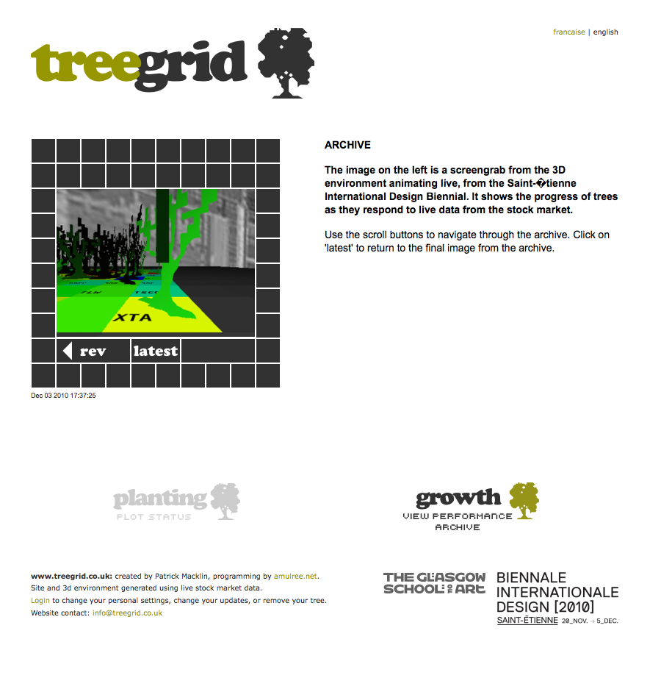
Users select a single ‘plot’ from a grid of the 100 FTSE companies which is planted with a tree. Information relating to the ‘plot’/FTSE company is harvested from the London Stock Exchange and this information is used feed the tree – the better the host company performs, the more and greener each tree grows. As sites are taken up the overall density of the grid increases, until a virtual space in the form of a forest emerges.
This environment is projected or screen based onsite, in a single location, the website is open online, and gives feedback to users via daily-screen grabs. Treegrid uses the venue and animation as a backdrop or set for a simultaneous web-based artefact. Data is captured at hourly intervals and fed into a specially created piece of software designed to both illustrate performance and control the panning of views around the grid, and to ensure that each plot is visited once a day.
(Screen grabs of both the website and the activities in the CCA itself – via chip camera - were distributed to participants).
As the piece is time based and live, each appearance delivers fresh market trends. During the CCA run the 2009 H1N1 swine-flu epidemic began, with observable impact on the behaviour of the GlaxoSmithKline and AstraZenica plots on the grid.
Treegrid web interface showing scrollable screengrab library

Slide 5
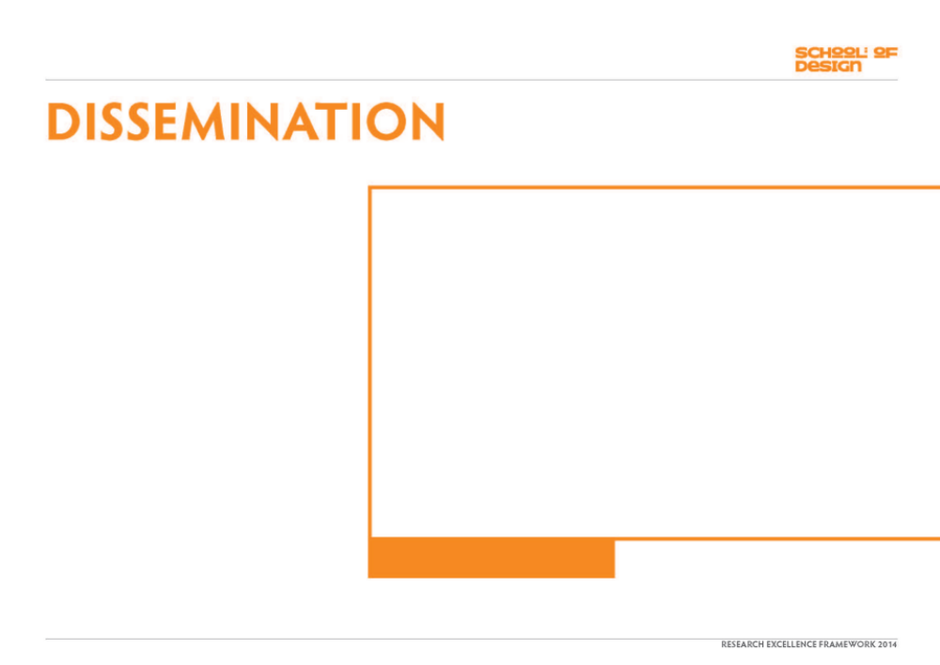
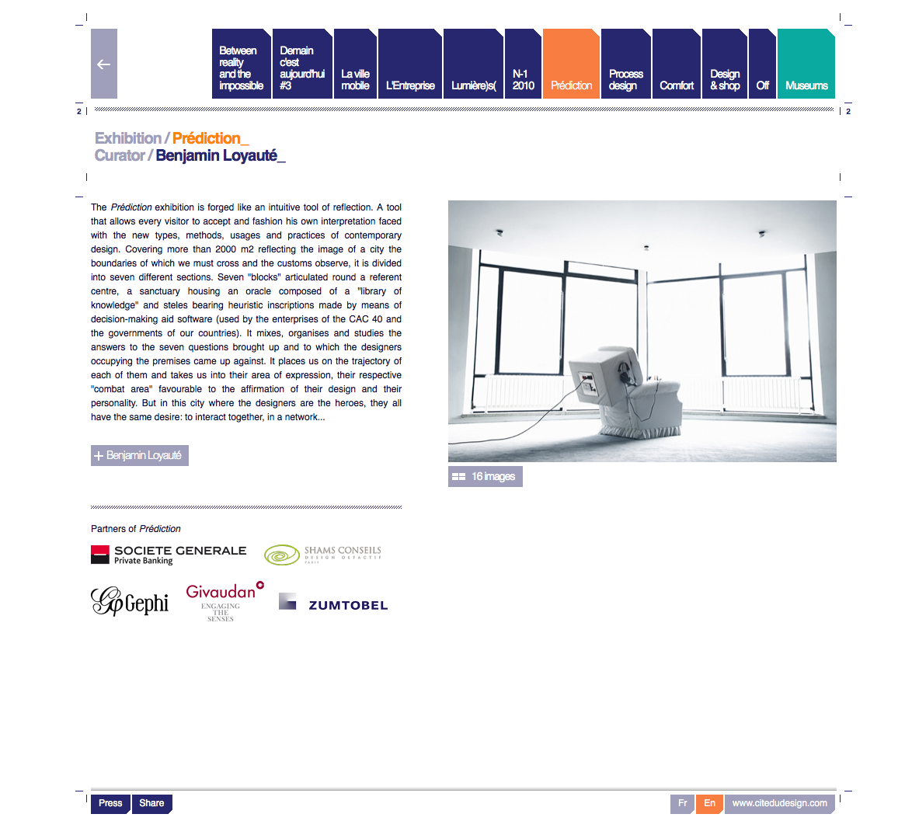
Treegrid was first shown in 2009 at Centre for Contemporary Arts in Glasgow (CCA) as part of Suspect Cultures’ Stage Fright. It was subsequently selected via panel submission, as a Poster contribution to the Digital Resources for the Humanities and Arts (DRHA) 2009 conference at Queens University, Belfast, and later selected from open submission by design curator Benjamin Loyauté for the Prediction section of St Étienne International Design Biennial 2010.
Prédiction micro-site from St Étienne International Design Biennial website

Slide 6

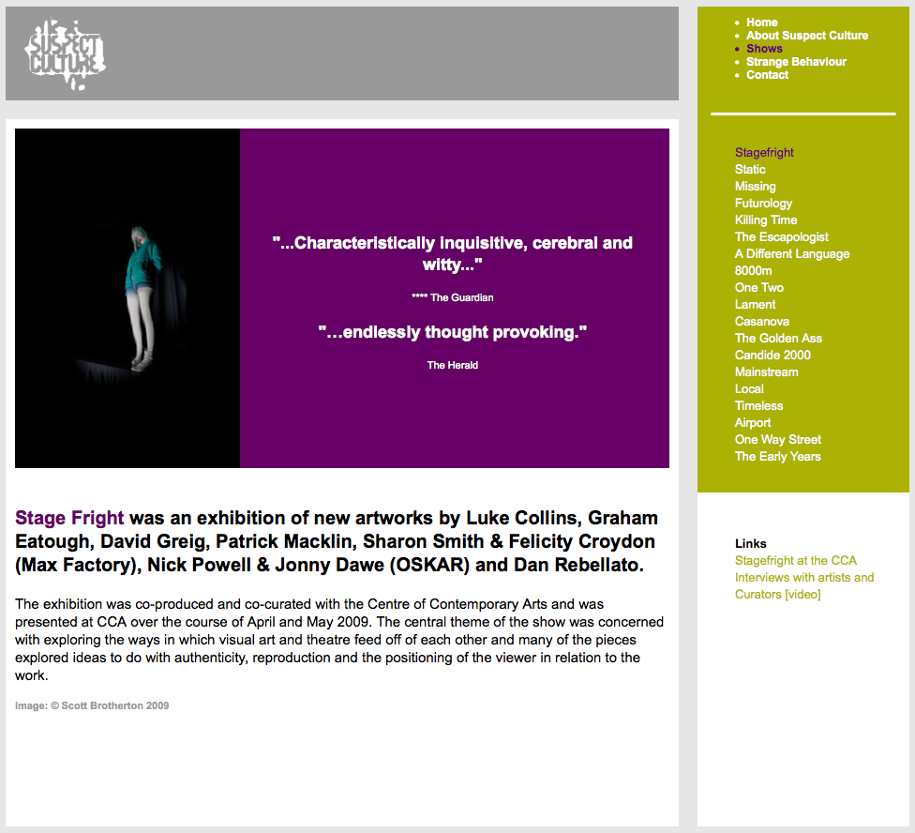
Suspect Culture’s Stage Fright
CCA Glasgow, 2009, Reviews and Archive
The Guardian
http://www.guardian.co.uk/artanddesign/2009/apr/18/review-stage-fright-cca-glasgow
The Herald
http://coffeetablenotes.blogspot.co.uk/2011/04/suspect-culture-make-exhibition-of.html
The Scotsman
http://www.scotsman.com/what-s-on/theatre-reviews-interiors-stage-fright-the-little-mermaid-1-1033431
The List
http://www.list.co.uk/article/17095-stage-fright/
CCA Archive http://www.cca-glasgow.com/archive
Publication
Eatough, Rebellato The Suspect Culture Book: Oberon, London, 2013. ISBN-13: 978-1-84943-939-8
Digital Resources in the Humanities and Arts (DRHA) Conference
Queens University, Belfast, 2009
DRHA Website
http://www.dho.ie/drha2009/
St Étienne International Design Biennial
St Étienne, 2010
Website
http://www.biennale2010.citedudesign.com/
Catalogue
Cité du design Biennale Internationale du Design de Saint Etienne 2010: Cité du design IRDD, France, 2010. ISBN-13: 978-2912808400
Stage Fright from Suspect Culture website

Slide 7

CCA Glasgow
CCA, Scottish Arts Council (SAC), SAC Lottery, Glasgow City Council, Suspect Culture
DRHA Queens University Belfast
Queens University Belfast, Swansea University, National Library of Wales, Royal Irish Academy
St Étienne International Design Biennial
St Étienne Metropole, Ville de St Étienne, Rhone Alpes Region, French Ministry of Culture, Conseil General de la Loire, Grand Lyon, Cultures France, EPA St Étienne, St Étienne Tourisme
Treegrid programming
amulree.net

